Slide 1
Level 1
Introduction to officiating
Focus on:
Line of Scrimmage Officials for Minor and High School Football

Slide 2
Level 1 ONLine Module
Introduction to FCOCP and preparing to be a tackle football official

Slide 3
Level 1 – online module
Level 1 FCOCP
Understanding the Job
Working as a team
Team Zebra – Referee/ Umpire / Line of Scrimmage officials
Qualities of successful new officials
Respectful; Objective; Outward confidence; Hustle; Learner
Looking forward to Facilitated components

Slide 4
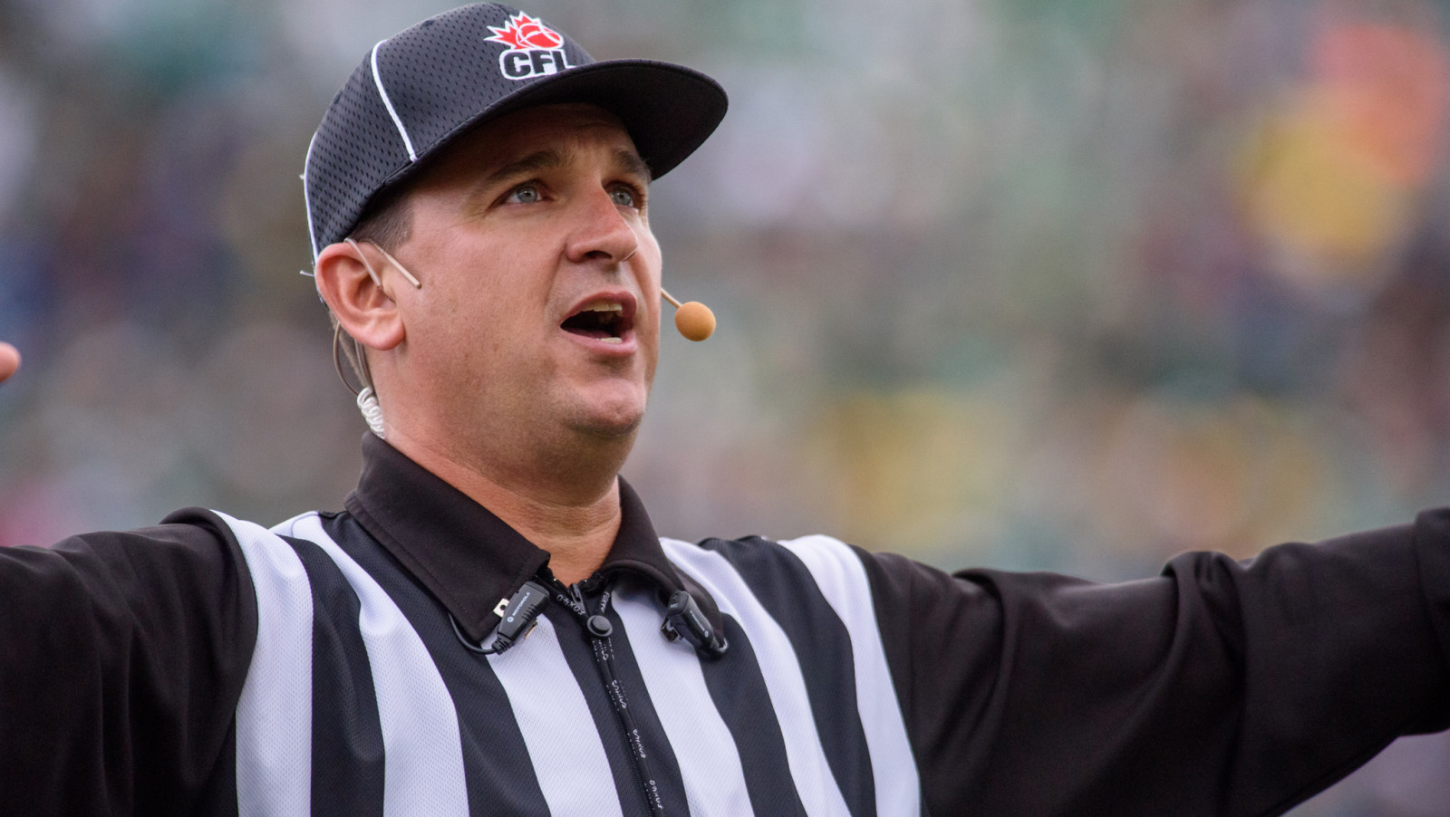
Level 1 – first (or another) step in a career
FCOCP
Notes:
All Football Officials have had a first game. The first time on the field can feel overwhelming. The content of the Level 1 program is intended to get you ready for that first game and beyond.
Whether your goal is to work a Grey Cup game as the Referee or to support local football, you must be the best official you can be.
FCOCP
LEVELS – being updated
Level I
New Official – Sidelines (DJ & LJ) – Minor in 3, 4 & 5 official crews
Level II
Umpire – Minor & H.S. in 3, 4 & 5 official crews
Level III
Referee – Minor & H.S. in 3, 4 & 5 official crews
Introduction – Field Judge in 3, 4 & 5 official crews
Introduction – 6 officials
Level IV
6 and 7– Official System – U Sport, CEGEP & CJFL

Slide 5
Understanding the job
Notes:
Football officials have an important role in the game. Understanding that role provides a foundation for understanding the roles, positioning and mechanics. Everything we do on the field is to support a good game between opposing teams
We are responsible for:
Developing a smooth flow to game with as little interference as possible
Ensuring the game played within the rules and safely
Preventing fouls
Making the “calls” when they need to be made

Slide 6
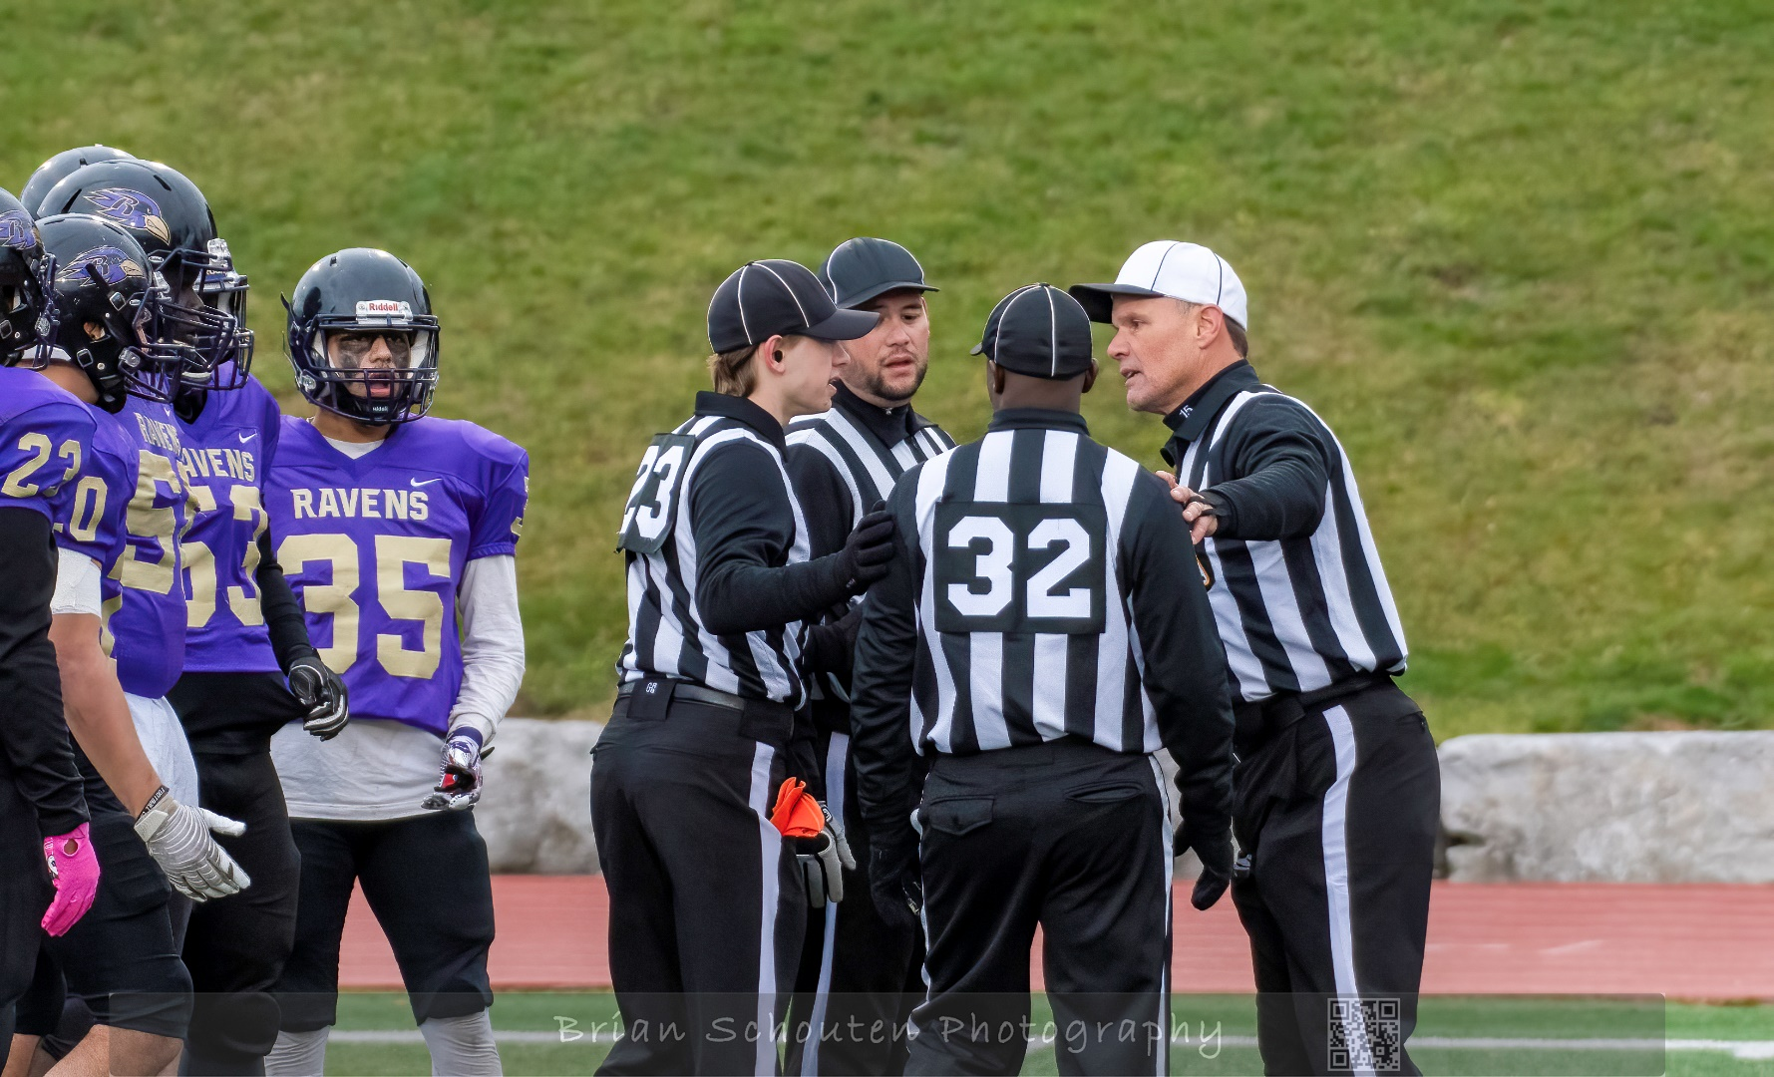
Working as a team
Communication
Keys
Hustle
Notes:
One quality of an effective official is being able to work as part of a team. Each official has duties that are specific to their position. These duties may change depending on the type of play and its progression. Good communication among officials is necessary in working together. A line of scrimmage official will be interacting with all other members of the team in 3, 4, and 5 official systems. Eye contact, signals, and verbal communication are ways we communicate with others on our crew.
As a new official, the action can be overwhelming. You do not need to do it all. Your focus as Line Judge and Down Judge will be on the Line of Scrimmage until the snap and then your “key” players – usually receivers on your side of the field. You can’t nor are you expected to watch it all.
It is also important to note that there are additional “officials” involved in every game. The minor officials – Timer, Yardstick Crew, and Downs Box Attendant may be volunteers or part of your association. Minor officials are part of the officiating team required to conduct a game therefore communication with them effectively is as important. Specifics about timing signals and working with the Stick Crew / Downs Box will be coming later in the next section.

Slide 7
Team Zebra
Three Officials | Four Officials | Five Officials
Referee (R) | Referee (R) | Referee (R)
Umpire (U) | Umpire (U) | Umpire (U)
Downs Judge (DJ) | Downs Judge (DJ) | Downs Judge (DJ)
 | Line Judge (LJ) | Line Judge (LJ)
 |  | Back Umpire (BU)
Notes:
As age and skill level of players increases, so does the number of officials required to effectively manage the game. As the number of officials increases each official will have more focus on key players and components of the game.
Most associations assign no fewer than 4 officials on games, however, there still may be situations such as injury or last minute circumstances where 3 officials are available. It is important that all officials be aware of the difference in responsibilities and coverage.

Slide 8
Team Zebra
Notes:
Each official has specific duties related to their position. As the crew size increase so does the focus on specific players and aspects of the game.

Slide 9
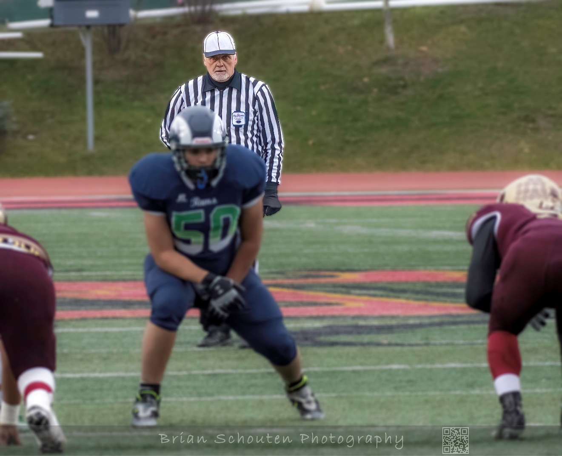
Referee
Crew Chief
Game operations including downs count, timing, and penalty applications
Counts offense
Quarterback
Play at line of scrimmage
Zone in backfield (to far sideline with 3 officials)

Slide 10
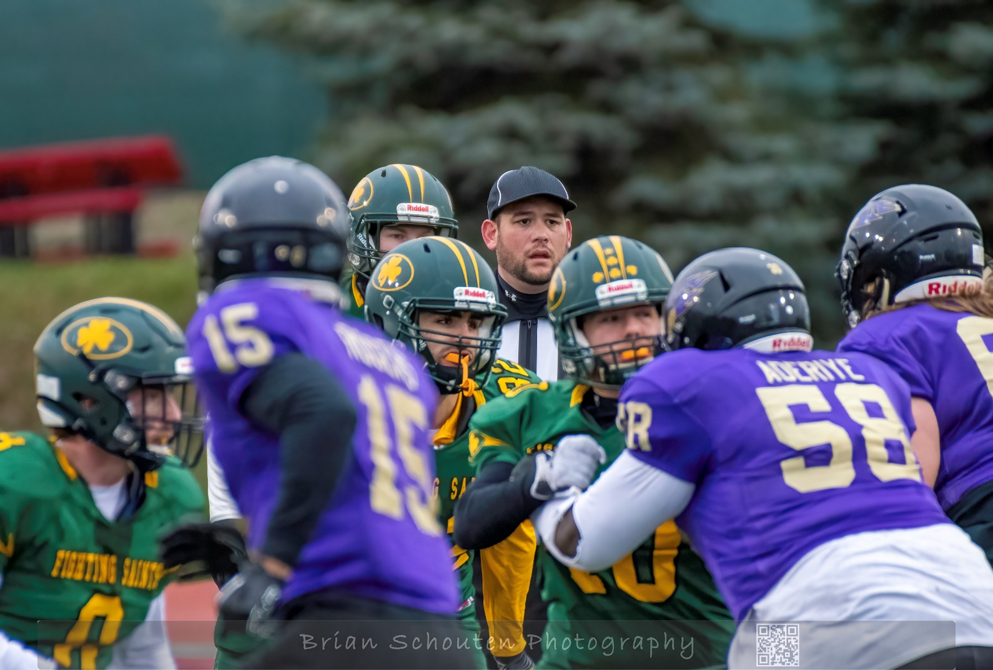
Umpire
Set ball for next play
Assist Referee with penalty application
Counts defense / offense– depends on # of officials
Communication with line players
Play at line of scrimmage
Zone in defensive area (expands to far sideline with 3 officials)

Slide 11
Line of Scrimmage Officials
What are the responsibilities of the Line of Scrimmage Officials?
Notes:
This will be examined throughout the Level 1 program.

Slide 12
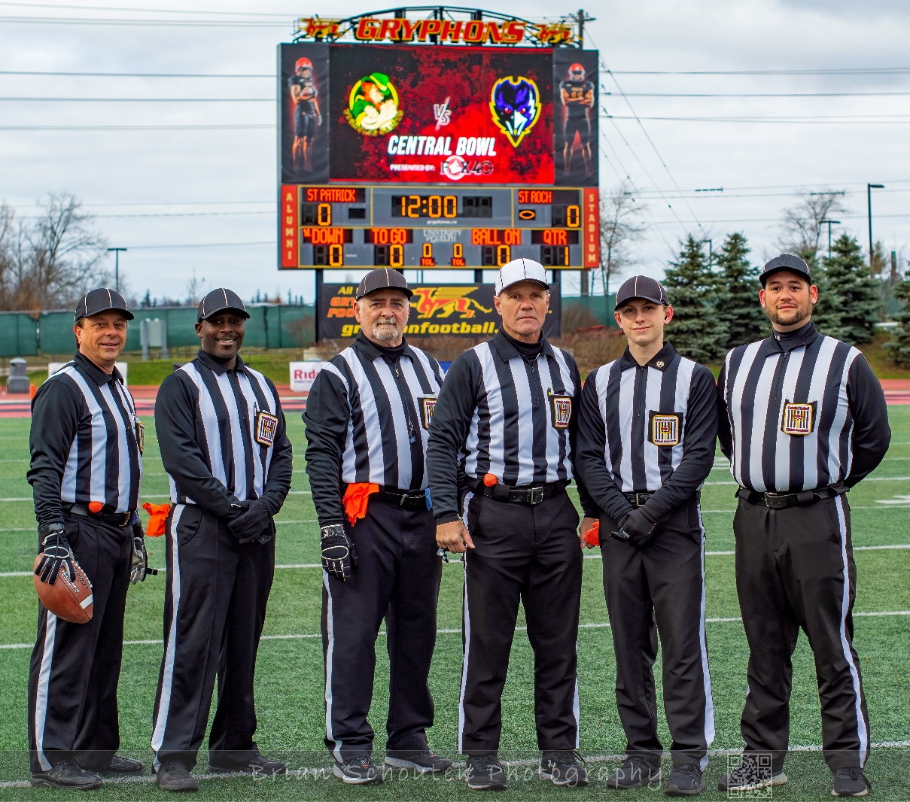
Qualities of successful new officials
Respectful
Objective
Confidence
Hustle
Learner
Notes:
The next slides describe what is meant by each of these qualities.

Slide 13
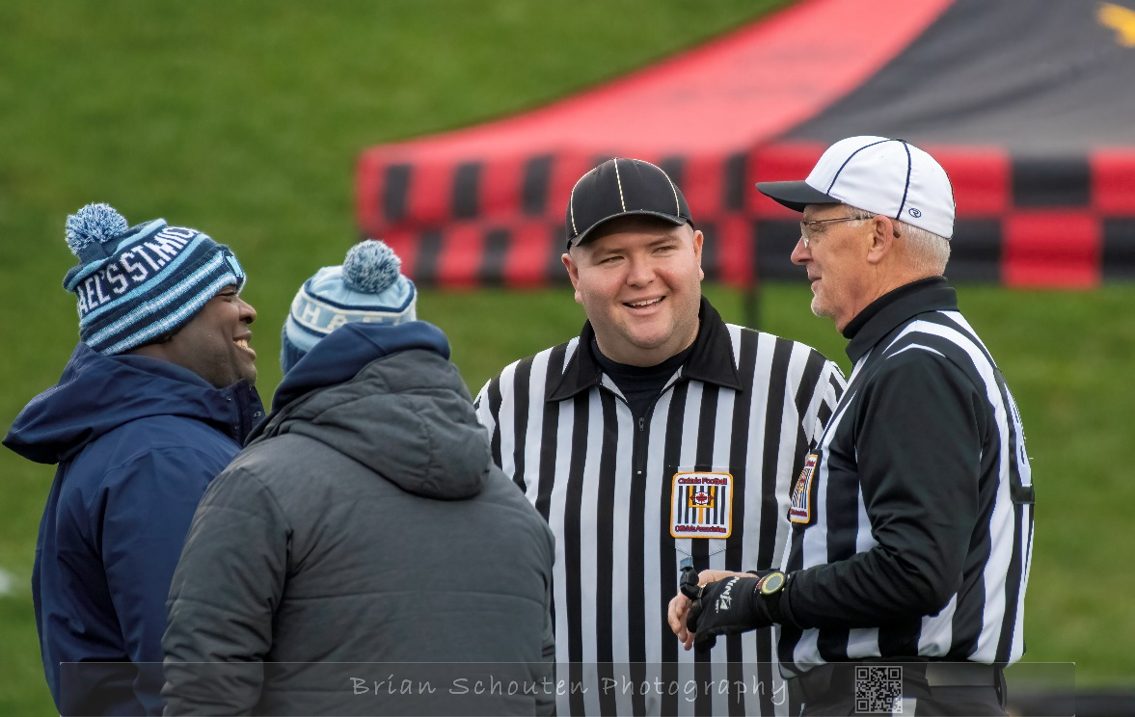
Respectful
Display courtesy and respect at all times.
Be professional.
Be mindful of your “Body Language”.
Be aware of the image that you are presenting to others.
Display a positive attitude towards the game and those involved
Notes:
Display courtesy and respect at all times. – be polite – address coaches with their title – “Yes coach…” etc. This is especially important if you know the individual.
Be professional. Do not be overly familiar with coaches or players. The other team may notice and think there is a bias. Keep conversations brief and factual about the game. If a coach is being too familiar address it.
Be mindful of your “Body Language”. – hand on hips or in pockets makes it look like you are tired or lazy. Be open.
Be aware of the image that you are presenting to others. – be dressed in a clean unfaded uniform. Use crisp signals.
Display a positive attitude towards the game and those involved. Smile. Congratulate players for good plays – boost those who are down. Talk with your crew – support them. Thank the stick crew and other minor officials (timer)

Slide 14
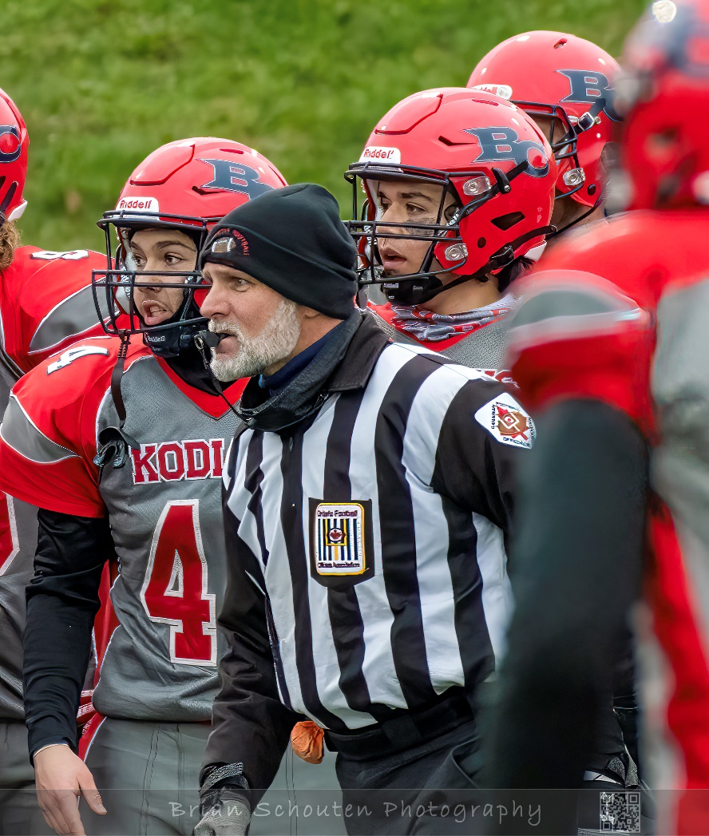
Objective
Judge each play on its own merits.
Avoid doing what is popular – you must make an objective judgement on every play.
“No Harm, No Foul” – call penalties that are impactful
Notes:
Judge each play on its own merits. Don’t make a call based on the last play or how a coach / player spoke with you.
Avoid doing what is popular – you must make an objective judgement on every play. You must decide if a foul has occurred. Don’t be swayed by the bench or crowd.
“No Harm, No Foul” – call penalties that are impactful. Although all safety penalties will be called, use discretion with penalties such as holding and illegal blocks. If there is no impact on the play, there is no harm and therefore no foul.

Slide 15
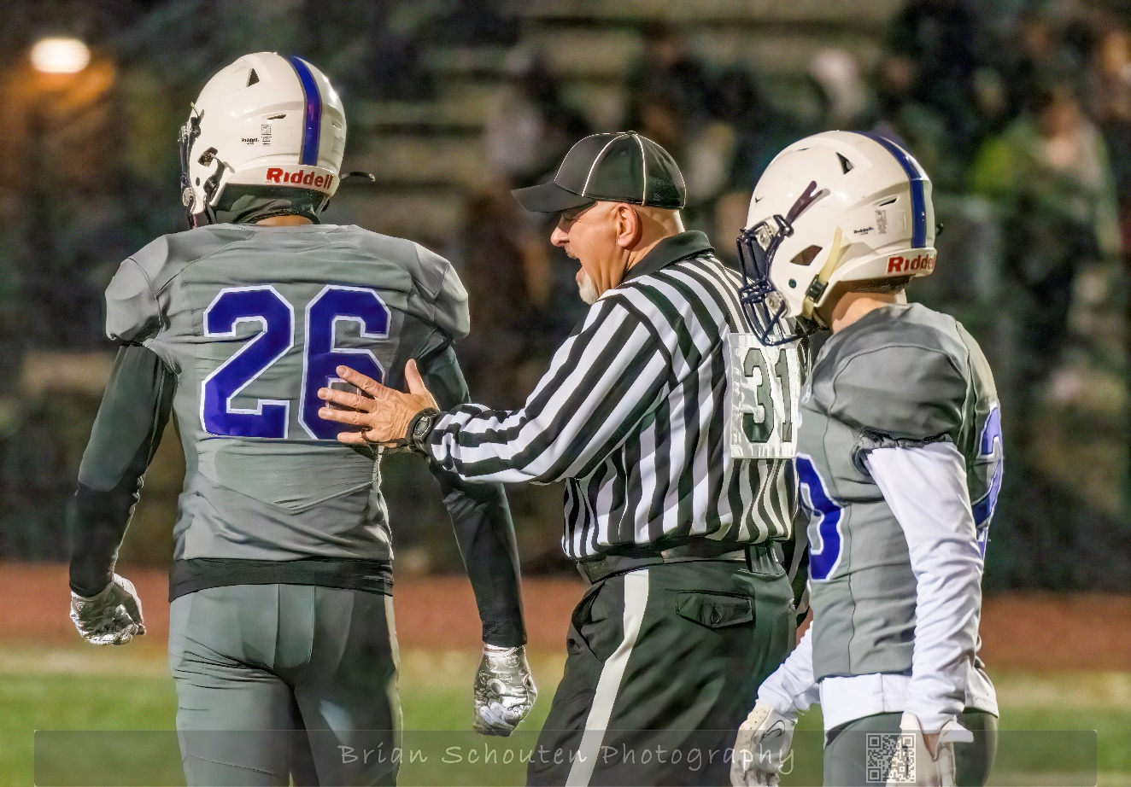
confidence
Display self-control.
Be positive.
Knowledge builds confidence.
Learn your job and do it to the best of your ability – always
Act with confidence; but don’t be “cocky”
Notes:
Display self-control. Be in control of your emotions.
Be positive in your approach to dealing with situations.
Knowledge builds confidence – there is no replacement for knowledge and knowledge comes through hard work.
Learn your job and do it to the best of your ability – always (regardless of the level of play or your assignment.)
Act with confidence; but don’t be “cocky”

Slide 16
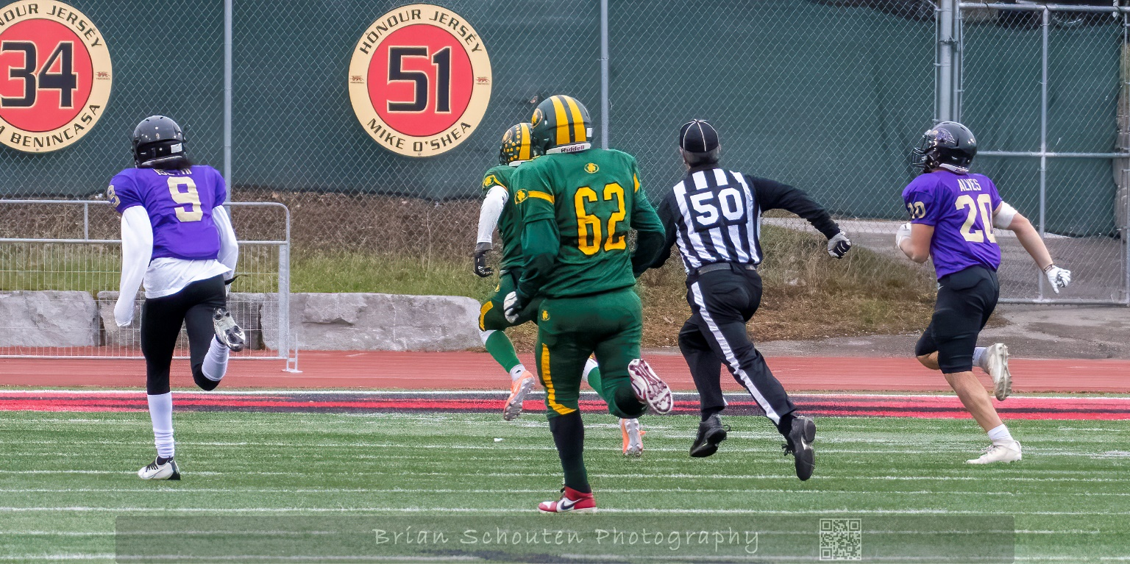
Hustle
Move quickly during play
Anticipate where you will need to be
Get into position between plays – jog
Continue to work on fitness
Notes:
There is no substitute for hustle on the field.
Coaches, Players, fans and other Officials are all aware of your hustle or lack of it.
Hustle creates a positive impression – it shows that you are interested.
Hustle does not mean “running at full speed all the time”.
Hustle is moving in a sharp and efficient manner
Hustle is needed to be correct - in the correct position at the correct time to make the correct call.

Slide 17
Learner
Knowing the rules
Canadian Amateur vs. other leagues / countries
Start with focus on key Line of Scrimmage rules
Player safety is paramount
Know positioning and mechanics
Observe
Study manuals / charts
Ask questions
Notes:
Your learning depends on you. Ask questions, participate in the training and most of all continue to learn. The levels following Level 1 will help you with different positions and crew sizes. Even if you do not want to move beyond a Line of Scrimmage official in Minor Football, learning is a necessary act. Rules change every year. Mechanics and positioning are frequently amended. Each official, through their local association, must maintain current knowledge and skill.
Knowing the rules
Canadian Amateur vs. other leagues / countries – watching football on television is an excellent way to learn more about the game. Understand that there are differences in rules and mechanics between the professional and amateur game. You may need to “unlearn” your Sunday afternoon knowledge and learn new information and skills that are required in our game.
Start with focus on key Line of Scrimmage rules – Section 4 of the in-person component will provide more information about specific rules of focus for Down Judge and Line Judge. In the early years of your career understand the intent of the rules and how to make good judgements on fouls that are in your area before trying to learn correct applications in different circumstance.
Player safety is paramount – always err on the side of player safety. Be vigilant at all times on the field. Understanding your position, zones of coverage, and “keys”, officiating between plays, being a presence on the field are all components in providing a safe playing environment. These topics will be covered throughout the Level 1 program. You must consider how you will put these ideas into your own actions on the field.
Know positioning and mechanics
Observe – watch other officials – arrive to games early to see how the previous game is being worked; take assignments on sticks where you can see the action at the Line of Scrimmage; watch games on television not as a fan but as an observer of officials – what are the Pros doing?
Study manuals / charts – before each assignment review manuals and positioning charts looking specifically at your assigned role.
Ask questions- attend association meetings. Seek a mentor to work with. Ask experienced officials questions not just about rules but also about positioning and technique. Seek feedback from the other members of your crew and from officials who may be able to observe you.

Slide 18
Facilitated Components
Part 1
Line of Scrimmage Officials – Duties and Responsibilities
Part 2
Plays from Scrimmage
Part3
The Kicking Game
Part 4
Rules and Next Steps
Quiz
Notes:
Part 1
Line of Scrimmage Officials – Duties and Responsibilities
What Line of Scrimmage Officials do and how they get ready
Part 2
Plays from Scrimmage
Running and Passing coverage – positioning and mechanics
Part3
The Kicking Game
Kick offs, punts, and field goals – positioning and mechanics
Part 4
Rules and Next Steps
Rules that are specific to Line of Scrimmage officials / next steps in rules study and improvement
Quiz
A True / False check of your knowledge

Slide 19
VIDEOS
Stick crew
WR check in
Free Official pass coverage
Run – Forward Progress
Official Safety
Ball retrieval

