Slide 1
Welcome to Level 1
Introduction to officiating
Focus on:
Line of Scrimmage Officials for Minor and High School Football
Facilitators:

Slide 2
Level 1 – Today’s Agenda
Part 1 – Line of Scrimmage Officials – Duties and Responsibilities
15 minute break
Part 2 – Plays from Scrimmage
Lunch
Part 3 – The Kicking Game
15 minute break
Part 4 - Deepening understanding / additional rules / practice

Slide 3
Level 1 Part 1
Duties and Responsibilities of Line of Scrimmage Officials
Preparation

Slide 4
Our Team – who is here today?
Introduce self and arrange in order of distance travelled
Notes:
Arrange in order of distance travelled
Create 3 groups?

Slide 5
Team Zebra (review from Online Module)
Three Officials | Four Officials | Five Officials
Referee (R) | Referee (R) | Referee (R)
Umpire (U) | Umpire (U) | Umpire (U)
Downs Judge (DJ) | Downs Judge (DJ) | Downs Judge (DJ)
 | Line Judge (LJ) | Line Judge (LJ)
 |  | Back Umpire (BU)

Slide 6
Sample Positional Charts
Notes:
Positional charts exist for all crew sizes from 3-officials to 7-officials with a variety of play types including runs from scrimmage, pass from scrimmage, punt, field goal, kick off and more.
We use these to understand what our zones of coverage are during each play. No official should be watching the entire field. To provide effective coverage during a game, we focus on action within our area first and move to adjacent areas when it is safe to do so.

Slide 7
Sample Positional Charts
Notes:
In general, as we increase the number of officials, the area each official is required to cover shrinks. The exception is as we move from 3 to 4 officials, the line of scrimmage officials are responsible for all deep areas (15 yards beyond the line of scrimmage) that were previously covered by the Umpire. This is because the Umpire’s focus remains with play at the line of scrimmage and players.

Slide 8
Sample Positional Charts
Notes:
With 4 and 5 official crews the line of scrimmage officials will be designated free or held depending which on the side of the field the play starts. More details will be provided in the next section – Plays from Scrimmage. It is important to note that even on 2 plays of the same type a Line Judge’s (or Down Judge’s) duties and zone of coverage may be different.

Slide 9
Line of Scrimmage Officials Responsibilities
Group brainstorm
Notes:
Provide 3 minutes
After round robin – ask group to look at list and identify any responsibility that is required before the snap (pre-snap). Take those answers only
Do the same in 3 more steps – at the snap, during the play, and after the ball is dead
Use the following from the rule book to help:
2.4.2. Sideline Officials are responsible for:
Counting the team whose bench is on your side of the field. If both benches are on the same side of the field, the Down Judge counts the Home Team and the Line Judge counts the visiting team.
Managing player substitution on your side of the field,
Watching the action by both teams on the line of scrimmage,
Determining if the offense has the required minimum number of players on the line of scrimmage and that there is an eligible number playing end on their respective side of the line.
Observe the position and movement of the defense for offside.
Covering assigned potential pass receivers, and
Coverage of the sideline from the Team A Dead Ball to Team B Dead Ball Line

Slide 10
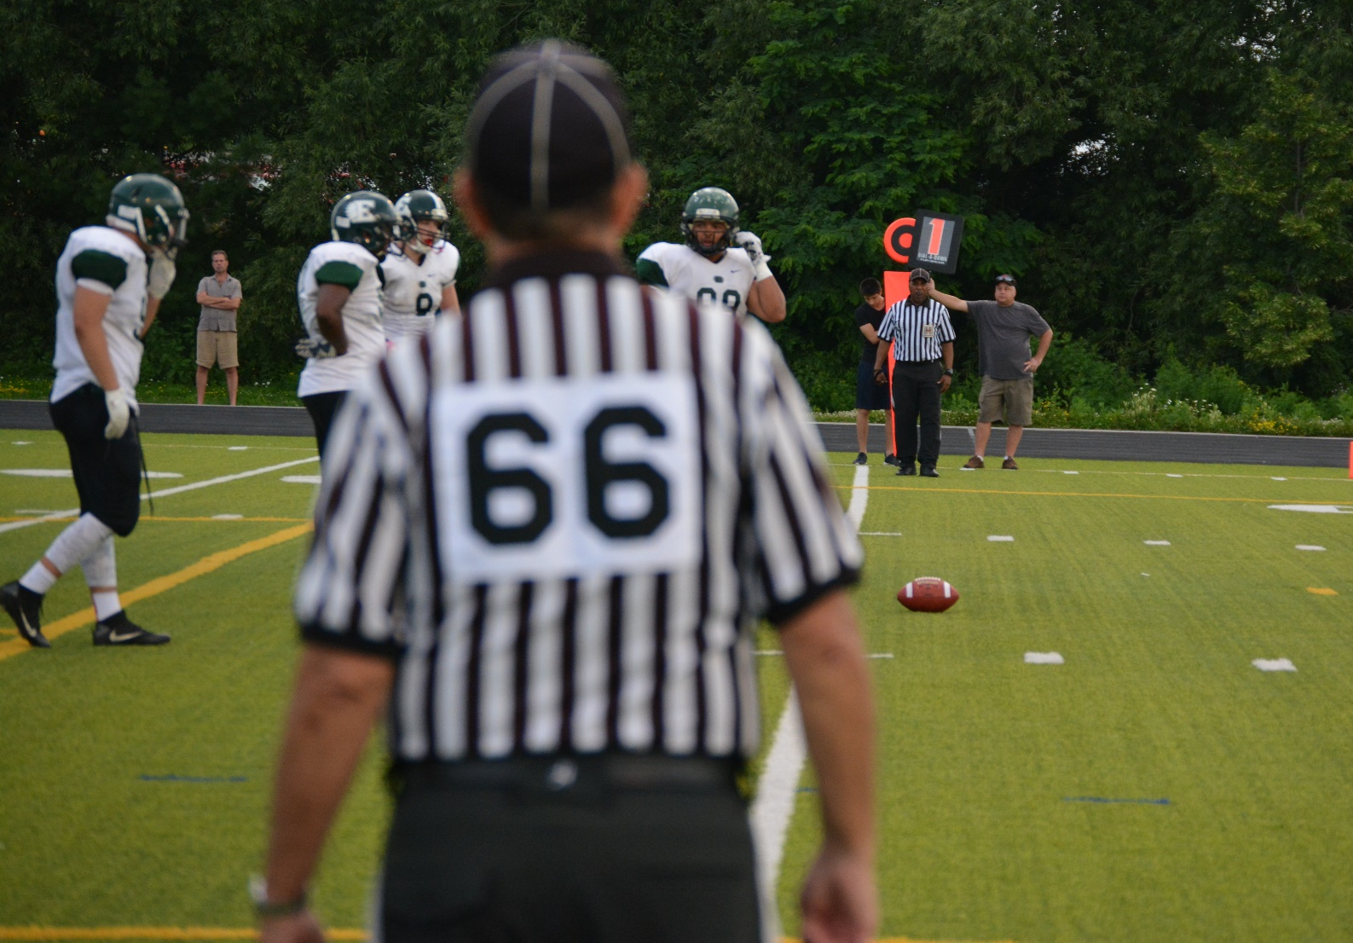
Line of Scrimmage Officials
Check ball and stick placement
Notes:
What?
Check ball and stick placement
Why?
To ensure that we have an accurate mark of the Line of Scrimmage and that we are scrimmaging the ball from the correct spot.
How?
The front of the ball should be lined up with the down’s marker (or vice versa)

Slide 11
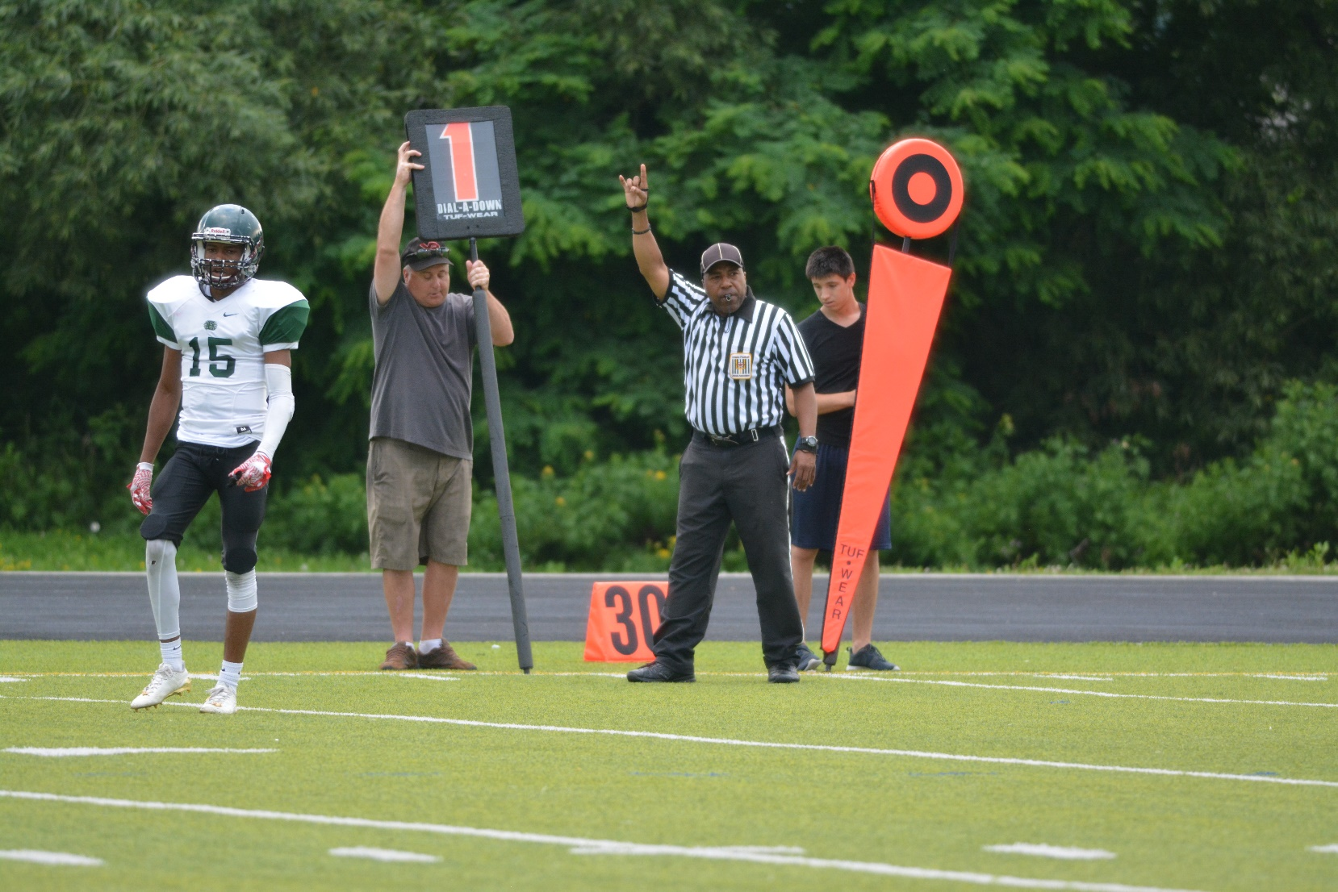
Line of Scrimmage Officials
Correct down
Notes:
Why?
All officials need to know the correct down as it influences position and responsibilities.
How?
Use a downs tracker. Signal and communicate down to partner.
Check down on box as ball is ready for play. Stop play before snap if there is any doubt.

Slide 12
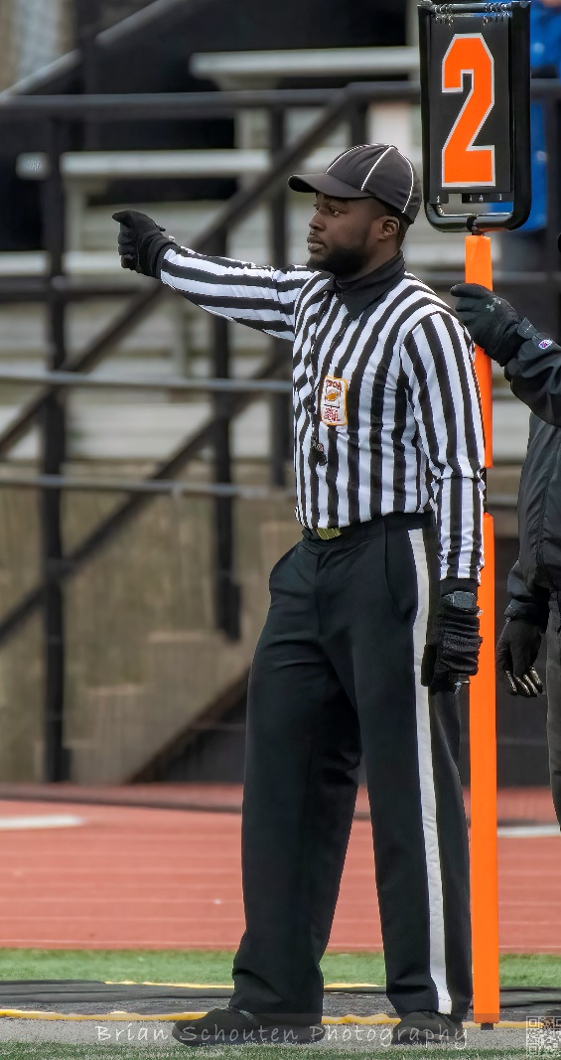
Line of Scrimmage Officials
Signal
Held or Free
Notes:
Explain free and held and the signals used.
The Free official will move downfield with receivers at the snap of the ball to cover potential deep passes.
Held official will remain at the line of scrimmage until the ball crosses (in cases where it is an obvious passing down the held official can start moving slowly downfield if receivers have cleared from the backfield and the Line of Scrimmage area)
In 3 official system LoS official is always “Free” and no signal is required.
Next slide is diagram of zones to help.
To ensure proper coverage in all areas of the field. Free official (short or boundary side) will release from Line of Scrimmage at snap – with any receivers going downfield. Held official (Wide or field side) will remain at the LoS until ball crosses
Free official will signal by
Raising downfield arm – parallel to ground and pointing
Held Official will signal by raising backfield arm parallel to ground and pointing

Slide 13
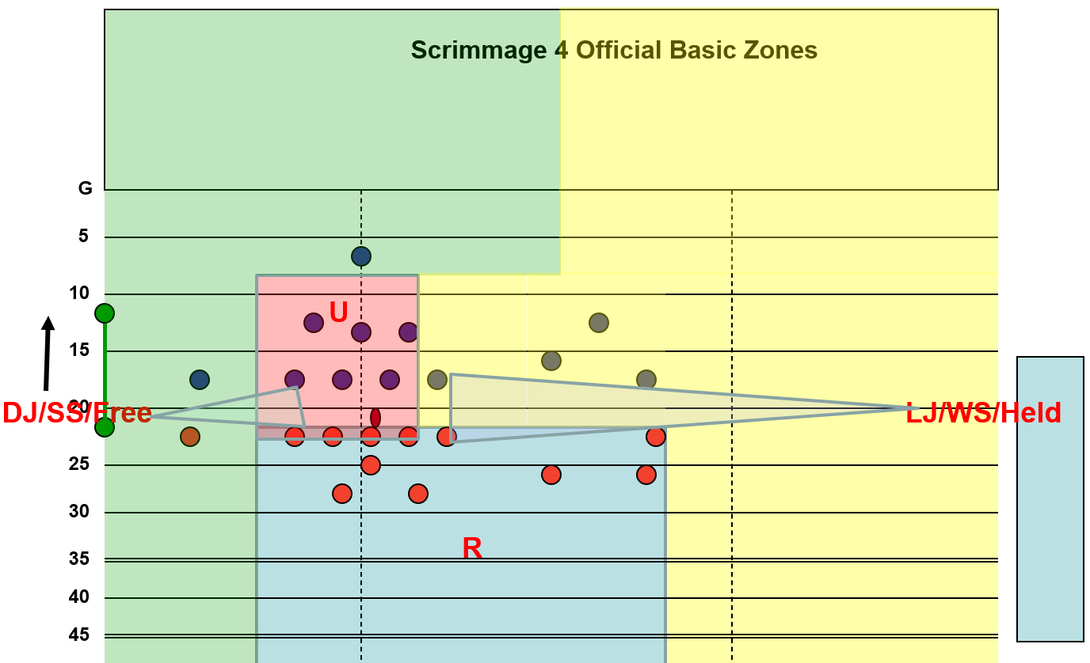
Line of Scrimmage Officials
Held or Free
Notes:
In a 4 official system the official on the Short or Boundary side – the sideline closest to the ball – is the free official. Therefore, the official on the wide or Field side (Sideline farthest from the ball) is held.
Remember that despite being held that official is still responsible for the entire sideline to the dead ball line.

Slide 14
Line of Scrimmage Officials
Substitutions
Notes:
c) The sideline officials (Down Judge and Line Judge) shall control the substitutes. As soon as possible after the ball is dead on a play, they shall observe their sidelines for possible substitutes, until Team A breaks its huddle. At this time, they will raise their arms to shoulder level, after which no substitute shall enter the field for any reason – regardless of the number of players a team may have on the field
Raise “gates” when 2 or more Team “A” Players break huddle until Team “A” is set over ball.

Slide 15
Line of Scrimmage Officials
Count
Notes:
All officials have duty to ensure a team is not playing with more than 12 players on the field.
It is also important to know if the offense has fewer than 12 as this may change the requirement for 7 players on the LoS or an eligible receiver on the end.
Make certain you know which Team you are to count:
Down Judge = Home Team (Or team on your sideline if benches are on different sides)
Line Judge Visitors (Or team on your sideline if benches are on different sides)
3-Official and 4 officials
Referee Offense
Umpire Defense
5 Official
Referee Offense
Umpire Offense
Back Judge Defense
3-Official
Referee Offense
Umpire Defense
Down Judge Home Team (Or team on your sideline if benches are on different sides)
4-Official
Referee Offense
Umpire Defense
Down Judge Home Team (Or team on your sideline if benches are on different sides)
Line Judge Visitors (Or team on your sideline if benches are on different sides)
5 Official
Referee Offense
Umpire Offense
Down Judge Home Team (Or team on your sideline if benches are on different sides)
Line Judge Visitors (Or team on your sideline if benches are on different sides)
Back Judge Defense

Slide 16
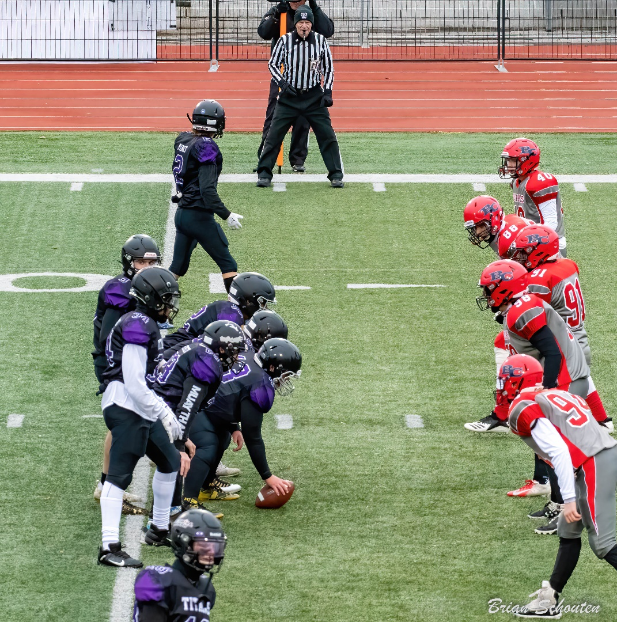
Line of Scrimmage Officials
Line of Scrimmage players
Notes:
The Line of Scrimmage Officials have the best view of the line of scrimmage and ability to see if a player is on their side of the line or out of the neutral zone
Pre snap – Ensure that Offense have 7 players on the line (this includes the receive at each end – next slide)
All offensive line players are behind the ball and within 1 yard of the LoS
Defensive players have all parts of body (including head) at least 1 yard away from LoS
Stance – back foot on LoS downfield foot 1 yard away = neutral zone
Use voice to have players move back – communicate with umpire if there are continuing issues

Slide 17
Line of Scrimmage Officials
Video – Receiver Check
Notes:
VIDEO
Watch receiver #13 moving to top of screen and official (Line Judge). He checks in with LJ and LJ responds by pointing and verbalizing – “You’re on”
The Line of Scrimmage Officials have the best view of the line of scrimmage and ability to see if a player is on their side of the line or out of the neutral zone
Receivers often line up close to LoS officials and can respond to communication
Stance – back foot on LoS Receiver knows where it is. – if receiver checks – answer with – “You are on the line” or You are off the line”

Slide 18
Line of Scrimmage Officials
Legally snapped
Notes:
Again the LoS officials have the best view of the Line and any movement into the neutral zone.
Action of centre
Rotating or placing the hand beneath the ball is allowed, but the centre shall not intentionally move the ball as if to snap it, so as to draw opponents’ offside. The centre may not move the ball forward while adjusting it for grip.
All Offense Line Players, including the Centre, must become stationary and remain motionless for at least one second immediately prior to the snap of the ball.
No player of either team shall encroach on the neutral zone until the ball is snapped, except that the head, arms and hands of the centre may be in advance of the line of scrimmage
Be aware of ball placement and any movement by the centrte. Whistle play dead if ball is moved forward. 1st time is warning. 2nd time is flag.
If a defense player goes offside, and breaks the plane of the line of scrimmage, before the ball is snapped, the officials shall stop the play immediately,
If an offense player goes offside, and passes the neutral zone, before the ball is snapped, the officials shall stop the play immediately
If an offense line player moves after assuming their 3 or 4 point stance or makes a motion to draw the defense offside - officials shall stop the play immediately

Slide 19
Line of Scrimmage Officials
Officiating play in zone
Notes:
To ensure effective coverage to playing field is divided and officials are responsible for action in their zone first and any adjacent zones if no action is happening in their area.
Use soft eyes to determine where the ball is – only focusing on the ball and ball carrier when opponents are close. At other times look for contact between other players

Slide 20
Line of Scrimmage Officials
Officiating play in zone
Held or Free

Slide 21
Line of Scrimmage Officials
Pass coverage downfield
What are the possible calls on every pass play?
Notes:
These are some decisions the Line of Scrimmage officials will need to make.
Complete
Incomplete – out of bounds - ground
Interception
Interference – Offense / defense
Illegal Contact - defense
Illegal block downfield – offense
Screen pass

Slide 22
Line of Scrimmage Officials
Video – Free official pass coverage
Notes:
Example of free official moving quickly downfield on a pass.

Slide 23
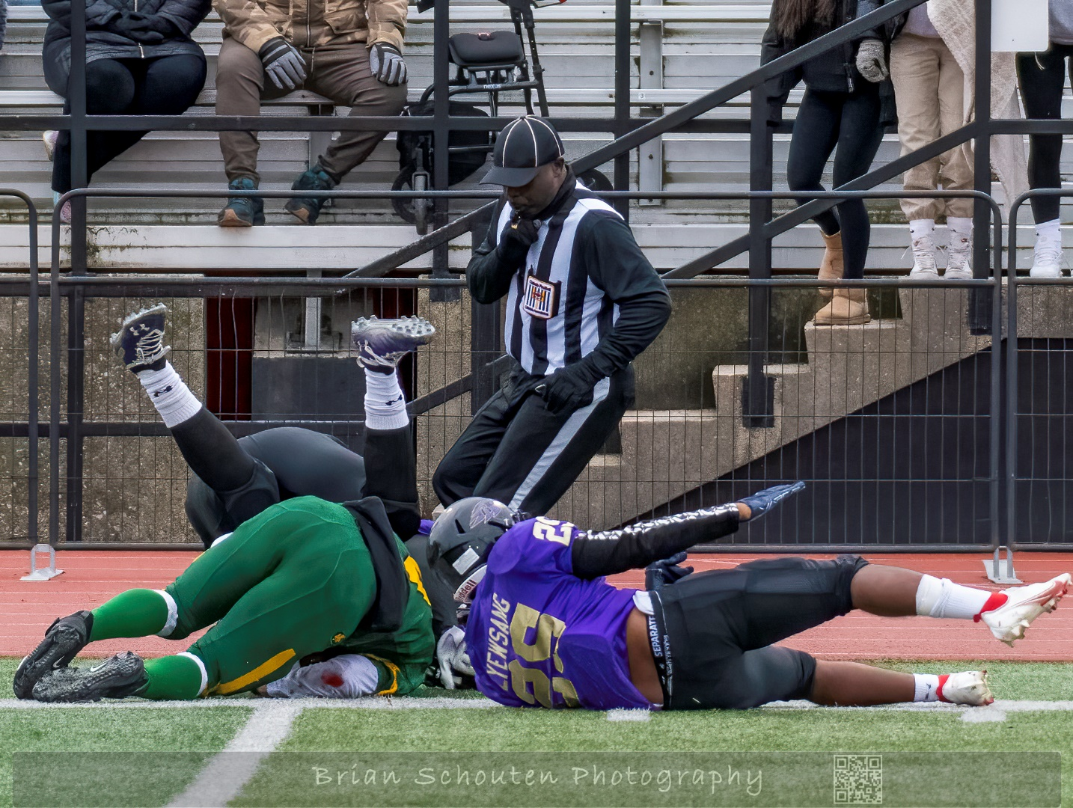
Line of Scrimmage Officials
Out of bounds
Notes:
Line of Scrimmage officials are responsible for the entire sideline from dead ball line to dead ball line.
Use the out of bounds area as your space – ensure sidelines are clear of substitutes and coaches before the play begins
Watch for players moving out of bounds and returning to the field

Slide 24
Line of Scrimmage Officials
When is the ball out of bounds?
Notes:
Article 1 – Definition
The ball is out of bounds when:
It touches any boundary line, or the ground or any object on or beyond these lines, including an official, any player or substitute.
A player in possession of the ball touches any boundary line, or the ground or any object beyond these lines, except a field official or another player who is out of bounds, while the ball carrier is fully in bounds

Slide 25
Line of Scrimmage Officials
Out of bounds
When can a player who goes out of bounds legally return to the field and participate in the play?
Notes:
Out of bounds because of contact with opponent, missed block or tackle, or who slides out of bounds on a slippery field

Slide 26
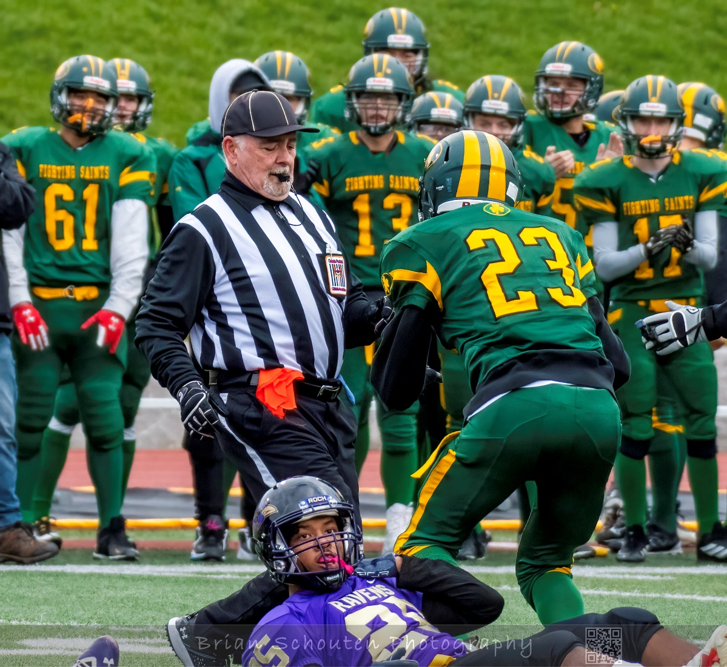
Line of Scrimmage Officials
Spotting ball
Notes:
The official who sees the ball go dead – blows the whistle and has the “spot” of the ball. This is where the front of the ball is at the moment it went dead. The Line of Scrimmage officials will have many of the spots because they have the outside in view and their zones cover most of the field.
How
Kill the play with the whistle when it is dead. When players have cleared, mark the spot : mark forward point of advance with out-thrust foot, with toe in line with forward point of ball, facing in the direction of the defending Team’s Goal Line.
If it is close to a possible first down move into a location near where the ball went dead. If the ball is dead out of bounds mark the spot on the sideline.

Slide 27
line of Scrimmage officials
Video – Forward Progress
Notes:
Video demonstrating forward progress
The ball is dead when the ball carrier is tackled, held and the forward progress has been halted.
If a ball carrier is stopped by an opponent and remains in the grasp, whistle the play dead and make the spot of furthest progress.
Consider a ball carrier running into a group of players, stopping then running back toward own goal line before being tackled. Is the forward progress given?

Slide 28
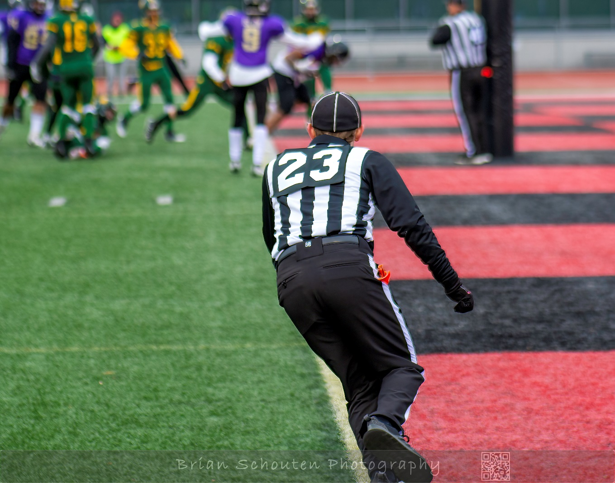
Goal Line
Goal line coverage

Slide 29
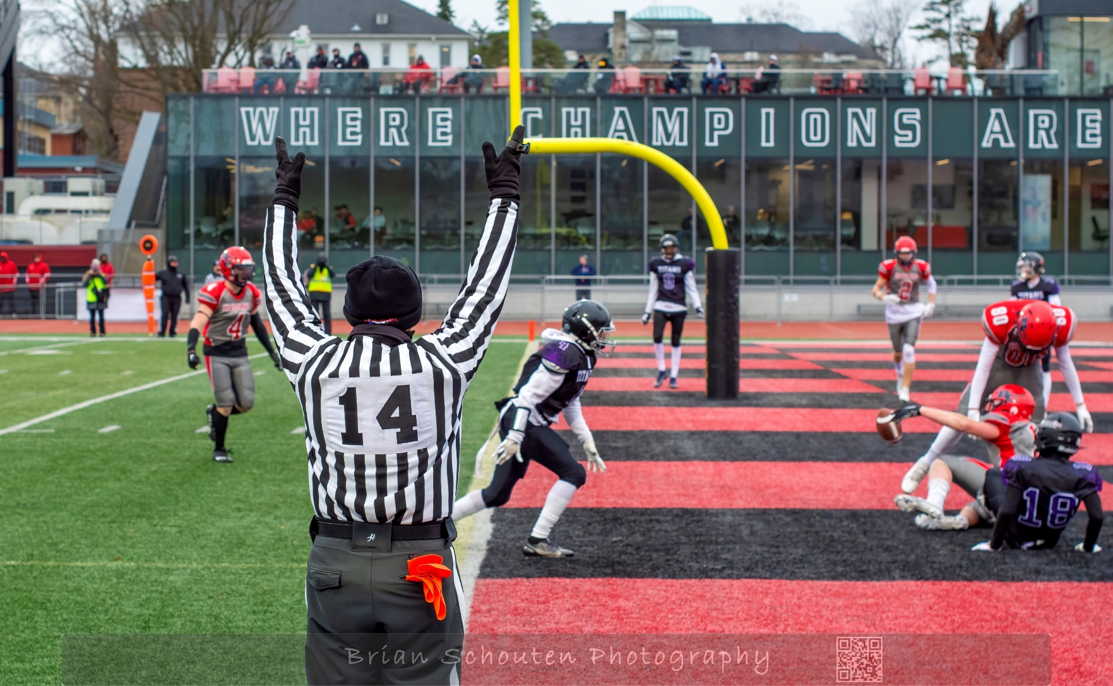
Goal Line
Touchdown
Notes:
When points are involved, it is critical that officials place themselves in a position to make a call.
Hustle to proper position to make calls. Signal touchdown but thrusting both arms above your head and blowing the whistle

Slide 30
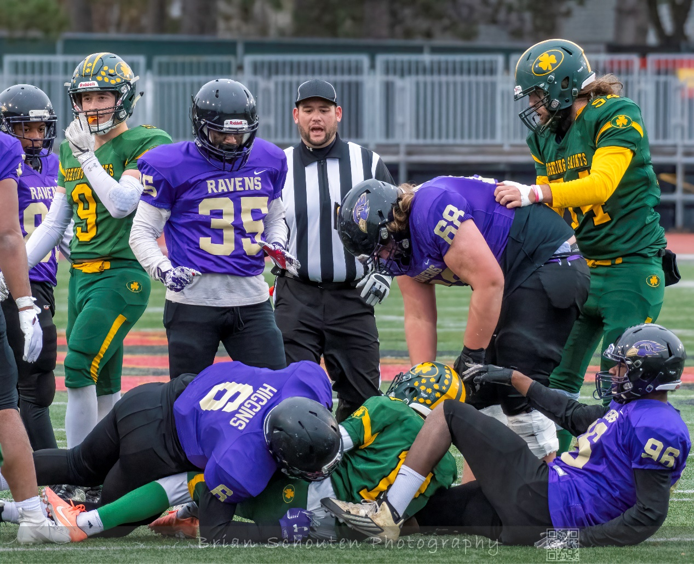
All officials
Dead Ball Officiating
Notes:
Officials must be always vigilant on the field as players from opposing continue to be in close proximity to each other.
Move quickly to the dead ball spot or to a safe location near group of players in your zone. Use your voice – encouraging players to get back to huddle of bench. Make them aware of your presence and talk them into good behaviour.

Slide 31
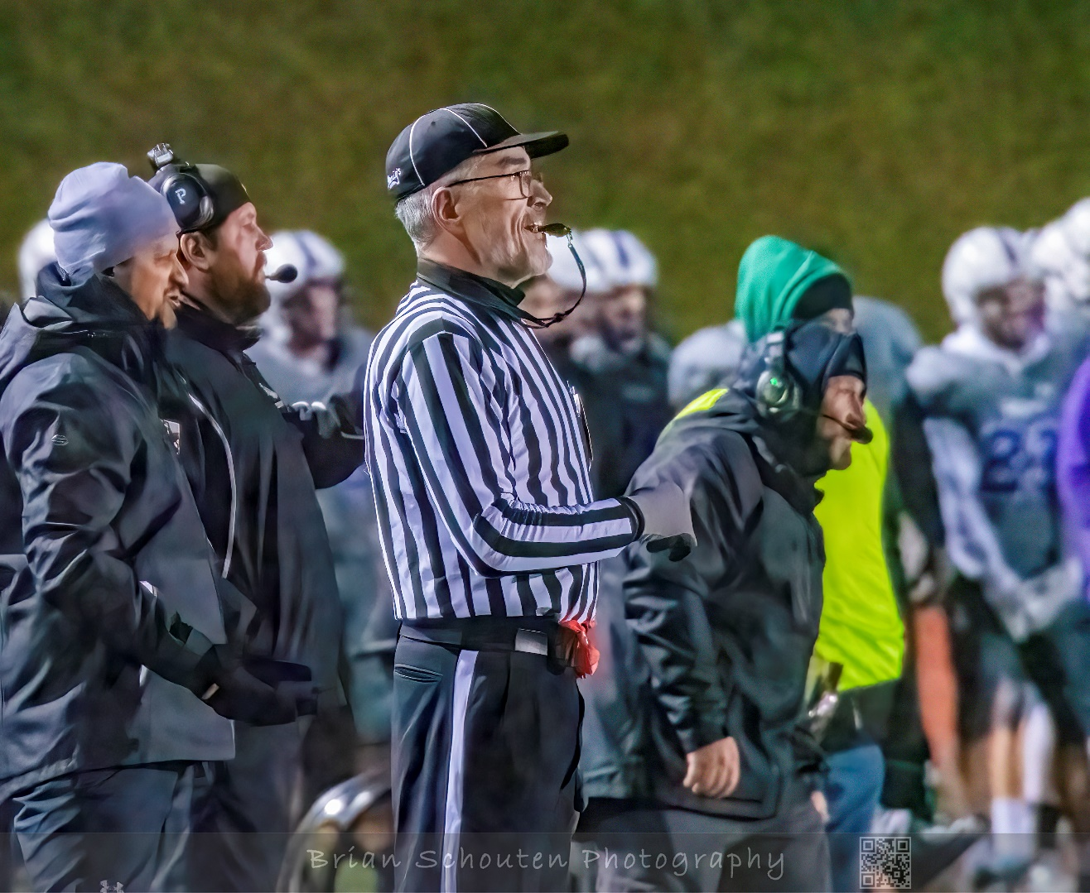
Line of Scrimmage Officials
Bench communication
Notes:
The line of scrimmage officials are positioned on the sideline and thus are the coaches connection with the officials.
Answer questions if you know the factual answer – never speculate or comment on a call by another official. If you do not have the answer let the coach know you will check and get back. At the next appropriate time – get the required information and let the coach know.
If the coach requests a conference with the referee, ask the reason or question. If you have the answer let the coach know, otherwise, speak with the referee to make them aware of the request.

Slide 32
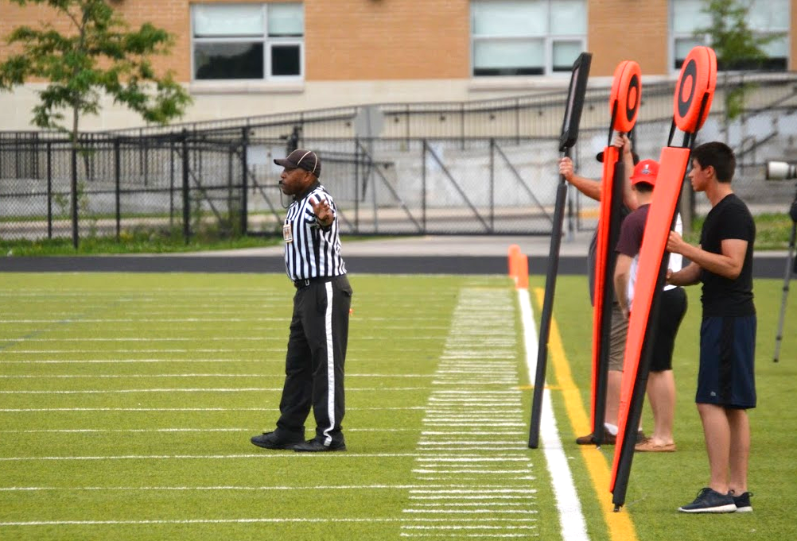
Down Judge – leader of stick crew
2.4.3. The Down Judge is responsible for supervising and controlling the yardstick crew

Slide 33
Downs Judge
Additional duties:
Supervision of stick crew
Placement of yardsticks and downsbox
Correct down indicated (with Referee)
Measurements – direction and bringing chain in
Change of quarters (2nd and 4th)
March distance on penalties – downsbox placement
Notes:
Downsman:
Only on the signal from the Referee and the Head Linesman will the Downsman change the location of the downsbox and/or the number of the next down. If the Downsman does not agree with the number of the down signalled by the Referee and/or the Head Linesman, he/she will immediately report it to the Referee or Head Linesmen before the ball is next put into play. If the Downsman sees a penalty fag down, he/she must not move the downsbox or let the sticks move, even if the Referee and/or the Head Linesman have inadvertently signalled them to be moved through not having seen the penalty fag.
Stickmen: The Stickmen will move the sticks on signal from the Referee and the Head Linesman. If a Stickman should see a penalty fag down, he/she should caution the others on the sideline not to move

Slide 34
Level 1
Line of Scrimmage Officials
Mindset
Preparation

Slide 35
Game Assignments
Check with your association regarding process
Communicate availability
Check for assignments
Accept assignments promptly
If something changes notify the assignor immediately.
Notes:
Discuss with association how games are assigned (most use online scheduling programs)
Ensure your availability is always correct and includes all days for the scheduling period (e.g. month, season,..)
You can indicate times available (if not all day) make sure you account for travel time)
Set alerts – either have the system message / email you or check frequently (at least every day)
Accept assignments promptly

Slide 36
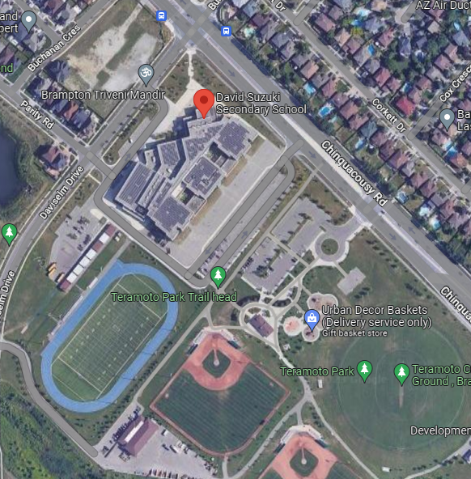
Preparation
Understand the assignment
Review league variations
Notes:
When?
Date / time
How early do I need to be there?
Where
Facilities?
Traffic?
Weather?
Who?
Age of players?
Crew size and members?
Provide examples of league variations a new official in your area may encounter – focus only on those that impact the Line of Scrimmage official.
e.g. 9v9, 4 timeouts per game

Slide 37
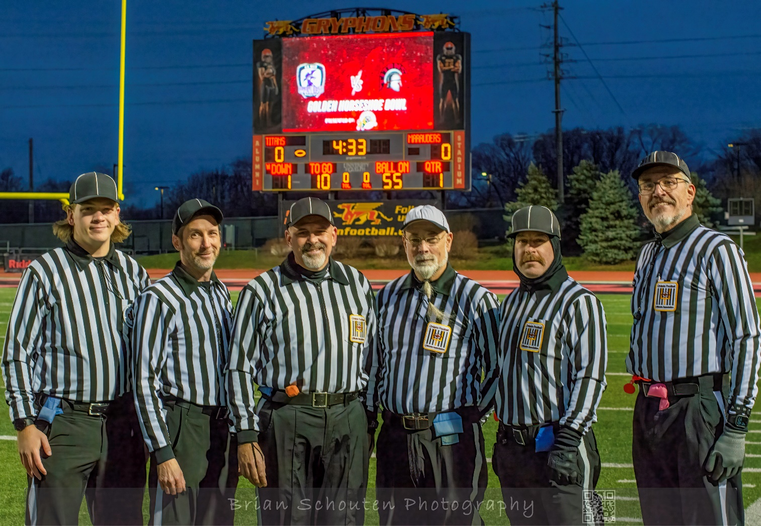
Preparation
Ensure uniform is ready
Pack gear
Notes:
Location
Time
Age
Crew size
Crew members

Slide 38
Look sharp be sharp
Notes:
Hat
Jersey – long and short sleeve
Undershirt (if desired (Black))
Pants – with stripe
Belt - black
Black socks
Black (primarily) shoes
Black laces
Local FOA requirements:
Toque
Crest
Number
Shorts
Orange Flag
Whistle – Fox 40 recommended
Penalty tracker / pencil
Optional:
Downs counter
Clip

Slide 39
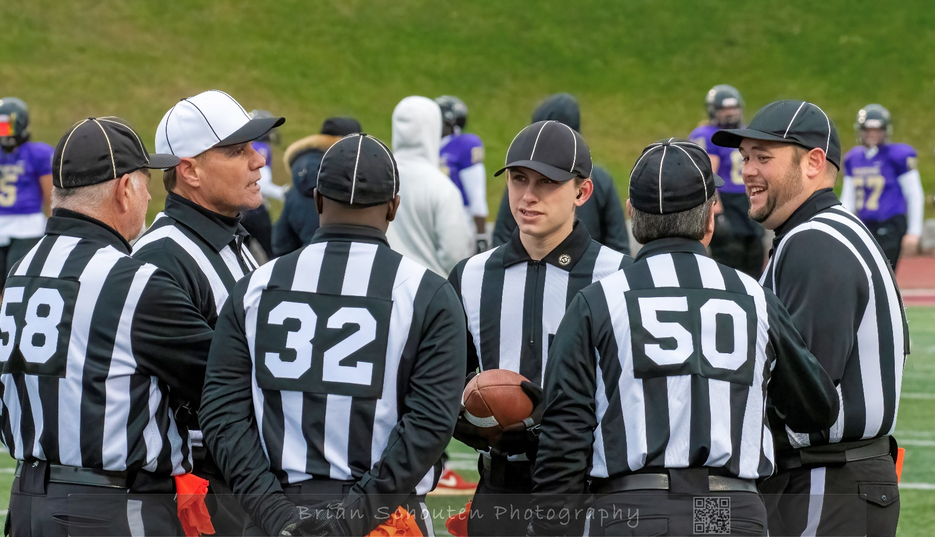
Pregame
Meet crew
Discuss mechanics
Discuss game
Rule variations
Field
Weather
Team
Ask questions

Slide 40
pregame
Field Inspection
Notes:
Note benches
What side of field? (if on opposite sides this will mean the downsbox and yard markers will start on the Home team side and switch at half time.)
Ensure all physical items (e.g. benches, coolers, tents) are placed at least 5 yards away from the sideline
Are there lines or a track that can designate the area for players so that they do not crowd the sideline?
Field Markings
Are yard stripes every 5 yards? 10 Yards?
Hash marks 24 yards in from each sideline – if no marks discuss with Umpire re: ball placement.
How are major lines marked? –
Sidelines – is there a wide stripe or other line for coaches and others to stay behind?
Goal line – Football vs. Soccer
Dead ball line is 20 yards back from the goal line. If there is a track, is dead ball line clearly marked inside?
Are 35 Yard line and 45 Yard line distinct – for easy set up after scores
Goal posts
padding (Game CAN NOT START without)
Alignment – cross bar parallel to goal line
Flexible markers are located at the intersections of the goal line and sidelines and the end zone sideline and dead ball line
Fields with a track around them, the deadline should be marked at least one foot inside the curb
Side lines are marked and clearly visible
Field is clear of debris and obstructionns – all equipment is placed well into the out of bounds area
Are there any puddles or “dips” that may impact play/ ball placement/ safety?

Slide 41
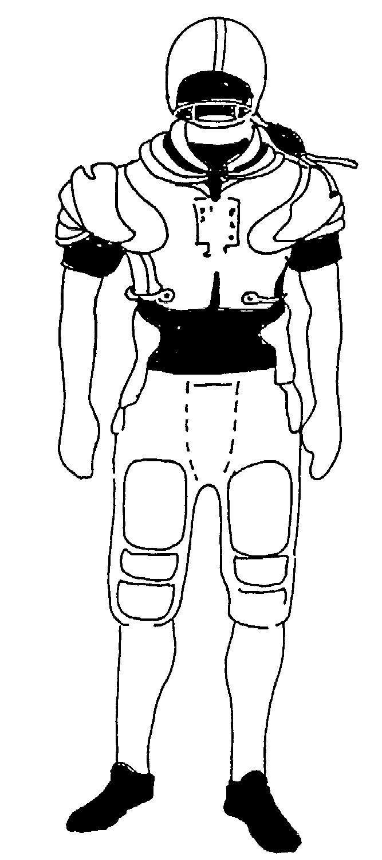
pregame
Player Inspection
Notes:
The following equipment is mandatory and shall be worn by all players. It shall be designed and manufactured by a professional manufacturer, and shall not be altered in any way which will decrease the protection of the player. The responsibility to ensure each player is properly equipped rests on the Head Coach.
Knee protection in the form of soft padding entirely captured within a continuous material or knee protection specifically designed for and insertable in football pants. Knee protection cannot include any strap featuring a buckle, Velcro, clip, or strap that could become unfastened during play
Thigh guards.
Hip pads with tailbone protector.
Shoulder pads.
Helmet with regulation face mask
No tinted visors (no communication devices)
Mouth guard, protecting the teeth and lips
Shoes which meet specifications
Check for casts, taping (and braces)
Uniform is worn as required by the league
Also:
Knotted jerseys
Discuss how to handle situations with a player not wearing a mouthguard

Slide 42
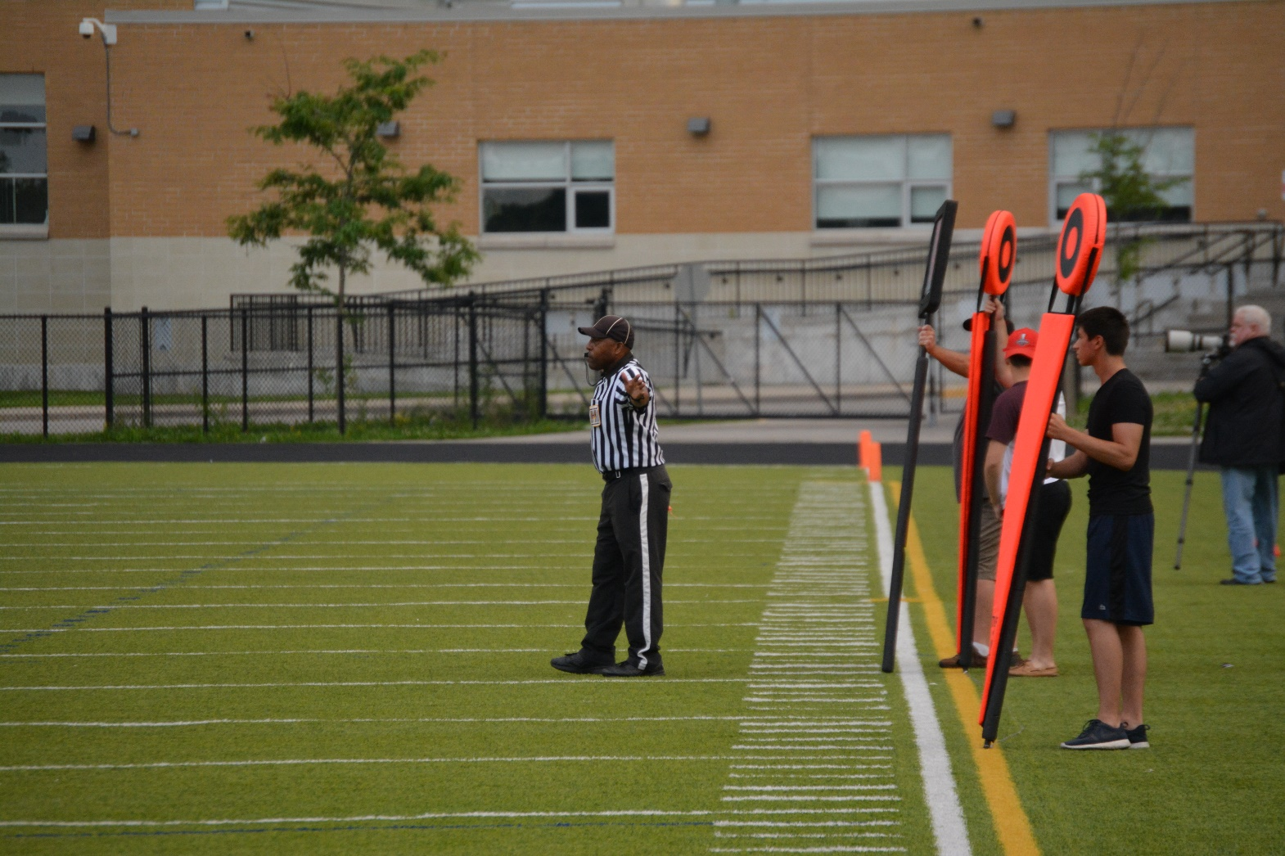
Pregame
Down judge
- instruct Stick crew
Notes:
Instructions:
You are part of the official crew – thank you
It does mean you must remain impartial so : No discussion or opinions with Players, Coaches, fans
Downs Box
Set at forward point of ball on all plays (DJ should make spot with toe of forward foot.
Do not move or change down until clear signal from Referee or DJ
Talk on every down what is the down and confirm on the box.
1st and Goal and Converts- Downs box only
Flag on the play DO NOT MOVE UNTIL SIGNALED BY THE REFEREE.
Field Goals – on all field goals discuss with DJ yard line of LoS
When play gets tight to your sideline and you are in jeopardy of being injured drop stick (to stands side) and back out.
Sticks
Do not move until 1st Down is signaled by Referee or DJ
On 1st down and 10 – Rear stick is at same spot as Downsbox
Keep chain tight – rear stick person uses foot to hold post while other crew member tightens
Keep the sticks vertical look professional.
Flag on the play DO NOT MOVE UNTIL SIGNALED BY THE REFEREE. Sometimes the flag may end up out of bounds you see a flag, stay there, even if the Referee has signaled you to move.
Quarter time wait for DJ to direct moving the chains to the opposite end of the field
When play gets tight to your sideline and you are in jeopardy of being injured Drop sticks (to stands side) and back out.
Use the entire white sideline.
Hustle
Be Alert
The Downs Judge must provide support for the stick crew following each play.
On first down, go to sideline and set the spot for downsbox.
Stickmen set the rear stick at same spot.
For each down change, turn and signal new down to downsbox attendant, and from the field, indicate the correct place. Ensure that down is changed.
At half time inform the crew when to return
After the game – help store the sticks and thank the crew
Measurements:
Down Judge go to sideline.
Ensure downsbox remain at previous line of scrimmage.
Check clip is placed correctly on back of the yard stripe closest to the rear stick.
Take position marking the front stick spot.
Have rear stick attendant pick up clip.
Both stick attendants bring sticks, clip and chain in for measure.
If first down is made – downsbox moves to spot and rear stick sets up there
If distance in not gained – front stick sets up at your spot and chain is pulled tight. The clip should be returned to back of the yard stripe closest to the rear stick.
At the end of first and third quarters:
If it is a new set of downs: check ball location and set sticks as 1st and 10 from the location on the opposite end of the field.
If not a new 1st and 10 then:
Check correct down, and approximate distance to go.
Check the yard stripe on which the clip is placed.
Ensure clip is at the back edge of the line.
Reverse the position of the Stickmen.
Move to the identical yard stripe at the opposite end of the field.
Place clip on the back of the correct yard stripe.
Reset the sticks.
Recheck the down and distance for accurate placement

Slide 43
Stick crew safety
Video – Support Crew Safety
Notes:
Video

Slide 44
Official Safety
Video – Official’s Safety
Notes:
How could this be prevented? What instructions are provided to the stick crew -

Slide 45
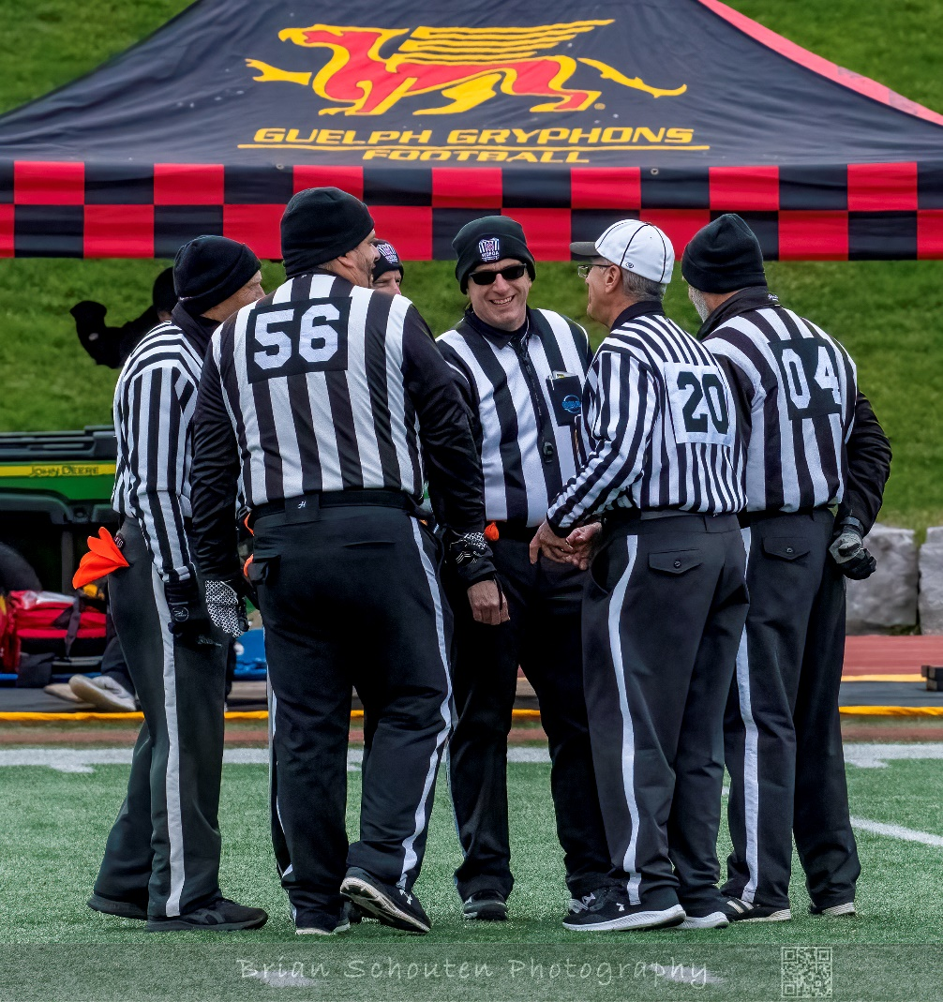
Pre-kickoff meeting
Notes:
About 5 minutes prior to start of the game
The Downs Judge will confirm Yard Stick crew is in place and have been instructed
Down Judge, Line Judge (and Back Umpire) will report field conditions and player equipment concerns
The Umpire will review special plays or numbering problems.
The Umpire will provide numbers of captains, kicker punter and holders
The Referee will provide information regarding team concerns or special plays
Crew gets ready for pregame protocol with captains

Slide 46
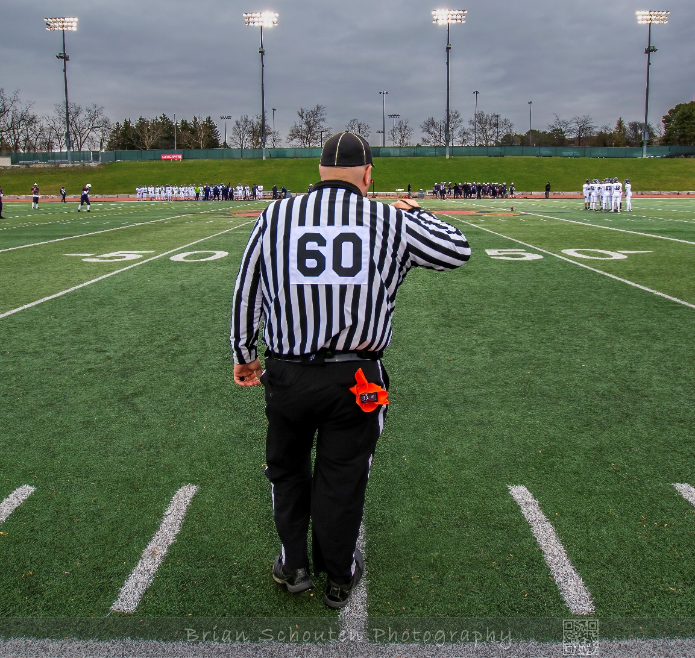
Prekickoff
Routine
Notes:
Who is kicking? who can block?
Where?
Wind?
Endzone?
Count
Sidelines
Players ready
Arm – look at ref – once acknowledged – point

Slide 47
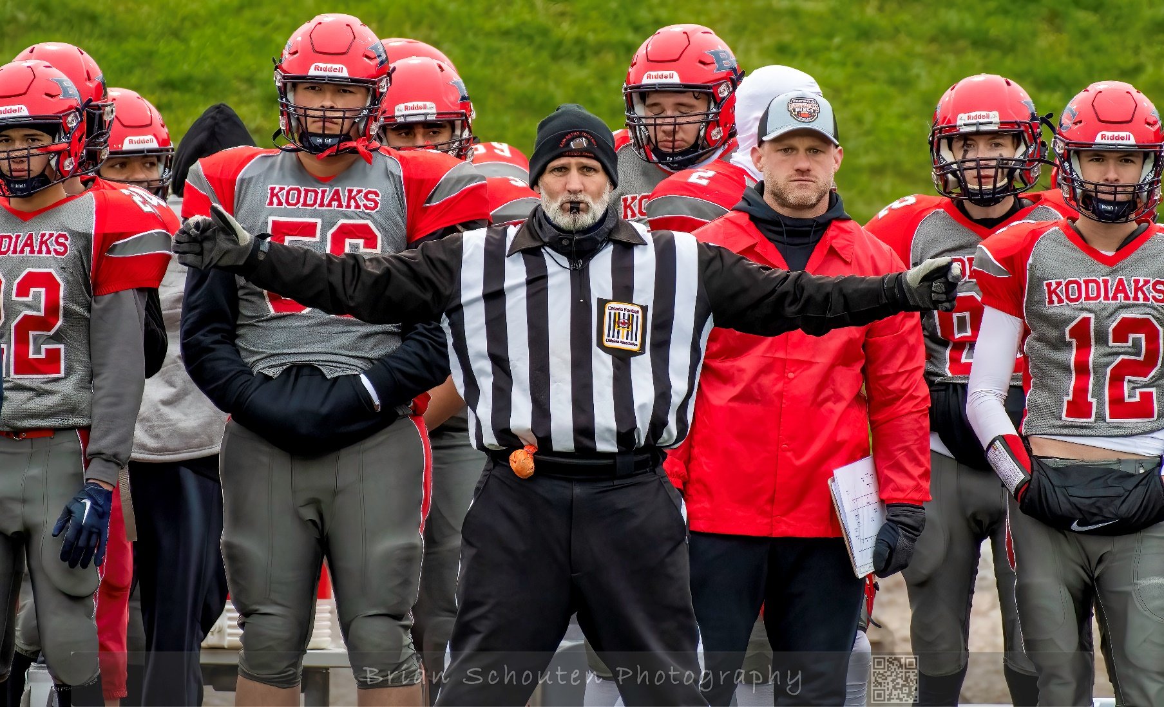
Presnap
Routine

Slide 48
Flag
Notes:
Use to indicate foul
Throw flag in air or to place ball held when the foul occurred
When is it thrown in the air?
Before first down gained. Dead ball fouls.
When to the place ball held?
After change of possession
After first down gained
Any Pass interference or loose ball interference
No whistle until play is dead

Slide 49
Whistle
Notes:
Stops play
Quick loud and sharp
Only use when you see ball become dead
If you have the whistle you also have the spot
Practice! New officials tend to be too soft on the whistle. Blow it loudly and help the sound for 1-2 seconds.
What type of whistle?
Finger grip
Lanyard – if so where?

Slide 50
Hustle

Slide 51
Ball Retrieval
Video – Ball Retrieval
Notes:
Short underhand passes to the umpire who will place the ball

Slide 52
Communication / Team Work
Notes:
All officials work together by communicating through voice, signals, whistles, and body language
Team work on coverages – out of bounds / dead ball
Keep play moving with ball retrieval and hustle between play
If something is not right – speak up

