Slide 1
Level 1 Part 2
Plays from Scrimmage:
Running and Passing

Slide 2
What is the Line of scrimmage?
Notes:
Group brainstorm

Slide 3
What is the Line of scrimmage?
Rule 4 Section 1 Article 1
(4.1.1)
Line of Scrimmage
The line of scrimmage is an imaginary line, extending from sideline to sideline, parallel to the goal line and passing through the point of the ball farthest from Team A’s goal line.
Notes:
Answer on slide

Slide 4
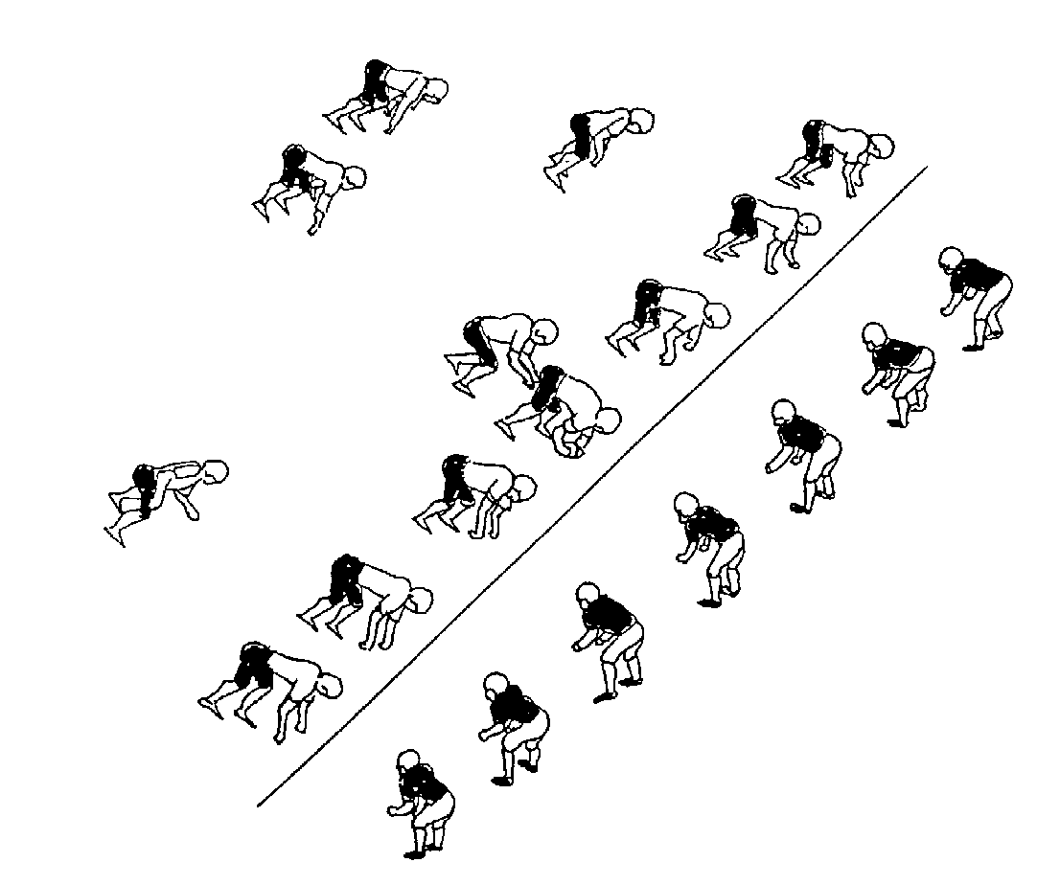
Neutral Zone
Rule 4 Section 1 Definitions:
Article 2 – Neutral Zone The neutral zone is the area from the line of scrimmage to 1 yard (1 metre) in advance of the line of scrimmage, extending from sideline to sideline
1 yard

Slide 5
What fouls are lOs dependent?
Offside
Defense
Offense
Illegal Procedure
Movement
Formation
Illegal Forward Pass
Intentional Grounding
Blocking downfield (except screen pass)
Illegal Contact
These are typical the fouls called by (or informed by) the Line of Scrimmage officials on plays from scrimmage
Notes:
Brainstorm
Answers will be revealed.
There may be additional correct answers.
These are typical the fouls called by (or informed by) the Line of Scrimmage officials on plays from scrimmage. (E.G. Intentional Grounding is a referee’s call but information may be required from the LoS officials (did thrown ball cross LoS or was an eligible receiver the intented target?)

Slide 6
Positioning to make LoS calls
Notes:
Note picture:
Officials at LoS
On Sideline or behind if on short (Boundary) side. In 3 and 4 official can squeeze in if on wide (Field) side.
Rear foot at LoS (for DJ that is also where the Downs box is)
Stance with feet 1 yard apart (Front foot marking extent of Neutral Zone)
Why?
Consistency
Clear view of action – can see if someone enters Neutral zone
Receivers and Offensive line know where LoS is – you can indicate by waving hand at back foot parallel to LoS
Defense knows where to line up
Mirroring official on opposite side looks professional

Slide 7
Scrimmage Initial positioning – 4 officials
Notes:
Remember that this is initial position until the snap. Play may take you off the line.
You are not Anchored!!!

Slide 8
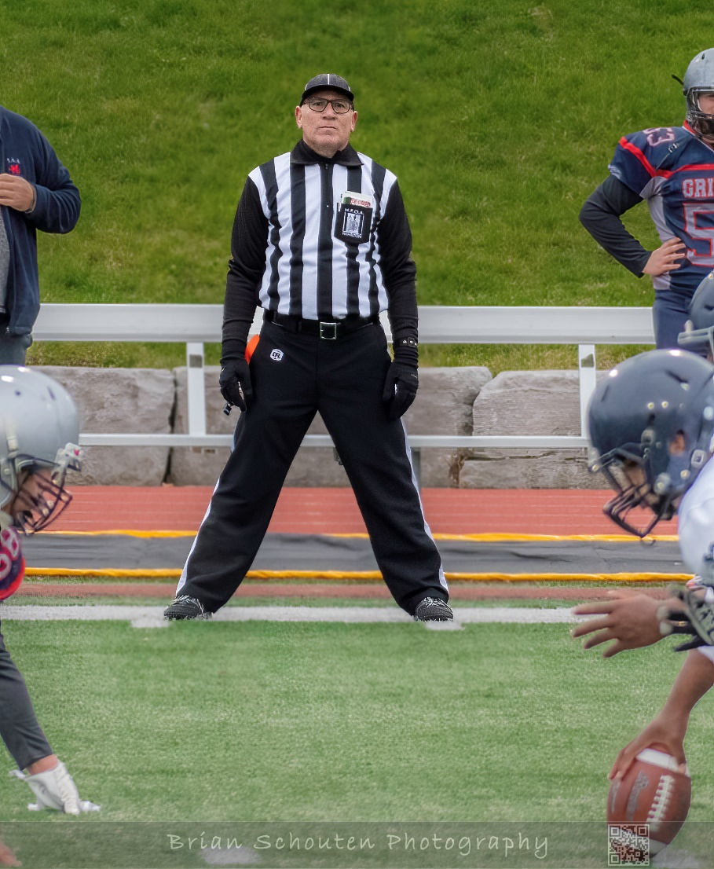
Offside
Rule4 Section 2 Article 3 – Offside
No player of either team shall encroach on the neutral zone until the ball is snapped, except that the head, arms and hands of the centre may be in advance of the line of scrimmage.
Notes:
Is this player offside? - so guide

Slide 9
Line up offside
Video – Lined Up Offside
Notes:
We try our best to prevent fouls from occurring.
In this situation here are the steps we would take:
Setting the ball. If possible, set the ball at a hash mark or major line. Sometimes this is not possible – e.g short yardage or ball was clearly dead between the lines.
Our stance – indicates where the Neutral Zone is.
Our voice – we would be yelling at the player to get back (if we can see the number use it otherwise “defense get back!”
Once we yell – the offender needs to move back. If no movement occurs – you must throw your flag at the snap.
If it is close and/ or the field is not well marked, it is OK to provide a warning to the defense, but be ready to follow through

Slide 10
Defense
Video – Offside Defence

Slide 11
Offense Offside – Wide Receiver
Video – WR Offside

Slide 12
Illegal Procedure
Rule 4 Section 3 Article 4 –
Stance and Motion
Team A Line Players after having assumed a three-point or four-point stance may not break their stance by lifting a hand. However, they may point, signal, shift or move slightly in a manner that does not draw the defense offside. All Team A Line Players, including the Centre, must become stationary and remain motionless for at least one second immediately prior to the snap of the ball.
Video – Illegal Pocedure
Notes:
The centre is allowed to make the motion which is necessary to snap the ball but may not break their 3- or 4-point stance on the ball, to allow another player to become the centre. A line player of Team A, may not legally be moving in any direction, or change position by moving in any direction, immediately prior to the ball being snapped.
What is the action of officials for a motion infraction?
- Whistle Flag and time stop signal

Slide 13
Illegal Procedure
Rule 4 Section 3 Article 2 –
Player Requirements
At the instant the ball is put into play, at least seven Team A players must be within 1 yard (1 metre) and on their own side of the line of scrimmage, not including the player in the position usually occupied by the quarterback.
The player who, at the snap of the ball is occupying a position at either end of the line of scrimmage may be in motion while within 1 yard of the line of scrimmage but must not be moving towards the opponents’ goal line when the ball is put into play.
Notes:
If Team A is playing with fewer than 12 players on the field, it may reduce the equivalent number of players on the line without penalty. If Team A has fewer than 7 players on the line due to a Team A offside, the penalty shall be for offside only.
What is the action of officials for a formation infraction?
Flag and
let play continue

Slide 14
Line of Scrimmage Action
Video – D Line up then IP
Notes:
LoS is busy
Routine is important
Player Action before ball is snapped:
Receiver checks in
Defensive end Line up offside
Linebacker move up – does he jump offside?
Receiver leaves – is it early?
Offensive end moves – is it early?

Slide 15
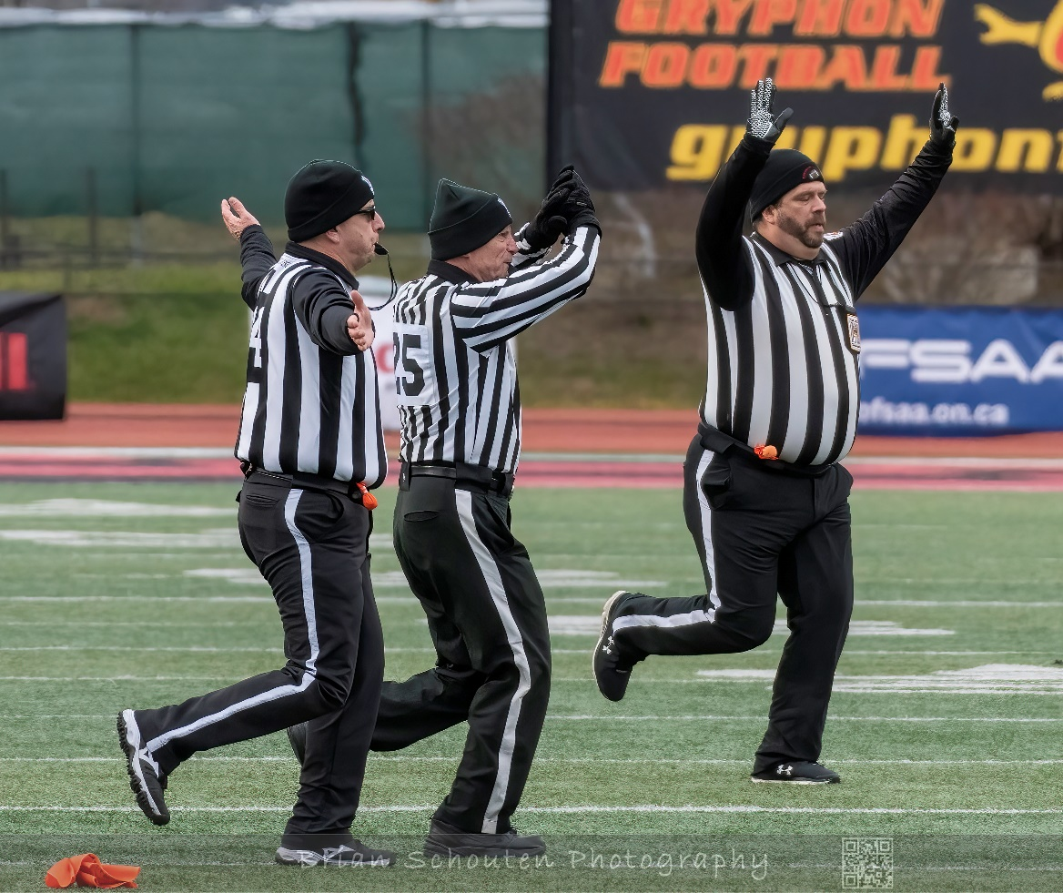
Mechanics – making the call
“Kill plays”
Illegal Procedure (movement by Offensive line)
Offside Defense
cross the LoS (may or may not have contact)
cause Offense movement
Offside Offense – beyond the Neutral zone
Whistle
Flag
Wave time-out

Slide 16
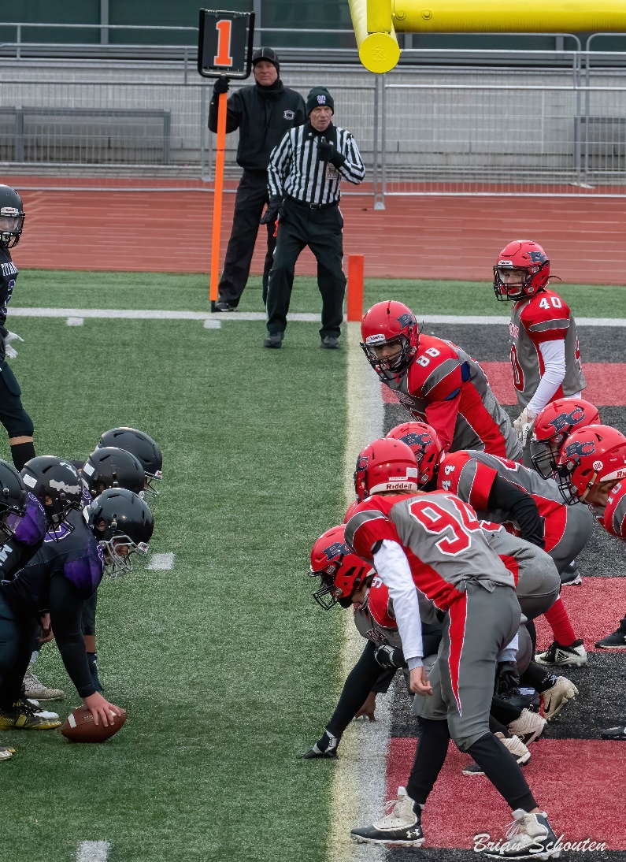
Mechanics – making the call
Play continues
Illegal Procedure - no end or fewer than 7 players on LoS
Offside Defense
– does not cross the LoS
– does not cause Offense movement
Offside Offense – within the Neutral zone
Flag
Officiate!!!!
Wave time-out at end of play

Slide 17
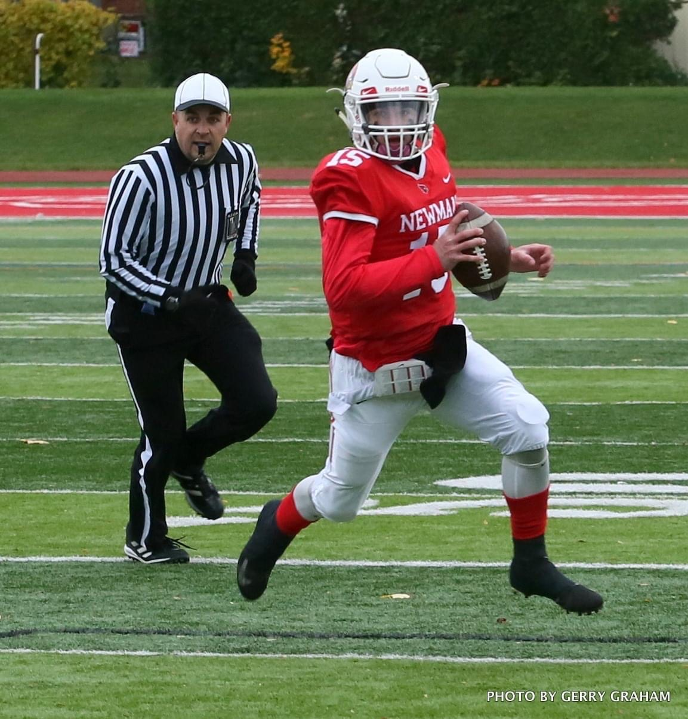
Possession
On a scrimmage play: Team A (Offense) has possession unless a fumble, interception, or a kick occurs. On a kick from scrimmage: Team A has possession until the ball is kicked across the LOS. Team B gains possession officially only once it gains control of the ball.
Notes:
Article 1 – Player Possession
A player is in possession of the ball when firmly held in the hand or hands, arm or arms, leg or legs, or under body.
Article 2 – Disputed Possession
When players of opposite teams have possession of the ball, it shall belong to the player who first gained possession, and who has not lost possession.
Article 3 – Simultaneous Possession
If players of opposite teams legally gain simultaneous possession of the ball, it shall belong to the team which last previously had possession. If a forward pass is caught simultaneously by eligible receivers of both teams, the ball shall belong to Team A (Rule 6-4-6-c).
If a kick off is legally caught simultaneously by players of opposite teams - before it has been touched by any other player after the kick off – kick off repeated at the previous line of kick off. - after it has been legally touched by another player, or players – possession to the team which last touched it before the simultaneous possession

Slide 18
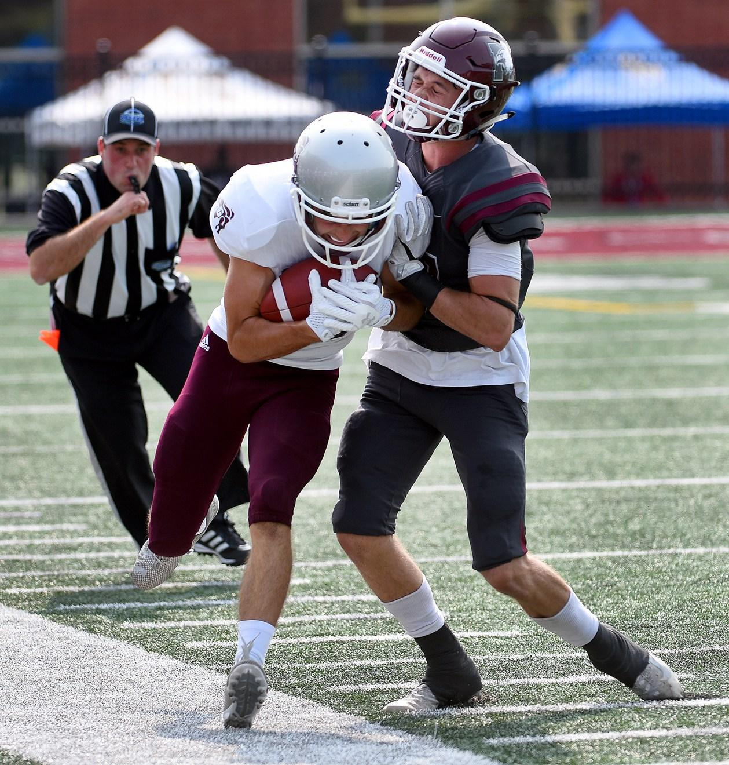
Possession
Is it a Catch or Not?
Complete Control
At least one foot (or contact in bounds)
Must survive contact with opponent or the ground
When in doubt; it is NOT a catch
Take your time
Notes:
Football is a game of possession. Ruling correctly on who is entitled to the ball is critical. The most common mistake is blowing the whistle too early – when the ball is loose (not in possession of any player). Take your time.
Article 1 – Player Possession
A player is in possession of the ball when firmly held in the hand or hands, arm or arms, leg or legs, or under body.
Article 2 – Disputed Possession
When players of opposite teams have possession of the ball, it shall belong to the player who first gained possession, and who has not lost possession.
Article 3 – Simultaneous Possession If players of opposite teams legally gain simultaneous possession of the ball, it shall belong to the team which last previously had possession. If a forward pass is caught simultaneously by eligible receivers of both teams, the ball shall belong to Team A (Rule 6-4-6-c).

Slide 19
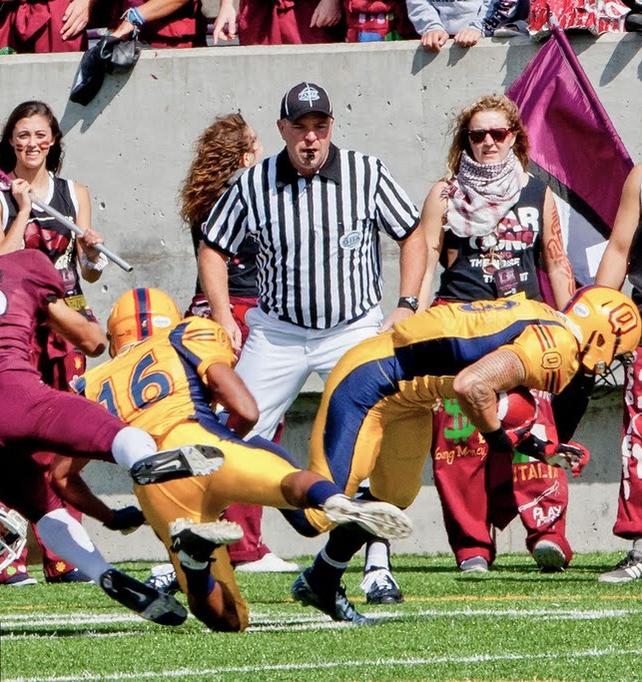
Out of Bounds
When the ball or the ball carrier touches the white out of bounds line or any area ground beyond the out of bounds line.
Whistle
Clock stops (signal).
Identify spot. (mental note… no need to stare at it).
**Where the ball is when player steps OB**
Dead ball officiate
Notes:
Line of Scrimmage officials will have the majority of Out of Bounds calls with 4 and 5 Official crews. This is because their zones of coverage encompass the entire sideline from dead ball line to dead ball line.
Outline and demonstrate the mechanic
Whistle
Clock stops (signal).
Identify spot. (mental note… no need to stare at it). **Where the ball is when player steps OB**
Dead ball officiate - especially if near benches or in groups of players – move to safe location to observe and use voice.

Slide 20
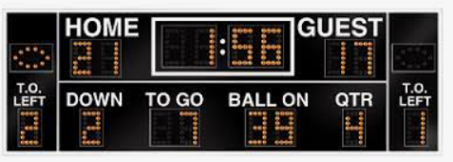
Timing (When does the clock stop?)
Regular time (Outside the last 3 min.)
The clock will be stopped after the ball is dead during a play if there was:
a change of possession
a score
a kick
a penalty
a long incomplete pass
a ball carrier going out of bounds
The clock will be stopped if the ball is not in play
for an injury; or
at an official’s discretion
Notes:
The clock will be stopped after the ball is dead during a play if there was:
a change of possession - stop clock signal
a touchdown – Score signal
a kick - stop clock signal
a penalty - stop clock signal
a long incomplete pass – incomplete pass signal
a ball carrier going out of bounds - stop clock signal
The clock will be stopped if the ball is not in play
for an injury or - stop clock signal
at an official’s discretion - stop clock signal

Slide 21
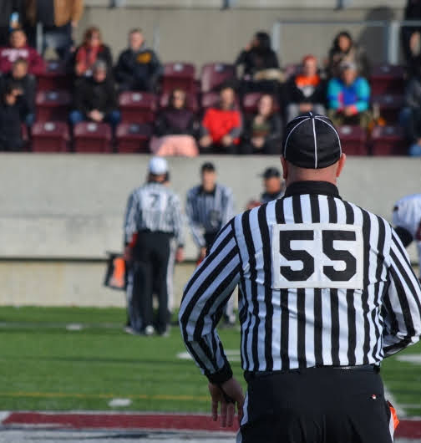
Timing (When does the clock stop?)
Last 3 minutes of each half
After every play
Out of bounds (additional signal)
Notes:
This is different than the rest of the game because timing rules are different in the last 3 minutes of each half. When the clock starts is dependent on how it went dead. The referee will need to know
An incomplete forward pass
Ball was carried out of bounds
Other situations will be evident to the Referee.
Signal time out for all plays (may not be required for incomplete passes, scores
For plays terminating near the sideline, immediately following the stop clock signal the official must provide either:
In bounds signal – facing inbounds point both open hands to the ground with arms straight at 45 degrees to the ground
OR
Ball carried Out of Bounds- facing inbounds - arms bent, closed fist with thumbs pointing back over shoulder.
How do we handle forward progress near the sideline?
Presenting this idea will depend on the level of awareness and comfort of the group. You do not want to overwhelm them with too much information but if they are advanced you may consider discussing this aspect.
Run on own power OB is ball carried OB
Push forward is ball carried OB
Push parallel or backward to OB – forward progress is given in bounds

Slide 22
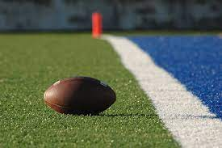
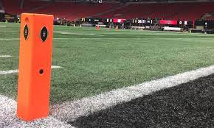
Touchdown
The goal line
The “plane”: Glass wall pylon to pylon at the “front of the white line”.
Pylon?
Notes:
Great position at the goal line to see the action.
Ball must be in possession and “break the plane”. Exception – Forward pass into end zone.
Goal Line and Pylons – this is why pre game field inspection is needed – ensure –
goal line is clear (sometimes blended with Soccer)
Pylons are set on sideline at corner of front of goal line and Sideline
Ball carrier and the pylon. - If ball touches or crosses top of pylon while live and in possession it is a touchdown.
Goal posts on goal line – in end zone

Slide 23
Touchdown
Take your time
See the ball before making a call
Don’t let yourself be influenced
Communicate with your partner
Clear and Clean signal
Notes:
Take your time
See the ball before making a call
Don’t let yourself be influenced
Communicate with your partner
Clear and Clean signal – Whistle and arms straight in air

