Slide 1
Level 1 Part 3
The Kicking Game
Notes:
Much can happen in the kicking game so again routine, hustle and awareness are key to an official’s effectiveness.

Slide 2
kickoff
Video – KO into EZ
Notes:
Set up
DJ – on restraining line (10 yards from KO line) WHY?
On side with sticks (opposite the Referee)
LJ – 4 deep and 5 on Restraining line (opposite DJ)
Pre KO – count / clear / signal
Key lines

Slide 3
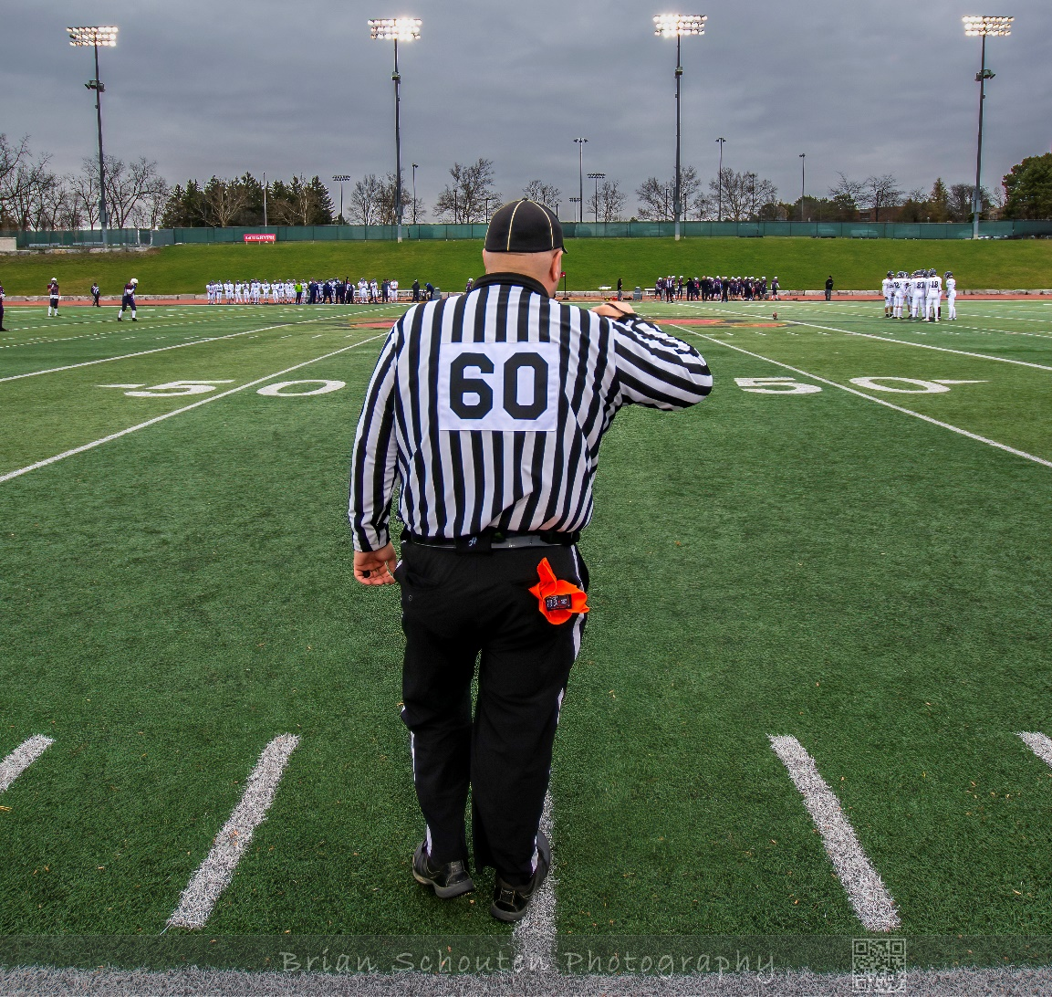
Prekickoff
Routine
Notes:
Who is kicking? who can block?
Where?
Wind?
Endzone?
Count
Sidelines - clear
Players ready
Arm – look at ref – once acknowledged – point

Slide 4
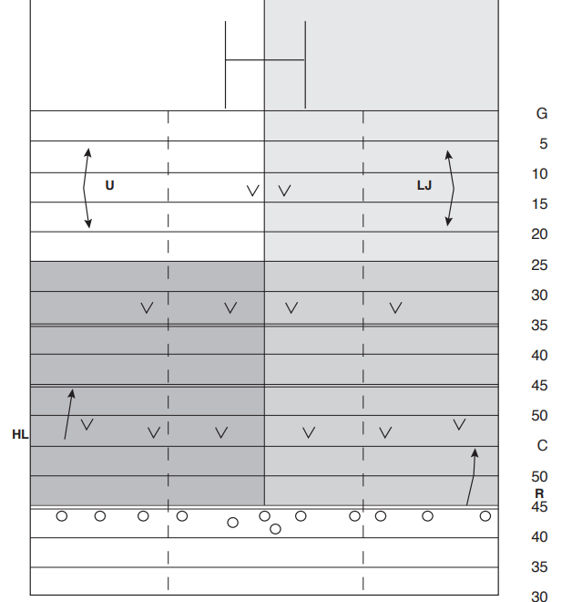
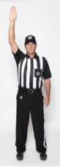
KICKOFF MECHANICS
Position
DJ always on restraining line = 10 yards ahead of kicking line (often the 55-yard line)
Responsibilities
    Count kicking team and confirm with Referee
    Ensure all are ready to play
    All players on receiving team are behind restraining line
    Check sideline
    GIVE Ref the READY signal
LJ
DJ

Slide 5
KICKOFF MECHANICS
Position (4 Officials)
LJ downfield opposite side of DJ about 10 yards in from sidelines and even with returner
Responsibilities
    Count receiving team and confirm with Umpire
    Ensure all are ready to play
    GIVE Ref the READY signal
LJ
DJ

Slide 6
KICKOFF responsibilities
Down Judge
Ensure receiving team is at least 10 yards away from the ball when it is kicked
Ensure the ball travels 10 yards before kicking team can touch it
Manage your sideline for kick OB and players OB
Short vs deep
Time in signal after the ball is touched in your zone
Cover return (ball or blocking)
–blocking (legal vs. illegal)
- fumbles, lateral, offside passes
Notes:
Discuss
Where to look for blocking
taking over the ball carrier

Slide 7
KICKOFF responsibilities
Line Judge
Assist with your sideline for kick OB and players OB
Short vs deep
Quickly determine if you have possession - then watch blocking
Do not watch ball in the air!
Time in signal after the ball is touched in your zone
Cover return (ball or blocking)
–blocking (legal vs. illegal)
- fumbles, lateral, offside passes
Notes:
Discuss
Where to look for blocking
taking over the ball carrier
giving the ball carrier to the next official

Slide 8
KICKOFF responsibilities
After the ball is dead in your zone:
Whistle and signal to stop clock if ball dead
Officiate until players move out of area
Mark spot (choose closest yard line)
Set up sticks and downs box (DJ)
After the ball is dead outside your zone:
Officiate until players move out of your area
Relieve referee if has spot or
  Assist with ball retrieval
Set up sticks and downs box (DJ)

Slide 9
kick off
Video – KO

Slide 10
kick off
Video – KO from 35

Slide 11
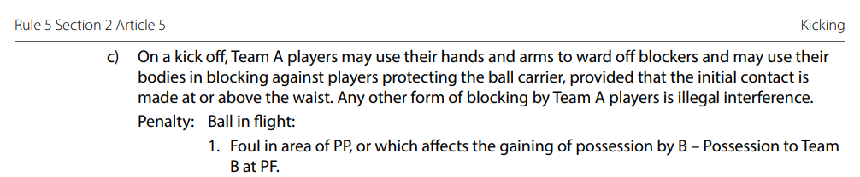
kick off – short kick
Video – Short Kick Interference

Slide 12
kick off – squib kick
Video – Squib Kick

Slide 13
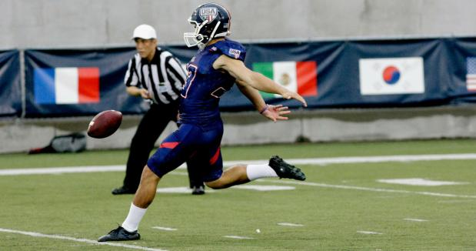
punting
Notes:
Much can happen in the kicking game so again routine, hustle, and awareness are key to an official’s effectiveness.
Possession, Points and Penalties all have variations after the ball is kicked.

Slide 14
PUNT responsibilities – Umpire
Deep 8 –12 yards outside & 5 yards forward deepest returner
Count the return team players
Responsible for entire width of field (4 officials)
Cover Goal Line and Dead ball line when threatened
Watch blocking until ball arrives
Rule on restraining zone (no yards)
Know Point of Possession
Rule on dead ball - goal post in flight
Rule on ball out of bounds
Notes:
Deep _______ yards outside
_______ yards forward deepest returner
Count the __________ team players
Responsible for entire width of field (4 officials)
Cover Goal Line and Dead ball line when threatened __________________________________________ (help understanding of term “threatened”)
Watch blocking until ball arrives – no need to ball hawk
Rule on restraining zone _____________
Know ___________ of ____________________
Rule on ____________________ - goal post in flight
Rule on ____________________

Slide 15
PUNT responsibilities – LS official
Remain at Line of Scrimmage
Count respective team
Watch for blocked/deflected kick
Be alert for “fake” or broken plays
Move after ball crosses Line of Scrimmage
Watch blocking in front of or beyond ball carrier
Be prepared to help at Goal line and with ball kicked out of bounds
Notes:
Remain at ____________________________________
Count the ______________ team players
Watch for _________________________________ kick Provide definition of Block vs. Deflected kick and why this is important
Be alert for “fake” or broken plays
Move _____________________________________________________________________
Watch blocking _______________________________________ ball carrier
Be prepared to help at Goal line and with ball kicked out of bounds

Slide 16
PUNT responsibilities – No Yards
Video – Punt Responsibilities
Notes:
Rule 5 Section 4 Article 1 – Offside beyond Line of Scrimmage (Restraining Zone Foul)
This article does not apply to a dribbled ball, or to a kick which does not cross the LS.
When on a kick from scrimmage (ball crosses the line of scrimmage), return kick or on an open-field kick, a player is offside in relation to the kicker, such player:
…
shall allow 5 yards to an opponent attempting to gain possession of the kicked ball. The five-yard zone is determined by a circle with a five yard radius, with the centre point being the ball at the instant it is first touched.
Penalty: – in field of play – L15 from PBT – in goal area – L15, penalty applied at 10-yard line If the ball strikes the ground before being touched by the receiving team: Penalty: – in field of play – L5 PBT or PBD – in goal area – L5 penalty applied at 10-yard line or PBD.
Official positioning and mechanics
As stated earlier proper positioning to:
See the ball being touched; and
Identify if any opposing players are within 5 yards
If Opposing players are within a 5 yard radius, the flag is thrown to the spot (or yard line of where the ball is initially touched.) The official throwing the flag is also responsible for noting the jersey number(s) of the player(s) in the zone. This is because ________________________________________________.(the player could have been onside)
Allow the play to continue until ball becomes dead. Report to the referee the following:
Penalty you have: No Yards
Number of the player(s) in the restraining zone.
Where the ball was when initially touched.
Is it a 5 yard or 15 yard penalty. If unsure, describe what happened – eg. Ball was caught in the air.

Slide 17
Punt Responsibilities - No Yards
Video – Punt-No Yards
Notes:
You be the Line Judge.
Is this No Yards? ______________ Yes Is the official in a good position to make the call? _______________ Yes – 5 Yards in front of reciever
Where is ball touched? _____________ Centre Field = 55 Yard line
Where should flag be thrown? ______________________ Centre Field = 55 Yard line
Should it be a 5 yard or 15 Yard penalty? ________________________ 15 Yards – caught in air
Where should the next play start? ______________________ 40 Yard line

Slide 18
SHORT KICK INTO GROUP
Video – Short Punt into a group
Notes:
Rule 5 Section 4 Article 2 – Miscellaneous
A scrimmage kick which travels only a short distance across the line of scrimmage, or a return kick (not including a dribbled ball) which is short, and thereby prevents players of the kicker’s team from giving the required distance, shall be whistled dead as soon as the ball touches a player or the ground, with possession awarded to the receiving team.
In obvious situations where the kick will clearly fall short into a group of players, the play may be whistled dead as soon as the ball begins to descend.
No distance penalty will be assessed, but if the ball is whistled dead in this manner on the final play of a half, the receiving team shall be entitled to 1 play from scrimmage if they so elect
There are exceptions to whistling the ball dead:
________________________________________________ (Ball is kicked into the endzone)
________________________________________________ (Ball is kicked from the endzone and is not leaving the endzone)
The Line of Scrimmage official may have the best view of where the ball is in relation to the players thus making this decision.

Slide 19
SHORT KICK not in to group
Video – Short Punt into a group
Notes:
If there are not kicking team players in the area – the play continues.

Slide 20
PUNT RETURN - ILLEGAL BLOCK
Video – Illegal Block on Return
Notes:
This clip demonstrates why it is important to watch the blocking around the ball carrier and not focus on the ball.
Rule 7 Section 1 Article 2 – Illegal Block
Blocking an opponent by pushing him/her from the rear with extended arms or bumping him/her above the waist from behind is illegal, and is defined as illegal use of hands.

Slide 21
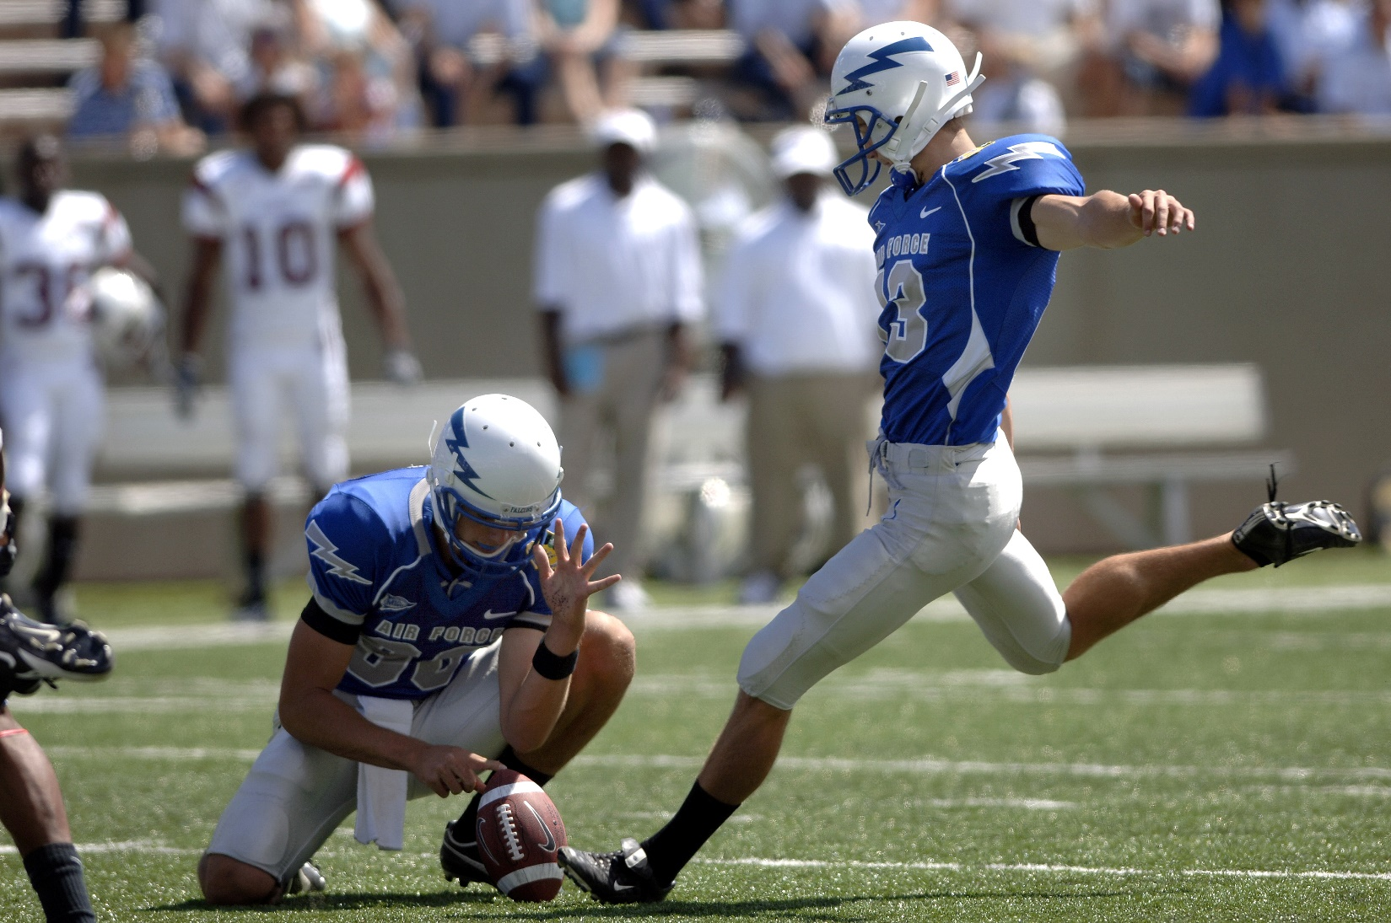
FIELD GOAL / CONVERT
Notes:
In many ways were treat field goals the same as a punt with added responsibility of determining if the ball crosses the goalpost through the upright posts. Punts and Field Goals are both “Kicks from Scrimmage” so the rules regarding no yards and blocking are the same.

Slide 22
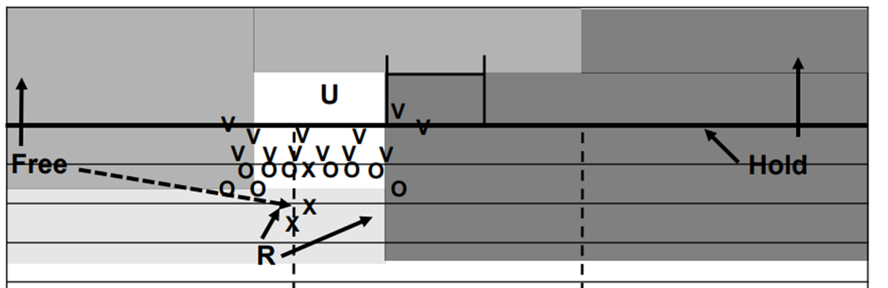
FIELD GOAL INSIDE 10 YARDS
FREE
Decide if you have the HOLDER/KICKER or the LOS action.
Signal to your partner.
Once ball is kicked, head to goal line.
HELD
Decide if you have the HOLDER/KICKER or the LOS action.
Signal to your partner.
Once ball is kicked, stay put unless the goal line near your side is threatened.
Notes:
The referee will make the decision on short Field Goals and Converts. This means that the Line of Scrimmage officials remain at the line. Since the referee will be looking to see if the ball passes through the uprights, actions against the kicker and holder become a priority of one of the LoS officials.
As in the diagram on the slide – the official who can see the holder’s face has responsibility for calling any fouls with respect to roughing the kicker or holder.
The following rules apply :
Rule 7 Section 1 Article 4 – Contacting the Kicker
Rule 7 Section 3 Article 3 – Kicker
Rule 7 Section 3 Article 4 – Place Kick Holder
The signals are:
Responsibility for Kicker / Holder ___point at kicker______________________
Focus on Line of Scrimmage ______point at line of scrimmage_______________________
In addition, on missed field goals, the Free official will move to the goal line and deeper to assume deep duties on kicks. The Held official remains at the Line of Scrimmage unless the Goal line area on their side is threatened.

Slide 23
FIELD GOAL INSIDE 10 YARDS
Video – FG Inside 10

