Slide 1
Level 1 Part 4
Rules for Line of Scrimmage Officials

Slide 2
Agenda
Reporting Infractions
Rules Basics
Wrap up / next steps
Notes:
Developing a deep understanding of the rules takes time and experience. Each year new rules are provided and old rules rewritten so officials need to be able to unlearn and relearn parts of their jobs. Level 1 is provided for new officials working in the line of scrimmage positions. The rules study in this part is focussed on relevant rules. Penalty application is not a required component. As you work games and discuss situations with your official colleagues you will learn more about options and application of penalties.
Some of the content in this section is review and reinforcement of previous information.

Slide 3
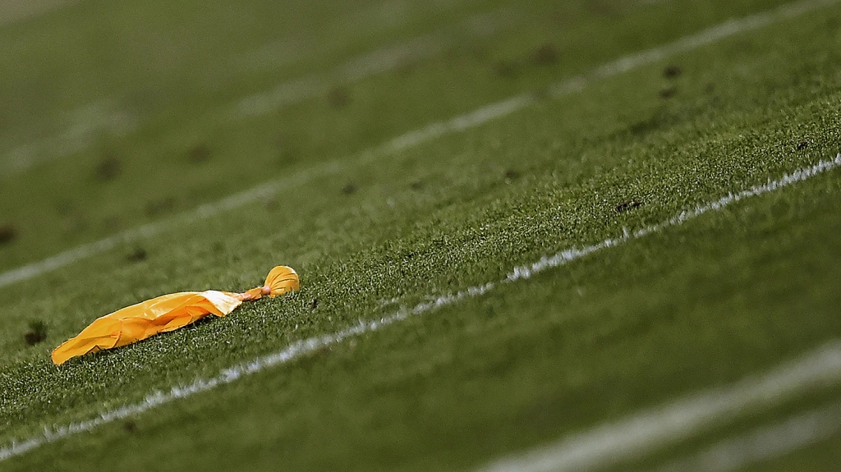
The Penalty Flag
The penalty flag functions:
Indicate foul occurred
Potential point of application for a foul (PBH)

Slide 4
The Penalty Flag
Throwing your flag:
Throw to be clearly visible
Technical Foul - flag thrown high in the air
e.g. illegal procedure, offside
Point of foul - if foul occurs during a play the flag is thrown toward the location of the ball at time of foul
e.g. holding, illegal block, no yards, unnecessary roughness
Get offending player’s number
Continue to officiate until end of play

Slide 5
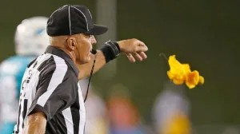
Stopping the Play
Wait until the play is over.
If you stop the play
blow your whistle
signal time out
mark the spot ball goes dead
wait until an official relieves you of the spot
Notes:
Stopping the play
Wait until the play is over.
If you stop the play:
blow your whistle
signal time out
mark the spot ball goes dead
wait until an official relieves you of the spot

Slide 6
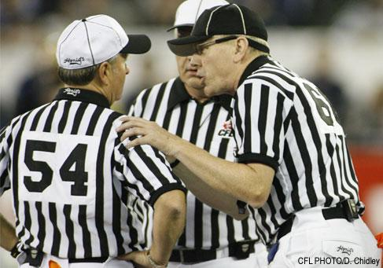
Reporting Infractions
TINS or CINS
T Team
I Infraction
N Number of the player
S Stay near referee

Slide 7
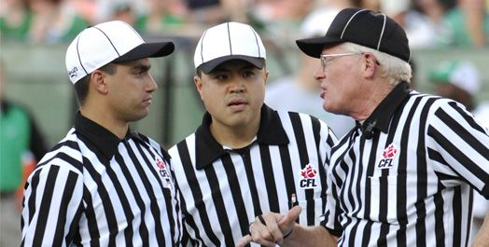
Reporting to the Referee
If more than one official has a flag don’t assume
check to see if you have the same call
(e.g. DJ and LJ)
Make sure both agree if it is offside or illegal procedure.
Ensure the penalty is applied correctly
Notes:
Ensure the penalty is applied correctly
This skill may take time. A minimum the new official can make sure the penalty was applied against the correct team.

Slide 8
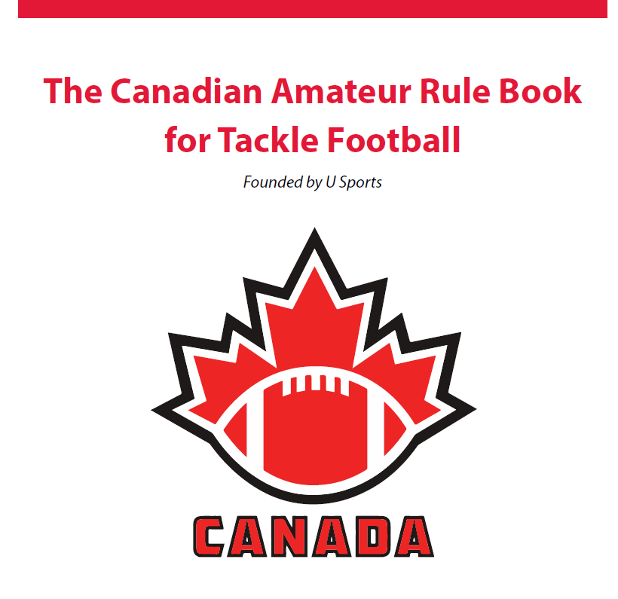
Rules Penalties and their Application
Guidelines not Hard Lines
Notes:
Officials are required to use judgement on every play. Player safety and fair play are the 2 criteria to use when enforcing rules. Any illegal action that puts player safety at risk such as any Unnecessary Roughness must be penalized. Offside or illegal procedure provide an advantage to a player and have impact on the result of the play and thus must be penalized.
There are situations where a foul has occurred by rule book definition, but the action has no impact on the result of the play or player safety. In such situations, the official can address the illegal action with the player to prevent a foul on subsequent plays. There are many ways officials can prevent penalties including being present, dead ball officiating, and using your voice.

Slide 9
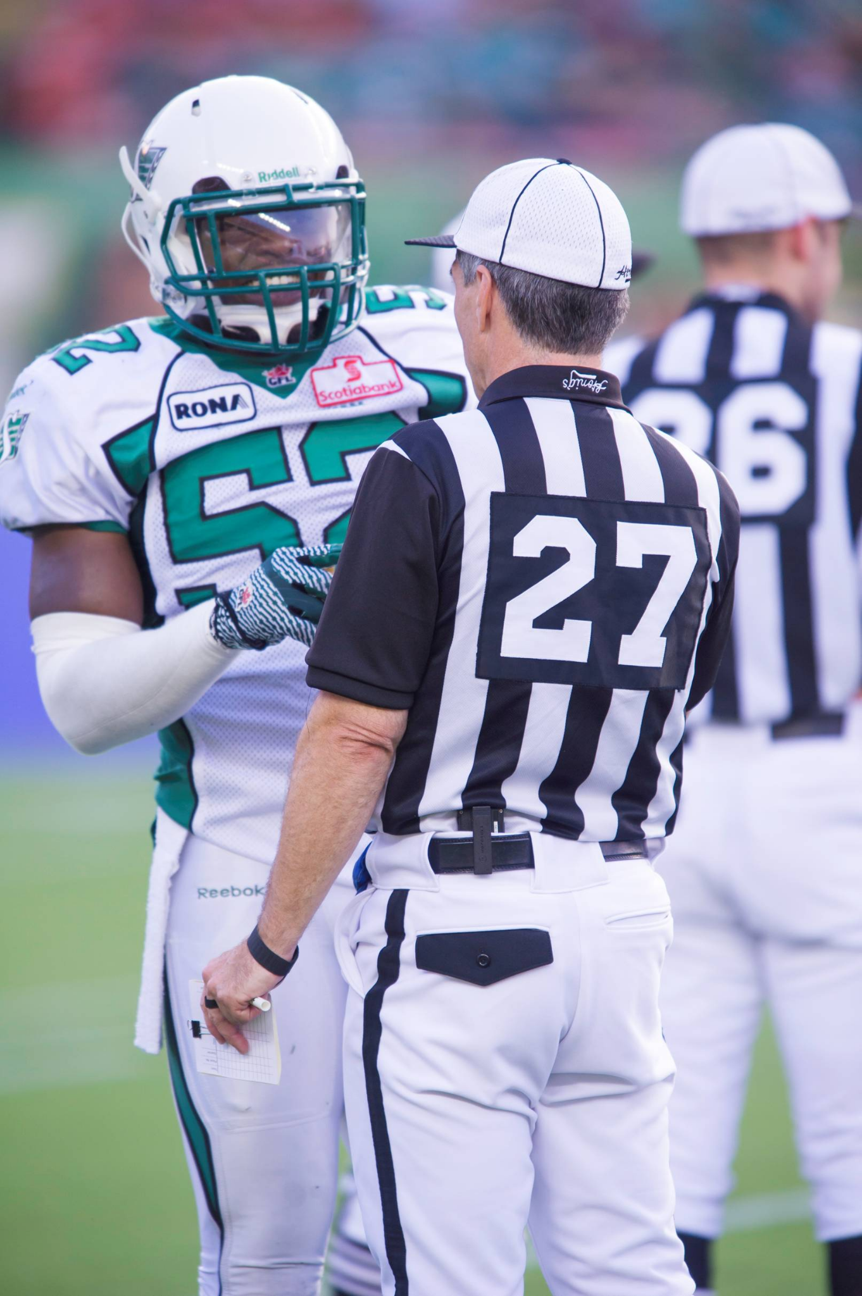
Prevention of penalties
Voice and proximity
Gates up - Player comes on
Player goes off field on wrong side
Lining up offside
Extra player(s) running off field before play starts
Kickoff – go when ready
Potential infraction - talk to player(s) after play
Notes:
Use your voice and proximity as a means of diffusing potentially difficult situations
Player enters the field after the gates are up – let team know “Too Late”
Player goes off field to improper sidelines during cadence – stop cadence and make him go to his bench
Call out to players on the line who are lined up offside
Do not penalize thirteenth player who takes position and then is running off and close to sideline field before play starts (except if he gets involved in the play)
Potential infraction - talk to player(s) after play

Slide 10
Learn the Rules of the Game
First
Learn basics
Learn to recognize legal vs. illegal
Then:
Rules in detail
Intelligent enforcement
Penalty application

Slide 11
What are the basics? ?
Points of emphasis for the starting official in learning the rules
Rule 1 – Conduct of the game
Rule 4 - Scrimmage
Rule 5 - Kicking
Rule 6 - Passing
Rule 7 - Fouls and Penalties
Rule 9 - Miscellaneous
Notes:
Line of Scrimmage sections of emphasis:
Rule 1 – Conduct of the game
Section
Topic
7
When is the ball live
8
When is the ball dead
5 article 2
When does timing stop
10
Is the ball in bounds or out of bounds
Rule 4 - Scrimmage
Section
Topic
1
Definitions- Line of Scrimmage
Neutral zone
Close line play area
Line and Backfield
Blocking below the waist zone
2
Method of Scrimmage
3
Requirements for legal scrimmage
Rule 5 Kicking
Section
Topic
1
Definitions
2
Kick off
5
Interference on a Kick from Scrimmage or Return kicks
Rule 6 Passing
Section
Topic
1
Lateral or Onside pass
2
Hand Off Pass
3
Offside Pass
4
Forward Pass
Rule 7 Fouls and Penalties
Section
Topic
1
Illegal tactics
2
Rough play
3
Unnecessary Roughness
4
Objectionable Conduct
Rule 9 Miscellaneous
Section
Topic
1
Definition
2
Interference on change of possession
3
Interference when ball not in possession

Slide 12
Improving Rules Knowledge
Regular organized method of reading and study
Rule by rule
Theme method
Cover to Cover method
Study sessions – other officials
Study rules related to the position being worked
Exams as a learning tool
Learn Intent of Rules
Not Just “Black and White”
Notes:
Use the casebook – but be certain that the answers are updated to reflect current rules.

Slide 13
Rules Study
The following slides contain scenarios with common questions, misunderstanding or examples to clarify specific rules.
The intent is to encourage discussion so ask questions and make comments.

Slide 14
Rule 1 Section 7 Live Ball
The ball is in play when
d) It is held in position by a player for the purposes of making a place kick, except on a kick off.
Can the holder make a play with the ball?
Notes:
The answer is Yes provided the holder gets off their knee before making any play.
Casebook
8-1-3 Play: A1 is the holder for a FG. He/she receives the ball with one knee on the ground and then (a) throws a pass to A2 while still on one knee, or (b) stands up to throw a pass to A2, or (c) fumbles the ball as he/she attempts to place it, recovers it and runs for a 1D, or (d) fumbles the ball as he/she attempts to place it, recovers it and sets it up for the FG.
Ruling: (a) Illegal play – the ball is alive with A’s knee on the ground only for the attempted FG. When A1 throws the pass he/she makes the ball dead at that same instant and the play should be whistled dead at the point of the pass where the knee was down. (b) Legal play – A1 can throw a pass as long as their knee is off the ground, even a small amount, so that it is not touching the ground. (c) and (d) Legal play provided A1 recovers the ball without again touching the ground with any part of their body other than their hands and feet. In (d) he/she may again go to one knee to hold the ball for the FG. (1-8-1-h-1)

Slide 15
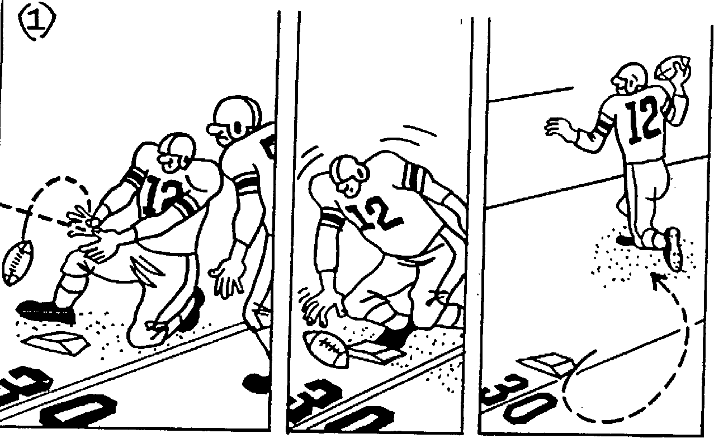
Rule 1 Section 7 Live Ball
ON FIELD GOAL TRY FUMBLES SNAP
(2) RETRIEVES BALL…
(3) PASSES OR RUNS
If the snap is fumbled, can A12 recover the ball legally and advance the ball?
Notes:
If the snap is fumbled, A12 may recover the ball legally and advance the ball provided that when he regains possession in (2), no part of his body, other than hands or feet, touch the ground. (1-8)

Slide 16
Rule 1 Section 8 - Dead Ball
g
What should the deep official do when a punt from the field of play hits the goal post assembly?
If it is a place kick (field goal attempt) is it successful?
Notes:
What should the deep official do when a punt from the field of play hits the goal post assembly?
Kill the play. The ball is placed on the 20 yard line – no points are scored
If it is a place kick (field goal attempt) is it successful?
If the ball continues between the uprights, a field goal has been scored. If not, no points – ball is placed at the 20 yard line

Slide 17
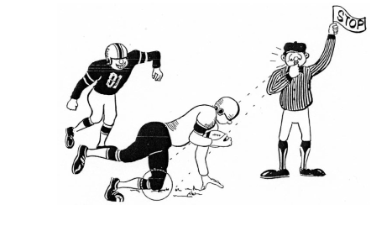
Rule 1 Section 8 - Dead Ball
h
Amateur Rules vs. Pro Rules
Notes:
In amateur rules no contact is required for a player to be declared down and the ball dead.
The ball becomes dead when
h) Any part of a ball carrier, other than hands or feet, touches the ground, even without contact by an opponent. The ball shall be declared dead AT THE POINT WHERE IT WAS HELD when the ball carrier touched the ground.

Slide 18
Rule 1 Section 8 - Dead Ball
Video – Dead Ball
Notes:
A recent rule change:
The ball becomes dead when:
k) a ball carrier begins, simulates, or fakes a foot-first slide

Slide 19
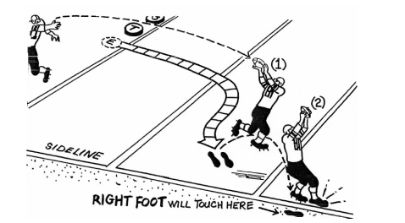
Rule 6 Section 5 Article 6 Completed Forward Pass
What is required for this pass to be ruled complete?
Notes:
Article 6 – Completed Forward Pass
A player is inbounds if one foot is touching the ground inbounds, and neither the player nor the other foot is out of bounds, even though that foot may step out of bounds after possession is gained; or if a player is in the air, at least one foot comes down inbounds, before the player touches out of bounds
A forward pass shall not be ruled as “completed” until the player, after catching the ball, maintains complete and continuous control of the ball throughout the process of contacting the ground, whether in the field of play, end zone or out-of-bounds.

Slide 20
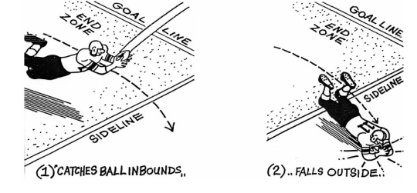
Rule 6 Section 5 Article 7 InComplete Pass
How does this situation differ from the previous?
Notes:
The receiver does not establish an inbounds position. This pass is incomplete.

Slide 21
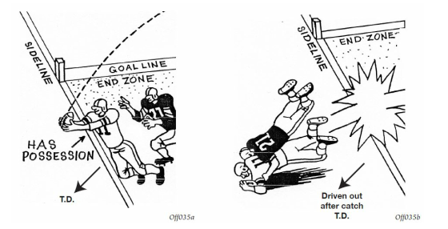
Rule 3 Section 2 Art. 1 Touchdown
Feet inbounds
Notes:
Rules work together
Rule 3 Section 2 Art. 1 Touchdown
A touchdown is scored when a forward pass is legally completed in the opponents’ end zone.
We need the completed pass rule discussed previously.

Slide 22
Rule 3 Section 2 Art. 1 Touchdown
Notes:
Article 1 – Touchdown A touchdown is scored when the ball is in the opponents’ end zone in possession of a player, or when the ball in the possession of a player crosses or touches the goal line, or the plane of the goal line, even in the air. Should the ball subsequently be fumbled, or the player in possession forced back into the field of play, the touchdown shall score

Slide 23
Fouls and Penalties
Is the action illegal?
Does the action have an impact on the play or the safety of participants?
e.g.
Pass Interference on an uncatchable ball
Holding well behind the play vs. Block from rear well behind the play

Slide 24
Use of Hands and Arms
Legal Use
Illegal Use
1) May be used to tackle the ball carrier
2) In blocking for run and pass plays provided:
hands are slightly behind the elbows, even with the elbows, or in advance of the elbows.
the arms may be fully extended
the hands shall be open, with the palms facing an opponent, or cupped or closed with the palms not facing an opponent
1) The hands and arms are not to be used :
- in a striking or punching manner
- to grasp , pull, encircle, lift and opponent
- to lock, hook or clamp an opponent
2) The hands may not be clasped or locked .

Slide 25
Illegal use of Hands and Arms

Slide 26
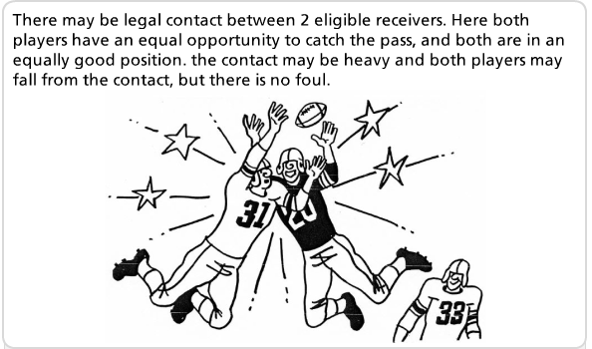
Rule 6 Sec 4 Art 9 Interference
Notes:
Contact between two opponents is legal, provided such contact results from a simultaneous and bonafide attempt to play the ball, which occurs at the spot of possible completion of a pass, where each player is intent on playing the ball; where such contact is unavoidable and incidental to the effort involved in attempting to catch or bat the ball, and where each player is in an equally favourable position to play the ball. A player, who is not looking at, or for, the ball, cannot be considered to be playing the ball. A player cannot drive «through» an opponent to reach the ball. Even if this player reaches the ball, such prior contact is illegal. Defensive players have equal right to the path of the ball as eligible A receivers.

Slide 27
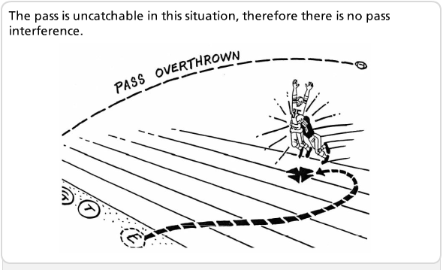
Rule 6 Sec 4 Art 10 Illegal Interference Penalties
Notes:
Article 10 – Illegal Interference Penalties a) Illegal interference is interference with an eligible receiver in the target area, or interference which prevents an eligible receiver from reaching the target area, when there is a reasonable expectation that the receiver would have had the opportunity to attempt to complete the pass. Note 1: Pass interference shall not be penalized if, in the judgment of the official, the ball is clearly uncatchable.
There can be other penalties such as Unnecessary Roughness – defenseless player

Slide 28
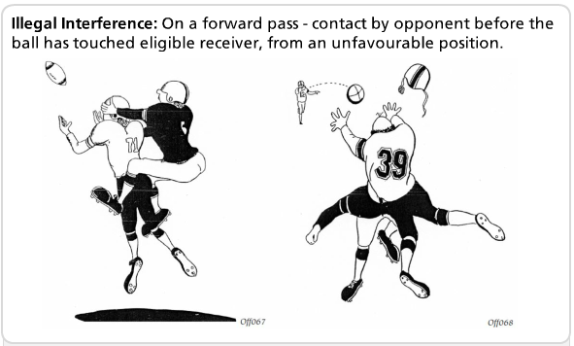
Rule 6 Sec 4 Art 10 Illegal Interference Penalties
Notes:
Simplified way of thinking about PI.

Slide 29
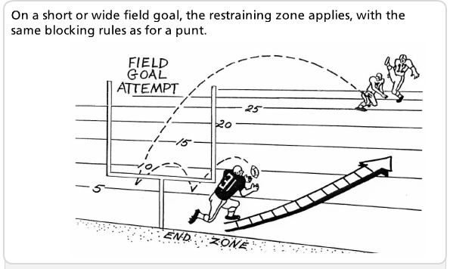
Rule 5 Sect 4 Art 1 Offside beyond Line of scrimmage (restraining zone foul)
What is the “restraining zone?
Think >>>No Yards
Notes:
Article 1 – Offside beyond Line of Scrimmage (Restraining Zone Foul)
This article does not apply to a dribbled ball, or to a kick which does not cross the LS.
When on a kick from scrimmage (ball crosses the line of scrimmage), return kick or on an open-field kick, a player is offside in relation to the kicker, such player:
shall not touch or be touched by the ball. Penalty: – in field of play – L15 from PBT (point ball touched) – in goal area – L15, penalty applied at 10-yard line
shall allow 5 yards to an opponent attempting to gain possession of the kicked ball. The five-yard zone is determined by a circle with a five yard radius, with the centre point being the ball at the instant it is first touched. Penalty: – in field of play – L15 from PBT – in goal area – L15, penalty applied at 10-yard line If the ball strikes the ground before being touched by the receiving team: Penalty: – in field of play – L5 PBT or PBD – in goal area – L5 penalty applied at 10-yard line or PBD..
If the kicking team player is making no effort to withdraw from the 5 yard zone, and is hovering over the ball or the receiving team player about to take possession of the ball: Penalty: – L15 will apply at normal point of application regardless whether the ball bounced.
If the kicking team player interferes with a receiving team player attempting to gain possession of the kicked ball, with or without contact: Penalty: – L15 from the normal point of application
A player of the kicking team who invades the five-yard zone, and contacts a receiving team player, who is attempting to play the ball in an unnecessarily rough manner, will be subject to an additional 15 or 25 yard penalty, regardless of whether the ball had struck the ground

Slide 30
Next Steps
Advice from experience:
Start a game log.
Note what you did well and what you need to improve on.
Check your log before your next game.
I've been doing this for 10 years and it has been very helpful.
Rich Higgins Hamilton FOA
Mistakes happen, own it - learn from it. Every official has made them. Take feedback as advice, not as criticism.
Matt Lothian Manitoba FOA
Mindset Actions Growth

Slide 31
Being Successful
Mindset
Have a positive attitude
Treat coaches, players with respect
Look and act the part
Invest in good quality equipment
All positions have equal importance
Carry your own responsibilities first
Have fun and enjoy it

Slide 32
Being Successful
Actions
Establish good habits from the first game
Strive for consistency in your performance – calling fouls, ball spots, positioning
Always hustle on the field
Conditioning - 4 quarters
Do not blow whistle unless you see the ball
Dead ball officiating

Slide 33
Being Successful
Growth
Be ready for the next play – you can’t change the last play
Learn the basics first
Watch games as official
Get involved in local FOA activities
Study and know the rules and mechanics
Seek feedback
Keep a log

