Slide 1
Football Canada Officials Certification Program Level 2

Slide 2
Football Canada level 2 certification
Purpose
To prepare Sideline Officials for assignments to the Umpire position
3 and 4 Official Systems, Minor and High School Leagues
To improve/upgrade understanding of Sideline positions
Encourage further participation and progress in the FCOCP
Requirements for Certification
Complete in-class theory clinic with 75% passing grade on written tests
Complete 2 on-field evaluations with 75% passing grade in either Sideline or Umpire positions

Slide 3
Line of scrimmage 1. Forward Progress 2. Bench & Sideline Control 3. the Kicking Game 4. Signaling and Tips

Slide 4
1. FORWARD PROGRESS
What is forward progress and why is it so hard to get right?
Identifying the furthest point of advancement of the ball, before a player is tackled, driven backwards, goes out of bounds, etc
Need to give the ball carrier everything they earned, and no more
Every situation is different, reinforcing the need to be in the right position – Angles, Angles, Angles
Finding the ball is only part of the battle. Need to identify when another part of the body touches the ground, line, etc
Notes:
Tackled or falling forward are the easy ones. Driven back is a challenge.
If unsure, give the ball carrier more yardage
Hand means other hand not back of hand ball is in, go back to intent of rule.

Slide 5
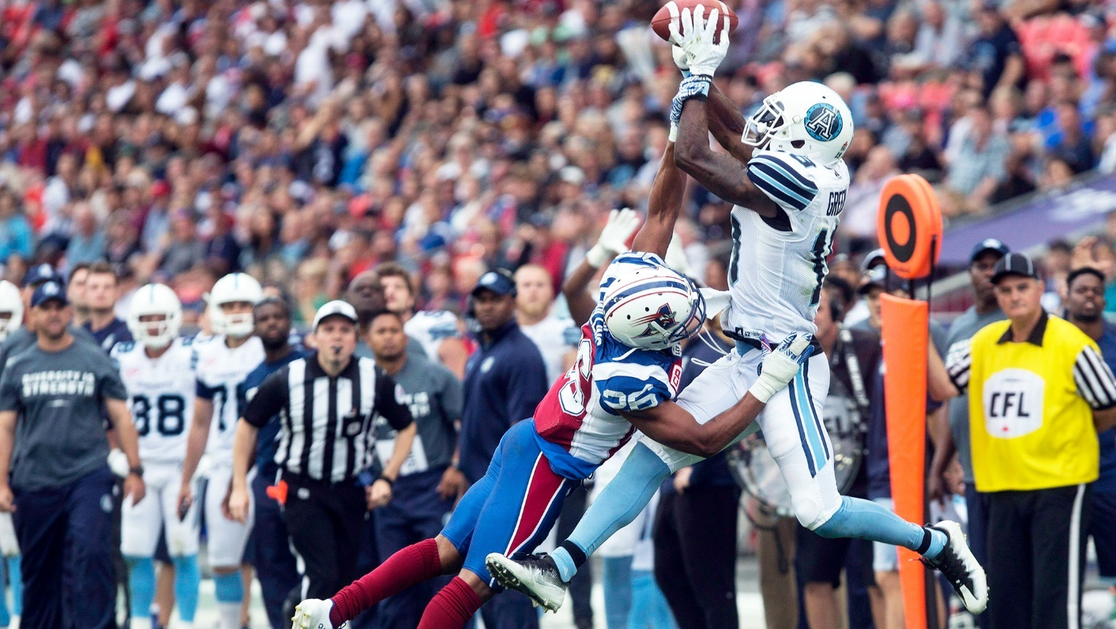
General tips and best practices
Movement
90 degrees where possible and appropriate
Visual Cues
Major lines, logos, etc
Situational Awareness
Down and distance, line to gain, etc
Notes:
Use the lines. Be aware of how far they have for a 1D. Kick plays and turnovers spot the ball on the yard.

Slide 6
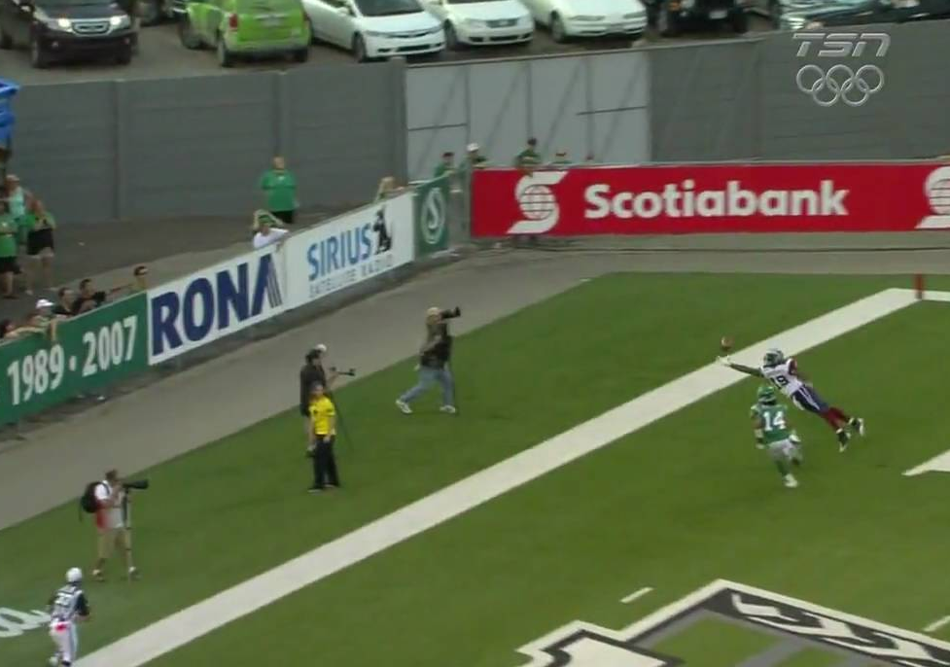
Every situation is different and requires you to adjust
Ball carrier/Receiver downed in the field of play
Ball carrier/Receiver wrapped up and/or driven backwards
Receivers coming back on own and then contacted
Boundary line plays – With or without contact
Goal line plays – Coming In and Going Out
Notes:
Receiver driven backwards and receivers coming back on own before being contacted are tough.
Driven back without being encircled is tough.
Hold onto your whistle for a second when ball carrier is caught up and driven back to see if they can break free. However, if you know forward progress is complete don’t allow a fumble in this delay.

Slide 7
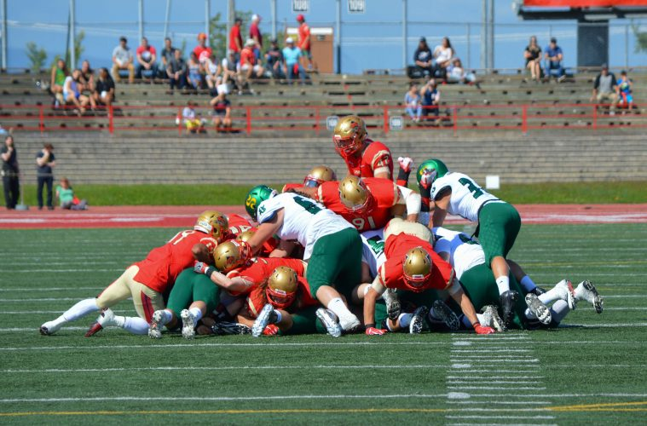
Marking forward progress inbounds
Stay even with ball carrier when in front of you, in the field of play, look through to Umpire for help if unsure or to help with receivers coming back to the ball
Receiver and Ball Carriers have right to try and advance the ball, need to distinguish between players advancing and being wrapped up
Once decided on giving a specific spot, get on the whistle early and loud!
Notes:
Only blow your whistle when you can see the ball.

Slide 8
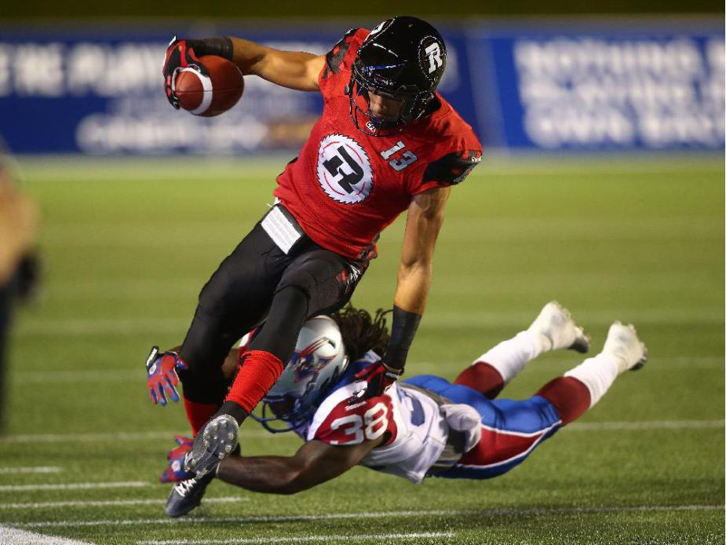
Boundary Line Plays
Trail position down the sideline is ideal for pursuing ball carrier
Watch for feet stepping out of bounds but have awareness of ball position in hands
Consider the game situation
Is the ball carrier reaching for a specific line?
Carried out of bounds vs. down inbounds?
Take your time, back out of the way to give enough room to make and sell the call
Notes:
Has a 1D been gained or not.
Face back towards the field before signalling whether play ended in bounds or OB.

Slide 9
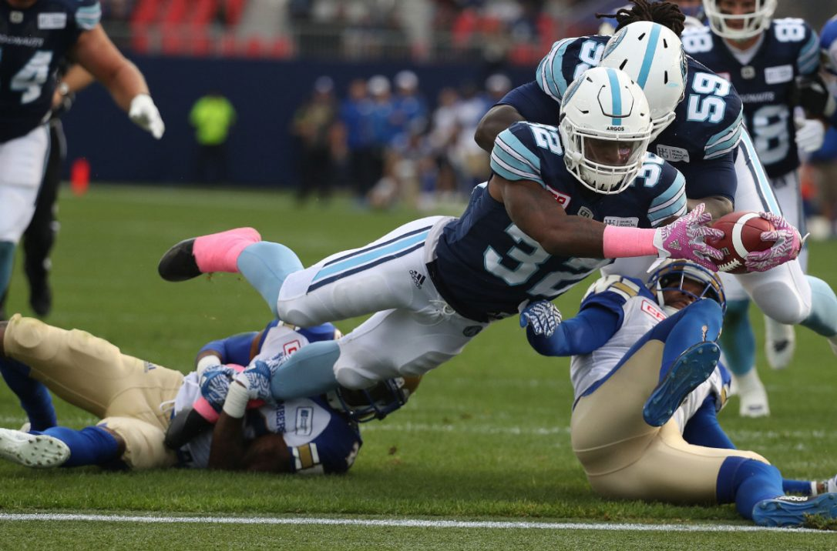
Goal Line Plays
Back off the sideline and give yourself room to work
Maintain view down the goal line, the ball only needs to break the plane in possession
Look through to Umpire to help box in the play
Try and keep whole body in view so you can see when a knee touches down before the ball breaks the plane
Once you see the ball cross the plane, whistle, and signal decisively
If down prior to the goal line, move in quickly mark a spot and kill the play

Slide 10
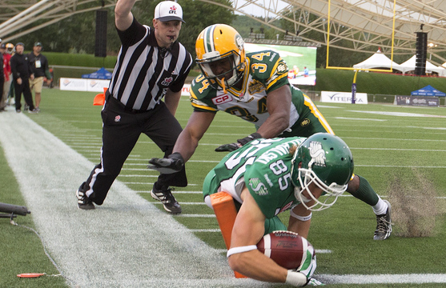
FORWARD PROGRESS - Closing Thoughts
Get into position – mechanics are a starting point
Take your time
Watch for the ball position
Look for help from other officials with opposite viewpoint
Be decisive in your call, sell it!
Give them everything they earn, and not an inch more!

Slide 11
VIDEO REVIEW
VIDEO – SL Sell the Call
Notes:
A1 - Justin Tight TD Play - Covering official moves immediately to GL, as a result is in the right spot to make the call

Slide 12
VIDEO REVIEW
A2 – Forward Progress
Notes:
A2 - Forward Progress - When is forward progress halted, inbounds or out of bounds? Slow whistles

Slide 13
VIDEO REVIEW
VIDEO – A3 Driven OB
Notes:
A3 - Driven Back to OOB - Good inbounds spot as player is driven backwards and OB

Slide 14
VIDEO REVIEW
VIDEO – A4 – Hit Directly OOB
Notes:
A4 - Hit Directly to OOB - Good inbounds spot as player is driven backwards and OB

Slide 15
VIDEO REVIEW
VIDEO – A5 Inbounds FP
Notes:
A5 - Inbounds Forward Progress - Inbounds or Out of Bounds?

Slide 16
VIDEO REVIEW
VIDEO – A6 Inbounds FP
Notes:
A6 - Inbounds Forward Progress - Good out of bounds spot, when is the ball carrier down?

Slide 17
VIDEO REVIEW
VIDEO – A7 OOB inside 3 min
Notes:
A7 - To Out of Bounds Inside 3min - Inbounds or Out of Bounds?

Slide 18
VIDEO REVIEW
VIDEO – A8 Obvious 1st DN gained
Notes:
A8 - 3D1 Made Easily - Good example of not needing to come in hard, obvious 1D gained

Slide 19
VIDEO REVIEW
VIDEO – A9 Close play, come in hard to sell spot
Notes:
A9 - When to Come in Hard - Close to 1D, need to come in and sell the spot. Watch the coaches at the end of the clip - these are the important ones

Slide 20
2. Bench & Sideline Control
The ability to create and maintain a professional and positive dialogue/rapport along your sideline is something every official should strive to accomplish
Relationships between officials and players, coaches, and fans start well before the game begins and end after it ends
Mastering the ability to deliver bad news to a game participant and projecting an appearance of being in control are key strengths of a football official at all levels

Slide 21
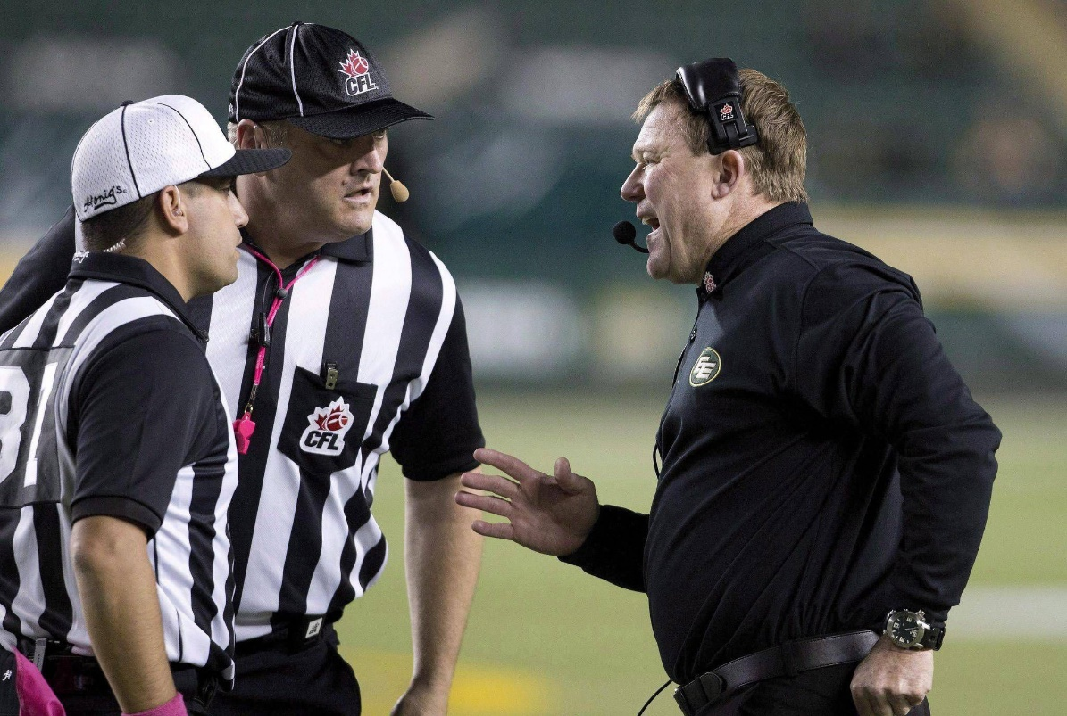
BODY LANGUAGE
Importance of Body Language, from entering the park to leaving it
Body language gestures will impact perception - Crossed arms, hands in pocket, walking vs running, etc
Interacting with players, coaches, fans, other officials - Be professional but also appear relaxed, calm, and in control
Looking confident in your rulings, spots, announcements

Slide 22
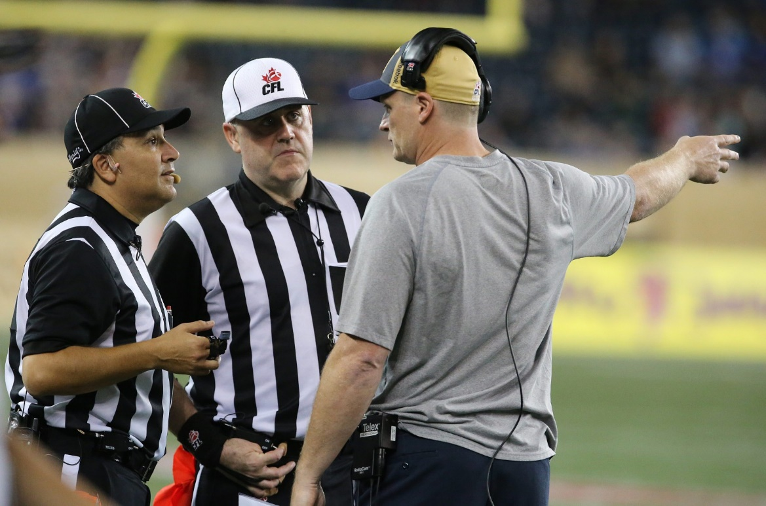
Body Language Cont…
Ensuring appropriate body language based on game situation (close game, high intensity, etc)
Delivering the bad news - looking calm and composed when announcing penalties, during coaches meetings, etc
Quick Tips
Learn not to be too robotic in your movements
Hustle - easy way to earn some credibility and look like you are in the game
Practice your signals, announcements, and movements at home or in the mirror

Slide 23
VIDEO REVIEW
VIDEO – B1 Proactive, Professional, Rapport
Notes:
B1 - Mic’d Up Edited - Conversation between official and player regarding rule, good example of sticking to the standard and calmly explaining why it is being applied.

Slide 24
VIDEO REVIEW
VIDEO – B3 Good Game Management
Notes:
B3 - National Card - Good example of late game situation, no time for coaches conference, but willing and able to work with coach in crucial moments to help them with what they need while you focus on job at hand, versus being dismissive to the bench.

Slide 25
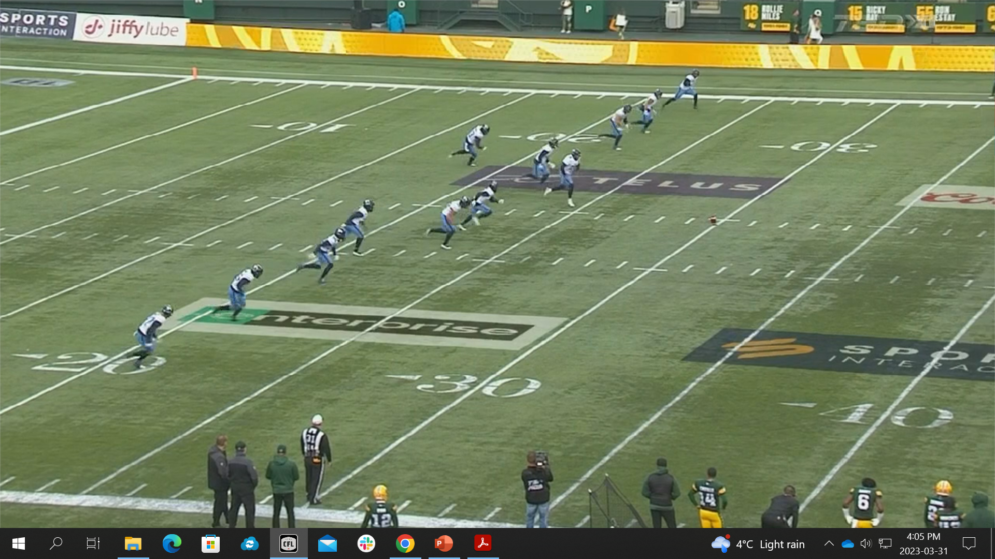
3. THE Kicking Game – THE MOST CHAOTIC FOOTBALL PLAYS

Slide 26
KickOFFs
Count, don’t let play start without correct number
Know where the ball is going
Signal ball and blocking
Start the clock
Downfield – key blocks at POA, players arrive at once
Upfield – POA blocks plus scan for next blocks
Deadball officiating
Notes:
You can still watch blocking when you have the ball carrier

Slide 27
Kickoff – video review
VIDEO – KO

Slide 28
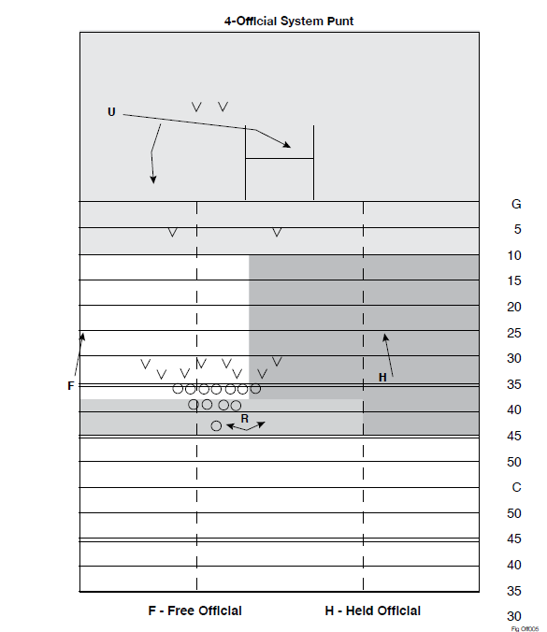
PUNTS

Slide 29
PUNTs
Line of Scrimmage Official(s)
• Remain at Line of Scrimmage.
• Count Players
- 3-Official – Home Team
- 4-Officials – DJ – Home, LJ – Visitor
• Watch for blocked/deflected kick.
• Be alert for “fake” or broken plays.
• Move after ball crosses Line of Scrimmage.
• Watch blocking in front of or beyond ball carrier.
• Be prepared to help at Goal line if play remains in EZ.
• Be prepared to help with sideline with ball kicked out of bounds.
Be ready to rule on Offsides and Illegal Procedure beyond the Centre.

Slide 30
FIELD Goals (OUTSIDE 10 YARD LINE)
Line of Scrimmage Official(s)
Remain at LoS
Count the team Players
– 3-Official – Home Team
– 4-Officials – DJ – Home, LJ – Visitor
• Watch for blocked kick… may need to move towards backfield to box in play with Referee
• Be alert for “fake” or broken plays
• Move downfield after the ball crosses LOS
• Watch blocking in front of or near ball carrier
• Be prepared to help at Goal line and with ball kicked out of bounds

Slide 31
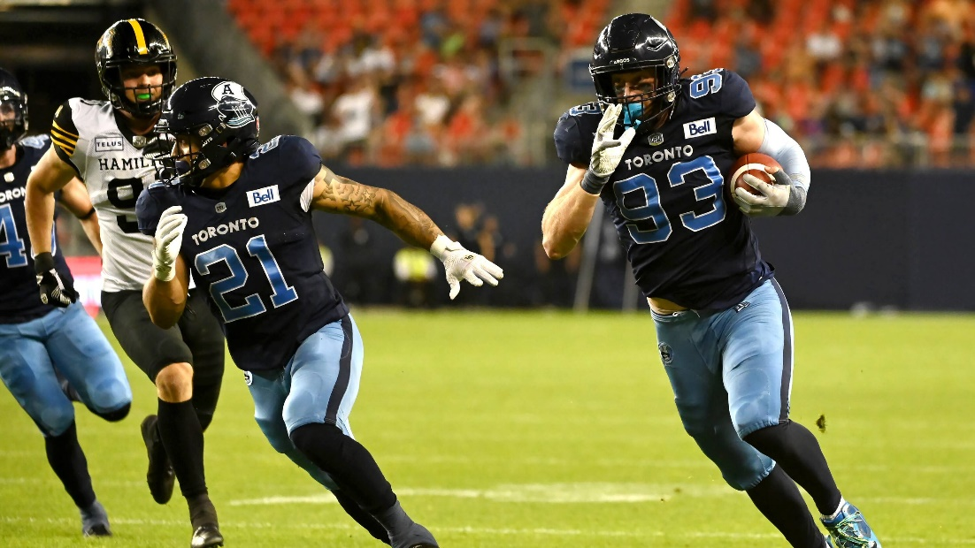
FIND THE IMPACTFUL BLOCKS
As the ball is in flight, start to identify important blocks for the return and focus on them in order once caught
1st Wave Blocks
Point of Attack
Etc.
Transition ball coverage to the next official as the return develops

Slide 32
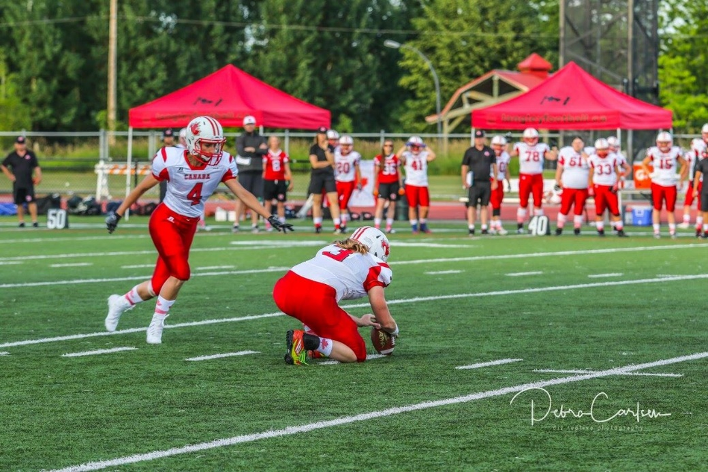
TIPS FOR KICKING GAME COVERAGE
Discussion: What best practices have worked for you to adequately cover kicking situations?
Punts – Inbounds and Out of Bounds
Long Field Goals – Successful and Unsuccessful
Kick Return Blocking

Slide 33
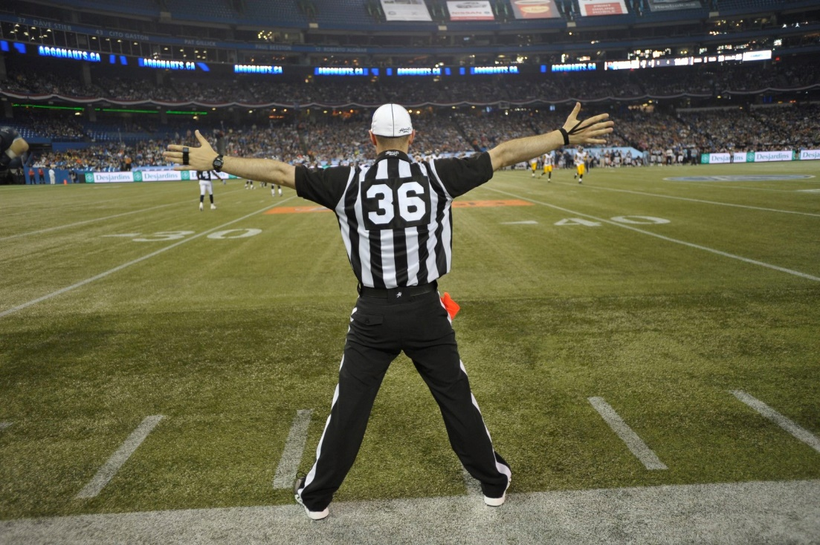
4. SIGNALLING & OTHER TIPS
Signals should be:
Sharp
Visible
Demonstrative
Purposeful
Supporting other forms of communication (verbal, body language)

Slide 34
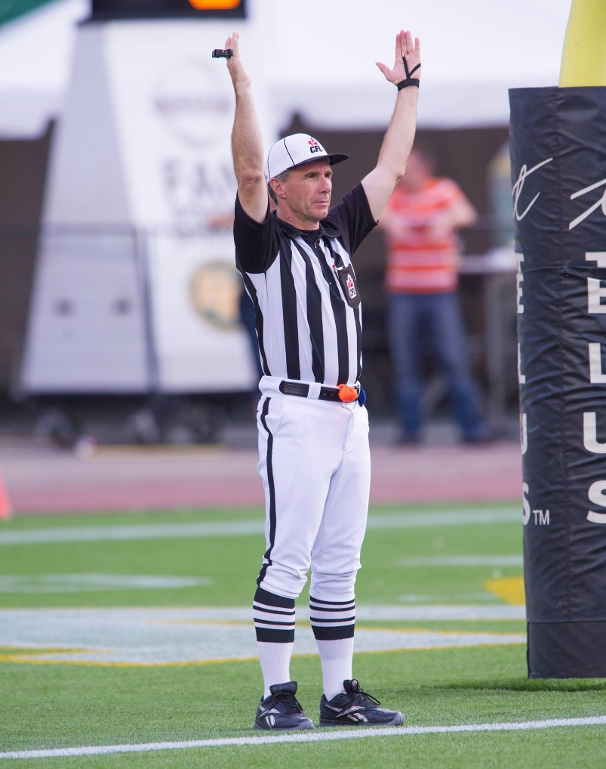
Key SIGNALS
Signaling can help communicate information from across the field to other officials, players, coaches, fans and speed up the game
Key Signals to Master
Held/Free
Gates
Screen Pass, Onside Pass
Incomplete Pass
Time In/Out
In Bounds vs Out of Bounds (Under 3min)
Scores
Etc.

Slide 35
TEST YOUR KNOWLEDGE / OPEN DISCUSSION

