Slide 1
1. FORWARD PROGRESS
What is forward progress and why is it so hard to get right?
Identifying the furthest point of advancement of the ball, before a player is tackled, driven backwards, goes out of bounds, etc
Need to give the ball carrier everything they earned, and no more
Every situation is different, reinforcing the need to be in the right position – Angles, Angles, Angles
Finding the ball is only part of the battle. Need to identify when another part of the body touches the ground, line, etc
Notes:
Tackled or falling forward are the easy ones. Driven back is a challenge.
If unsure, give the ball carrier more yardage
Hand means other hand not back of hand ball is in, go back to intent of rule.

Slide 2
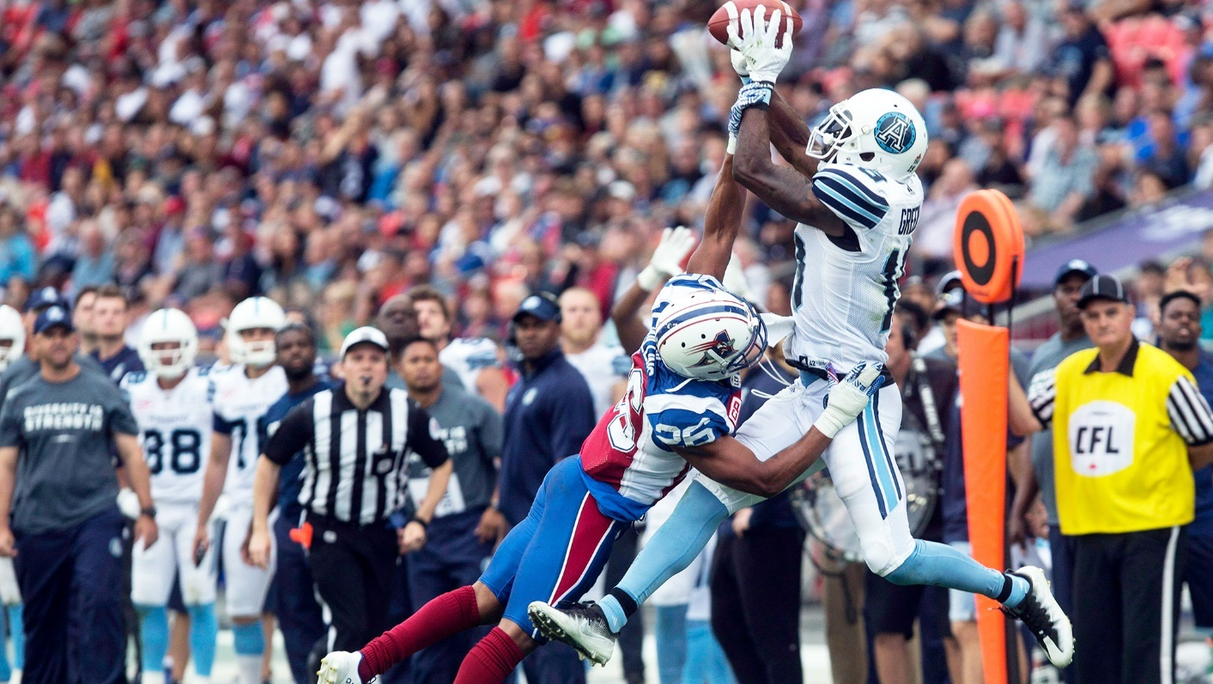
General tips and best practices
Movement
90 degrees where possible and appropriate
Visual Cues
Major lines, logos, etc
Situational Awareness
Down and distance, line to gain, etc
Notes:
Use the lines. Be aware of how far they have for a 1D. Kick plays and turnovers spot the ball on the yard.

Slide 3
2. Bench & Sideline Control
The ability to create and maintain a professional and positive dialogue/rapport along your sideline is something every official should strive to accomplish
Relationships between officials and players, coaches, and fans start well before the game begins and end after it ends
Mastering the ability to deliver bad news to a game participant and projecting an appearance of being in control are key strengths of a football official at all levels

Slide 4
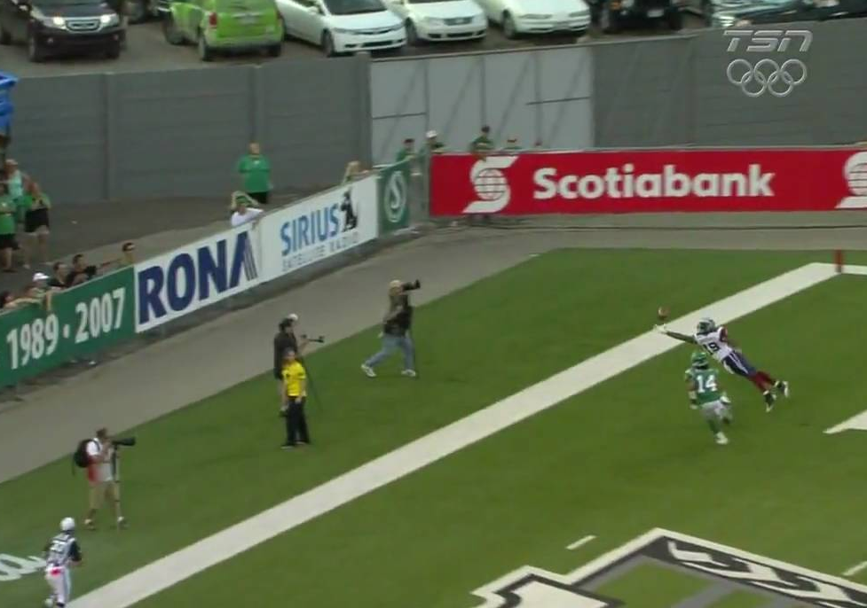
Every situation is different and requires you to adjust
Ball carrier/Receiver downed in the field of play
Ball carrier/Receiver wrapped up and/or driven backwards
Receivers coming back on own and then contacted
Boundary line plays – With or without contact
Goal line plays – Coming In and Going Out
Notes:
Receiver driven backwards and receivers coming back on own before being contacted are tough.
Driven back without being encircled is tough.
Hold onto your whistle for a second when ball carrier is caught up and driven back to see if they can break free. However, if you know forward progress is complete don’t allow a fumble in this delay.

Slide 5
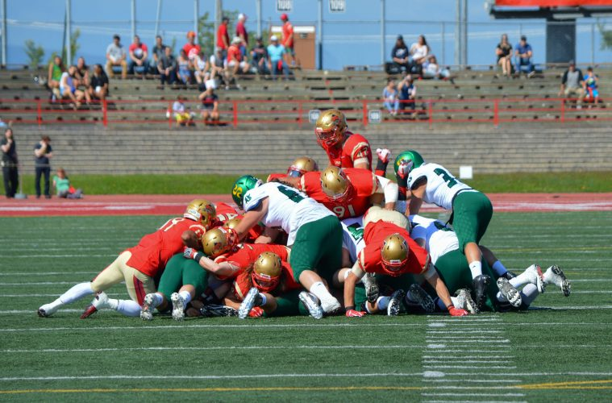
Marking forward progress inbounds
Stay even with ball carrier when in front of you, in the field of play, look through to Umpire for help if unsure or to help with receivers coming back to the ball
Receiver and Ball Carriers have right to try and advance the ball, need to distinguish between players advancing and being wrapped up
Once decided on giving a specific spot, get on the whistle early and loud!
Notes:
Only blow your whistle when you can see the ball.

Slide 6
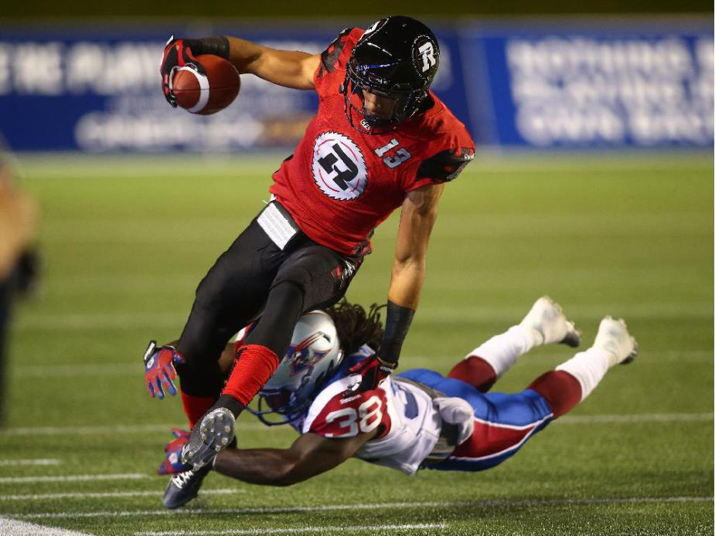
Boundary Line Plays
Trail position down the sideline is ideal for pursuing ball carrier
Watch for feet stepping out of bounds but have awareness of ball position in hands
Consider the game situation
Is the ball carrier reaching for a specific line?
Carried out of bounds vs. down inbounds?
Take your time, back out of the way to give enough room to make and sell the call
Notes:
Has a 1D been gained or not.
Face back towards the field before signalling whether play ended in bounds or OB.

Slide 7
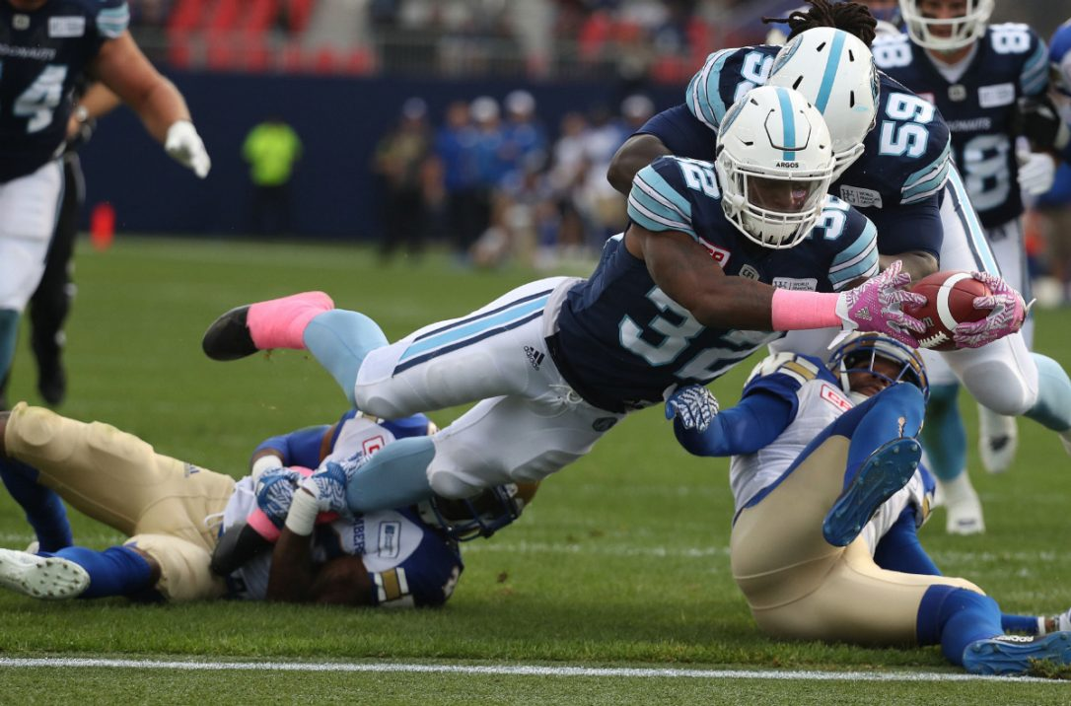
Goal Line Plays
Back off the sideline and give yourself room to work
Maintain view down the goal line, the ball only needs to break the plane in possession
Look through to Umpire to help box in the play
Try and keep whole body in view so you can see when a knee touches down before the ball breaks the plane
Once you see the ball cross the plane, whistle, and signal decisively
If down prior to the goal line, move in quickly mark a spot and kill the play

Slide 8
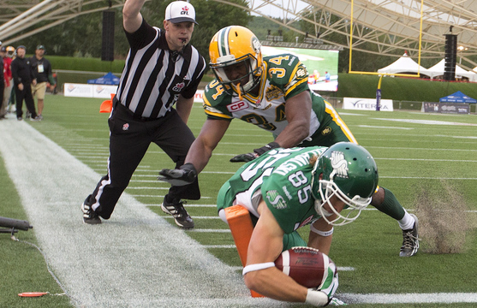
FORWARD PROGRESS - Closing Thoughts
Get into position – mechanics are a starting point
Take your time
Watch for the ball position
Look for help from other officials with opposite viewpoint
Be decisive in your call, sell it!
Give them everything they earn, and not an inch more!

Slide 9
KickOFFs
Count, don’t let play start without correct number
Know where the ball is going
Signal ball and blocking
Start the clock
Downfield – key blocks at POA, players arrive at once
Upfield – POA blocks plus scan for next blocks
Deadball officiating
Notes:
You can still watch blocking when you have the ball carrier

Slide 10
PUNTS
Free Official – Where to Position Yourself Downfield?
Maintain view of returner
Provide adequate coverage of restraining zone
Understand 5 vs 15-yard penalty scenarios
(Add 4-official punt diagram from Level 1 manual)

Slide 11
PUNTs
Need a long snapper, blocking scheme and kicker to make work
Open sideline
Stay out wide, be prepared to move
Be aware of position on field, is goal line challenged?
Ensure yards are given
If ball hits ground focus goes to recovery and possession
Key blocks at POA
Deadball officiating

Slide 12
FIELD Goals (OUTSIDE 10 YARD LINE)
Position downfield between the uprights, ideally several yards back to maintain adequate view of both posts
Once the ball is in flight, position accordingly, moving to the nearest post that the ball is heading towards for more accurate ruling
Missed FG – Be prepared and treat exactly like a punt
(New 4-official FG diagram from L1 Manual)

Slide 13
FIELD GOALS
Need a long snapper, blocking scheme and kicker who can aim
Open sideline
Under the posts, initial positioning
First job is score, FG or single
If ball hits ground focus goes to recovery and possession
Key blocks at POA
Deadball officiating

Slide 14
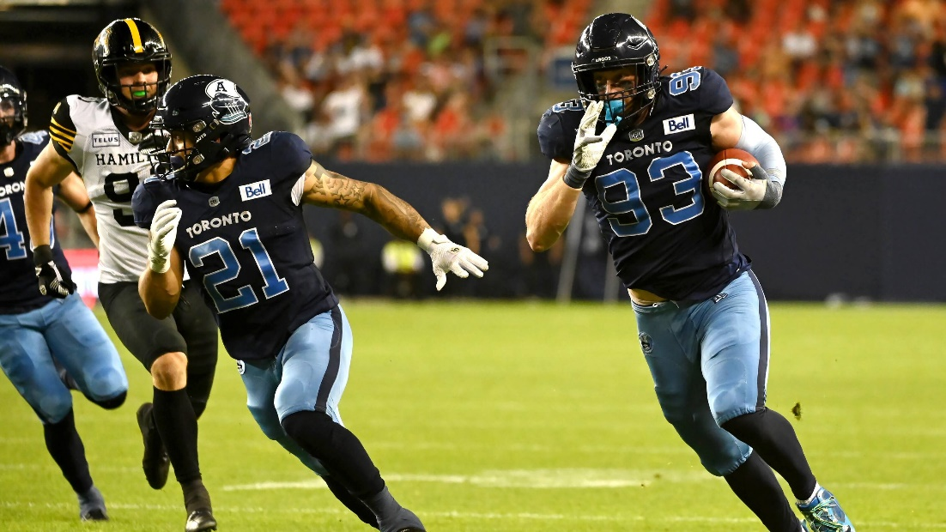
FIND THE IMPACTFUL BLOCKS
As the ball is in flight, start to identify important blocks for the return and focus on them in order once caught
1st Wave Blocks
Point of Attack
Etc.
Transition ball coverage to the next official as the return develops

Slide 15
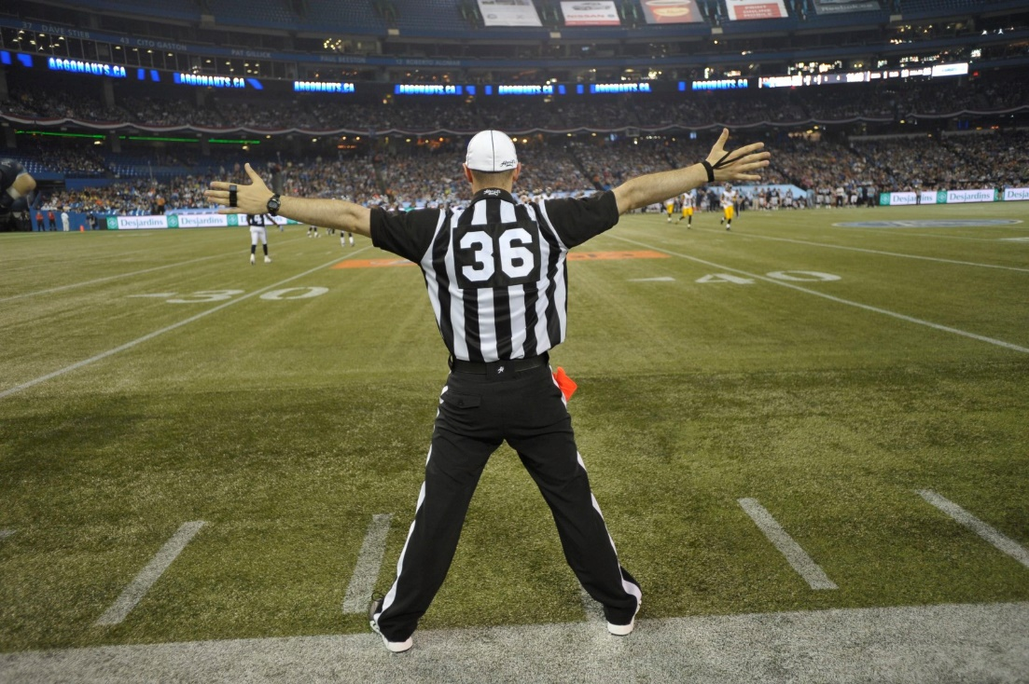
4. SIGNALLING & OTHER TIPS
Signals should be:
Sharp
Visible
Demonstrative
Purposeful
Supporting other forms of communication (verbal, body language)

Slide 16
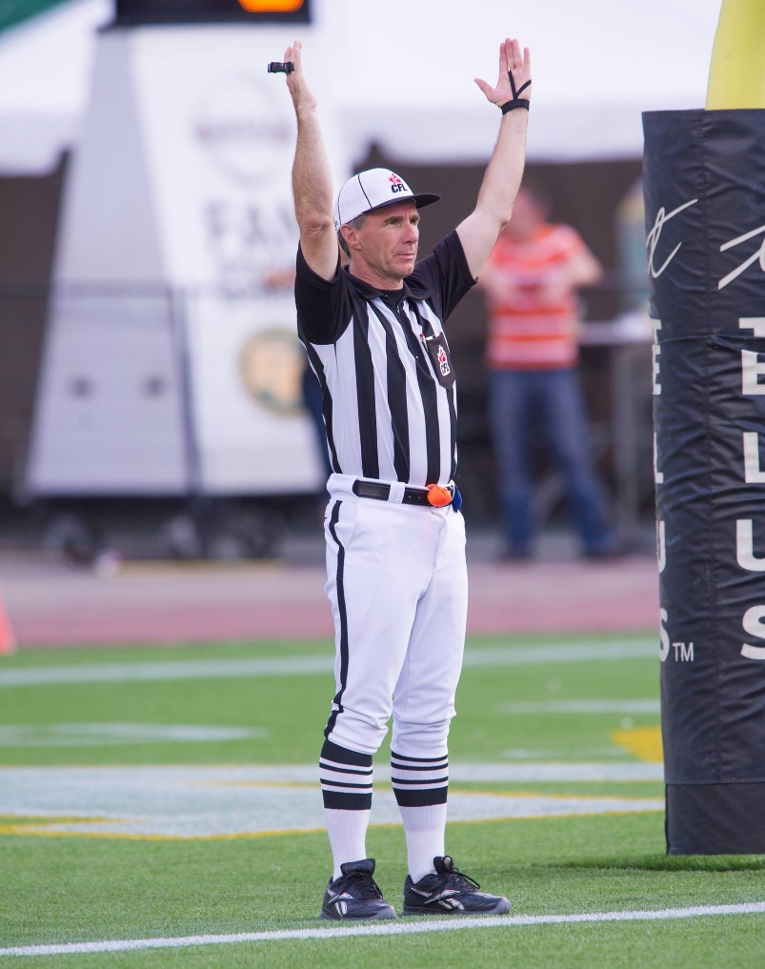
Key SIGNALS
Signaling can help communicate information from across the field to other officials, players, coaches, fans and speed up the game
Key Signals to Master
Held/Free
Gates
Screen Pass, Onside Pass
Incomplete Pass
Time In/Out
In Bounds vs Out of Bounds (Under 3min)
Scores
Etc.

